Slide 1

ITCPs and Productivity
ITCPs and Productivity
PREVENTING RUNOVERS AND BACKOVERS IN ROADWAY CONSTRUCTION
ITCPs and
Productivity
Notes:
NIOSH has been heavily engaged in research and product testing to review the practicality and effectiveness of various technologies designed to warn operators when they are near workers on foot. This module reviews some of those technologies that are now available—or will soon be available—for roadway construction applications.
Credit: Much information in this presentation is taken from research conducted by Todd Ruff, NIOSH Office of Mine Safety and Health Research.

Slide 2

ARTBA Disclaimer
Contact ARTBA for information about Student Handbooks.

Slide 3



Course goals
ITCPs and Productivity
PREVENTING RUNOVERS AND BACKOVERS IN ROADWAY CONSTRUCTION
At the end of this module, you will know
  How ITCPs improve productivity
  How ITCP improve communications
  Management elements addressed in the ITCP
QC Truck
Foreman Truck
GW Truck
QC
SI
SO
SP
SI
Worker Area
Staging Area
Lane 1 10’
Enter
Exit
Lane 2 10’
GW
SI Truck
Breakdown Lane 10’
The well-planned ITCP improves productivity
through greater efficiency.

Slide 4
ITCPs Improve Productivity
ITCPs and Productivity
PREVENTING RUNOVERS AND BACKOVERS IN ROADWAY CONSTRUCTION
ITCPs Improve Productivity
Key concept of Internal Traffic Control is PLANNING for worker safety
  ITCPs integrate other aspects of planning to coordinate on-site activities
  so they run in a safe, smooth, efficient manner
  ITCPs improve safety and productivity if the plans are well thought out
QC Truck
Foreman Truck
GW Truck
QC
SI
SO
SP
SI
Worker Area
Staging Area
Lane 1 10’
Enter
Exit
Lane 2 10’
GW
SI Truck
Breakdown Lane 10’
Notes:
ITCPs integrate other aspects of planning to coordinate on-site activities so they run in a safe, smooth, efficient manner. Increased productivity is a by-product of ITCPs as the process of setting up an ITCP translates into smoother operations unrelated to internal traffic control. To improve productivity, the ITCP must be well conceived.

Slide 5
Integrated Process
ITCPs and Productivity
PREVENTING RUNOVERS AND BACKOVERS IN ROADWAY CONSTRUCTION
Integrated
Process
Project Management and Scheduling
Quality
Control
Worker Safety
Temporary Traffic Control Plan
Occupational Safety and Health
Subcontractor
Communications
Notes:
When considered during the planning and design phases, ITCP integrates easily into other planning processes so that it does not require significantly more time or resources to implement. Anticipating ITCP/worker safety needs will improve delivery schedules and processes, minimize disruptions, improve safety, and create more efficiency.

Slide 6
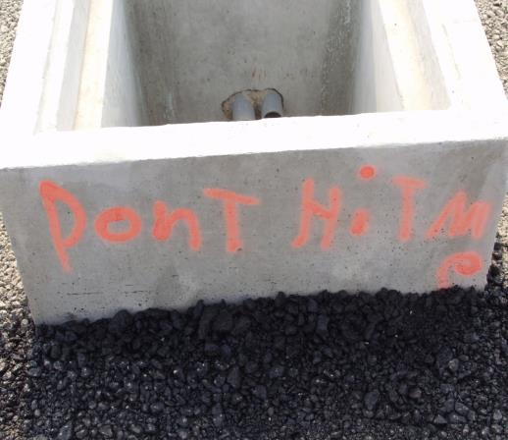
Productivity and effciency
ITCPs and Productivity
PREVENTING RUNOVERS AND BACKOVERS IN ROADWAY CONSTRUCTION
Productivity and Efficiency
Better internal traffic
routing and strict control
over backing reduces
time-consuming incidents
Would we see this
on a job covered by
a good ITCP?
Notes:
In addition to minimizing risk to workers, there are other hazards that ITCP will protect against, including hidden dangers such as catch basins and open holes. ITCPs will guard against excavation work in or around wall openings. The plan will reduce hazardous exposures to site visitors.

Slide 7
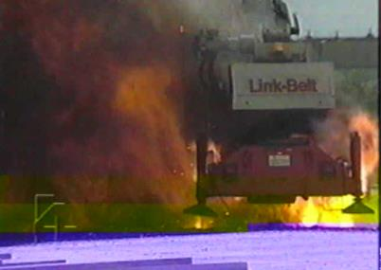
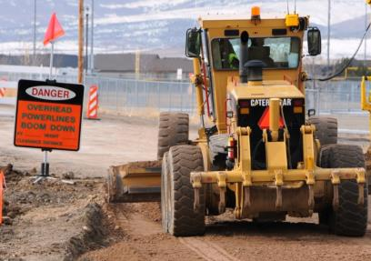
Productivity and efficiency
ITCPs and Productivity
PREVENTING RUNOVERS AND BACKOVERS IN ROADWAY CONSTRUCTION
Productivity and Efficiency
  Well executed ITCPs control overhead and buried cable hazards – such
  as power lines, cranes, other utilities – and alert workers to locations
Which of these scenarios is more productive and efficient?
Notes:
ITCP planning will ensure operators do not operate equipment around overhead power lines unless they are authorized and trained to do so. These plans can also alert workers to other overhead and buried hazards such as cranes, utilities, excavations, etc.

Slide 8
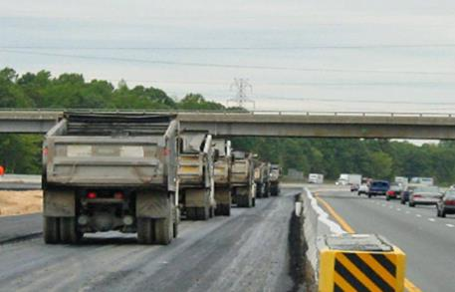
Productivity and efficiency
ITCPs and Productivity
PREVENTING RUNOVERS AND BACKOVERS IN ROADWAY CONSTRUCTION
Productivity and Efficiency
  Can improve efficiency
  through reduced repositioning
Notes:
ITCPs work in tandem with project scheduling processes. In addition to assigning dates to project activities, project scheduling is intended to match the resources of equipment, materials and labor with project work tasks over time. Good scheduling can eliminate problems due to production bottlenecks, facilitate the timely procurement of necessary materials, and otherwise insure the completion of a project as soon as possible. Inasmuch as ITCPs require timely communication with delivery vehicles (dump trucks), ITCP coordination and project scheduling fit together easily.

Slide 9

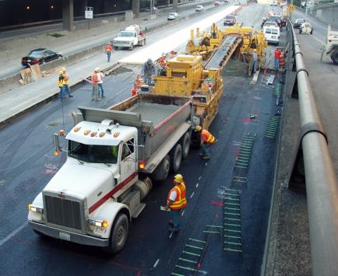
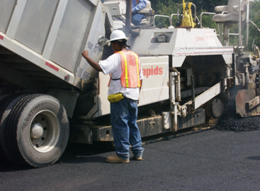
Productivity and efficiency
ITCPs and Productivity
PREVENTING RUNOVERS AND BACKOVERS IN ROADWAY CONSTRUCTION
Productivity and Efficiency
  One of the greatest contributions of ITCPs is improved communications
Notes:
An important part of and internal traffic control plan is how you will handle communications on site. The large photo shows an asphalt truck arriving at the paving site. In developing and ITCP, one must consider how you will communicate with drivers before they arrive. Planning for this communication will translate into overall better communication with all subcontractors with regards to other on-site scheduling and activities. One solution is to install a CB on the paver or other onsite equipment. Another is to identify a “lead driver” who will communicate with others in the fleet.

Slide 10
Communications
ITCPs and Productivity
PREVENTING RUNOVERS AND BACKOVERS IN ROADWAY CONSTRUCTION
Communications
  Management Elements Addressed
  Chain of command
  - On-site equipment and personnel
  - Contact information,
  including on-site contractors
  - Contracting agency
  - Emergency response services
  - Location, time table, and
  scope of the project
  - Assignment of responsibilities
Notes:
The process required for setting up an ITCP communications plan can translate into better communications and productivity for the overall project. ITCP elements such as creating notifications for the chain of command, creating lists of key contact persons and emergency responders, and organizing daily communications with site personnel create a process for dealing with day-to-day project management issues.

Slide 11
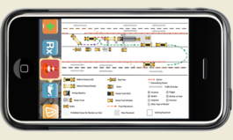

Communications
ITCPs and Productivity
PREVENTING RUNOVERS AND BACKOVERS IN ROADWAY CONSTRUCTION
Communications
  Management Elements Addressed
  ITCP operations communication plan should include
  - Communications regarding changes to the ITCP
  - Means for workers on foot to talk with operators, truck drivers, others
  coordinating access and egress of vehicles, and the movement of
  heavy equipment within the work space
  - Means for equipment operators to communicate with each other and
  with key site personnel
  - Plan for orienting independent truck drivers and subcontractors
  to the work space and the ITCP
Notes:
The ITCP communications plan requires specific items that may not be considered for other project communications. The ITCP will anticipate a means to communicate with workers, operators, truck drivers, etc. about routine changes to the plan. It will cover worker-to-operator/driver communications when traffic and worker paths cross. This includes hand signals, radio communications, lighting, etc. A very simple communications tool is an air horn, which can be sounded if there is a problem with instruction to stop all operations. The ITCP will cover a process for communicating with the truck boss and truck drivers daily to explain the routes and precautions they should take.

Slide 12
Discussion and questions
ITCPs and Productivity
PREVENTING RUNOVERS AND BACKOVERS IN ROADWAY CONSTRUCTION
Discussion
and
Questions

