Slide 1
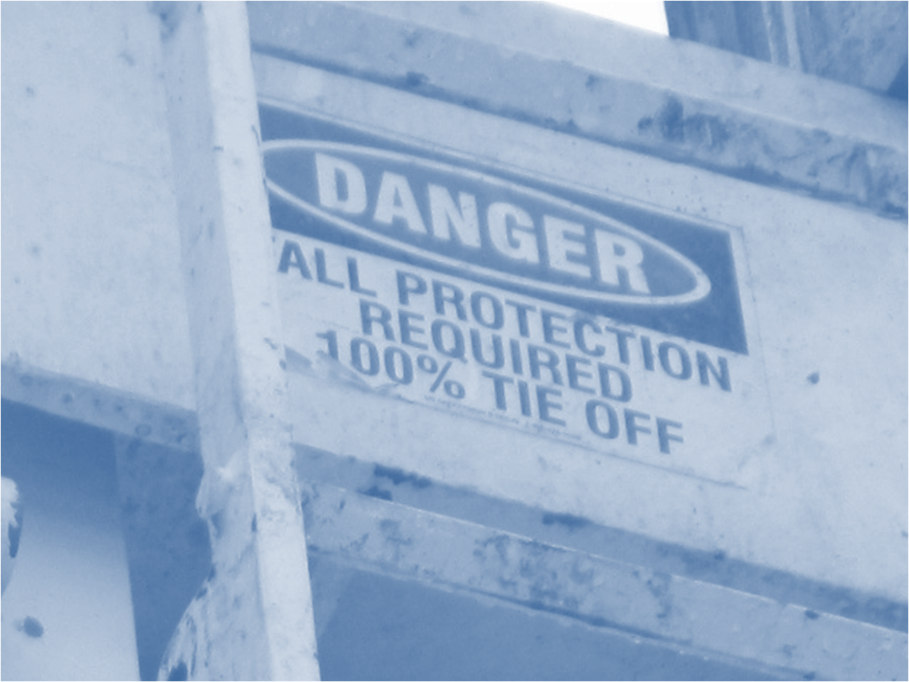
Susan Harwood Training Program Grant
Fall Hazard Awareness
This material was produced under grant number SH-26327-SH4 from the Occupational Safety and Health Administration, U.S. Department of Labor. It does not necessarily reflect the views or policies of the U.S. Department of Labor, nor does mention of trade names, commercial products, or organizations imply endorsement by the U.S. Government.

Slide 2
Objectives
After this module you should be able to
identify the most common fall hazards
take the steps necessary to avoid those hazards

Slide 3
Fall Prevention and Protection
Falls can be the result of
unprotected sides or edges
trips or slips
improper ladder use
much more
Fall prevention examples
guardrails
hole covers
Fall protection examples
personal fall arrest systems (PFAS)
safety nets
Fall protection (which includes prevention and protection) is required at 4’ for general industry and 6’ for construction
Notes:
Falls and falling objects can result from unstable working surfaces, ladders that are not safely positioned, and misuse of fall protection. Workers are also subject to falls or to the dangers of falling objects if sides and edges, floor holes, and wall openings are not protected. Any time a worker is at a height of six feet or more (construction industry) or four feet or more (general industry), the worker must be protected.
Fall prevention is the term used for systems that prevent the worker from falling in the first place. Some systems that prevent the worker from falling include guardrails and hole covers. This method, as opposed to fall protection, is the safer route.
Fall protection, on the other hand, is the term used for systems that protect the worker from the fall itself, arresting the fall in some way. Some systems that arrest the fall of a worker include personal fall arrest systems (PFAS), also known as body harnesses, and safety nets.

Slide 4
Fall Hazards
Uneven working surfaces
Unprotected sides and edges
Ladders
Open pits
Climbing and working from the derrick
Working off the bed of trucks
Floor holes
Stairs
Getting on and off mobile equipment
Equipment, materials, lines, etc. on rig floor or ground

Slide 5
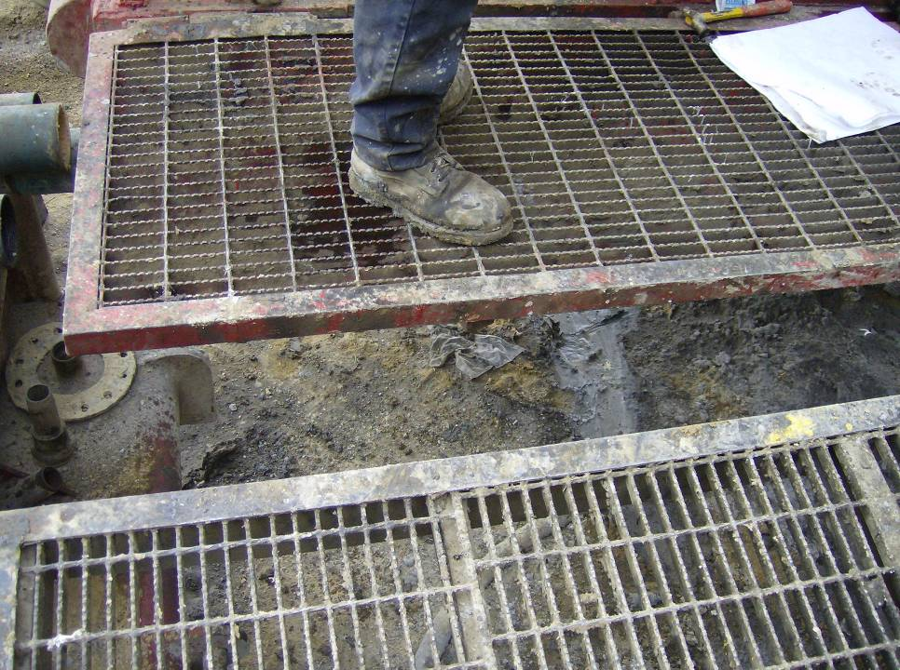
uneven walking/working surface
uneven walking/working surface
Corrective Action: inform your supervisor that a potential for falls exists here
Notes:
This photograph shows uneven work platforms on a rig. This could have been a result of improper setup or poor design.
A worker should fix this issue if it is within a worker’s capabilities, otherwise a worker can inform the supervisor and come up with a plan to even up the work platforms or provide some type of fall protection.

Slide 6
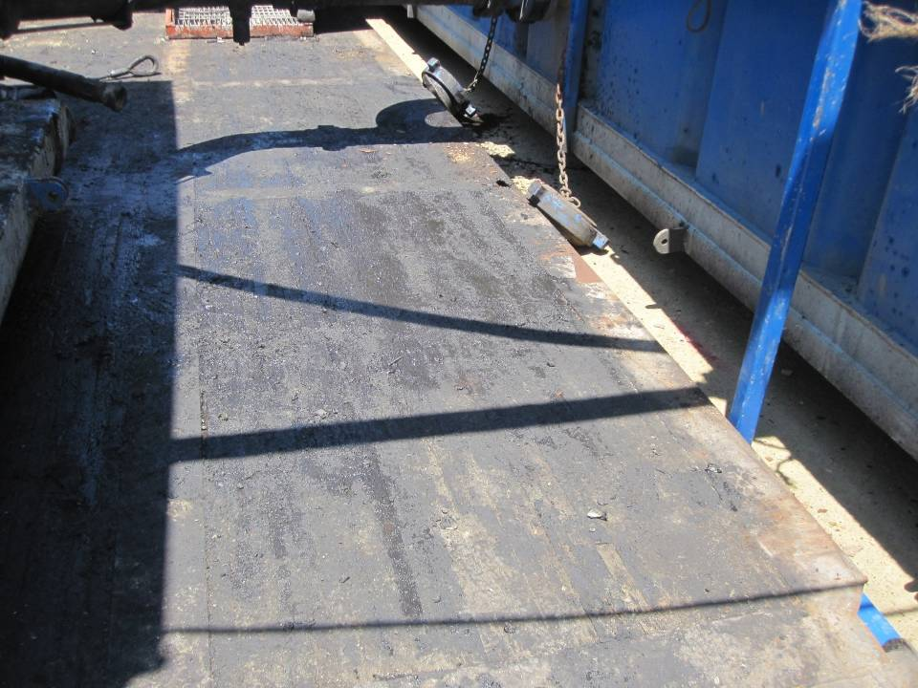
walking surfaces
walking surfaces can get slippery from oil spills during maintenance activities
Corrective Actions: keep walking surfaces as clean as possible; spread something down for traction
Notes:
This photograph shows a wooden walking/working surface on which oil has be spilled from a maintenance activity. This surface is now very slick and can easily be the cause of a fall. [1910.22(a)(2)]
Workers should do their best to prevent spills like these anywhere on the rig. If they do occur, like the one in this photograph, spread an oil-adsorbent or sand down for traction. Also, a non-skid skid surface can be installed.

Slide 7
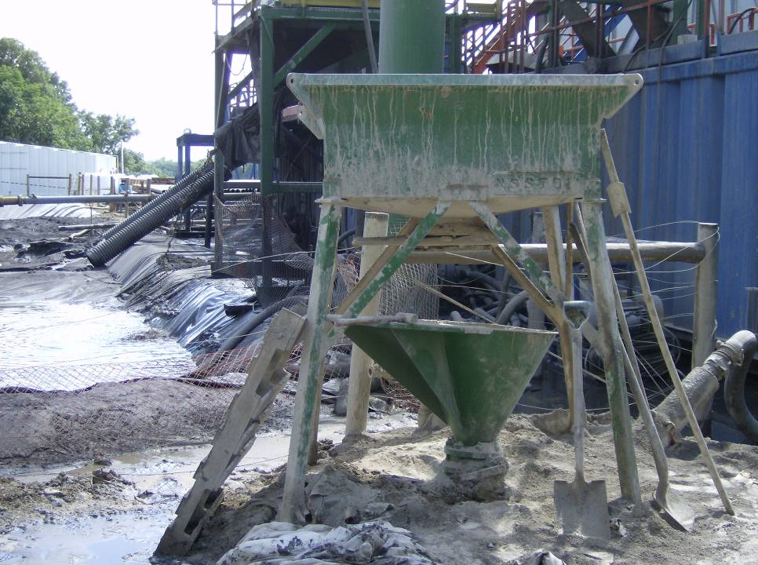
a pallet used in place of a ladder
a pallet used in place of a ladder
Corrective Action: use only approved ladders
Notes:
This photograph shows a pallet being used as a ladder. A pallet is not designed for any other purpose than stacking and moving materials. They must not be used as ladders or makeshift walking surfaces such as bridges or hole covers.
An extension or step ladder should be used in this situation.

Slide 8
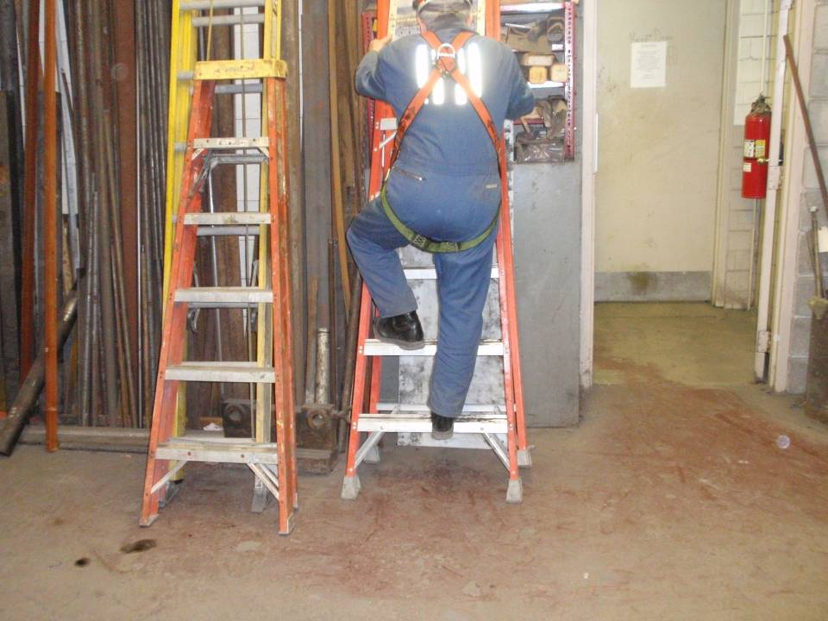
employee climbing a step ladder that is not set up right
employee climbing a step ladder that is not set up right
Corrective Action: set up step ladder properly or use an extension ladder
Notes:
This photograph shows a worker climbing a step ladder that is leaned against a wall. Step ladders, or A-frame ladders, should only be used extended out with the spreader fully extended and locked. A worker should only use the face of the ladder that is designed for climbing, or the front face, not the back face, unless the ladder is designed to be climbed on either face. Also, the top two rungs of the step ladder should not be climbed. [1910.26(c)(3)]
In this situation, the worker should either extend out the step ladder and use it properly or use an extension ladder, which can be leaned against the wall (at a 4:1 ratio).

Slide 9
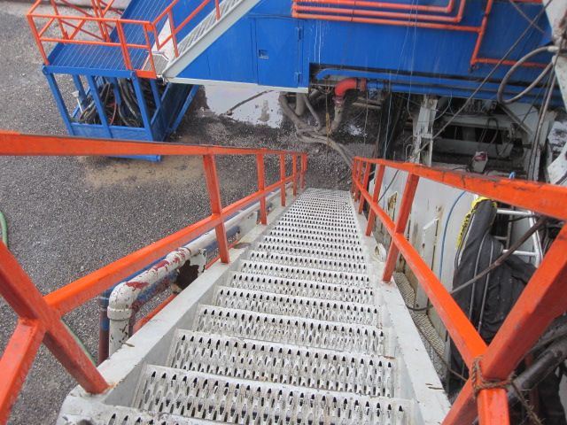
even a good set of stairs with stairrails can be the site of a fall
even a good set of stairs with stair rails can be the site of a fall
Corrective Actions: 3 points of contact; walk; clear and clean; carry only light loads; do not jump last few steps
Notes:
maintain at least three (3) points of contact
do not run up or down stairs
ensure stair are kept clear of objects and as clean as possible to prevent slips and trips
do not carry heavy objects, only light loads
do not jump the last few steps

Slide 10
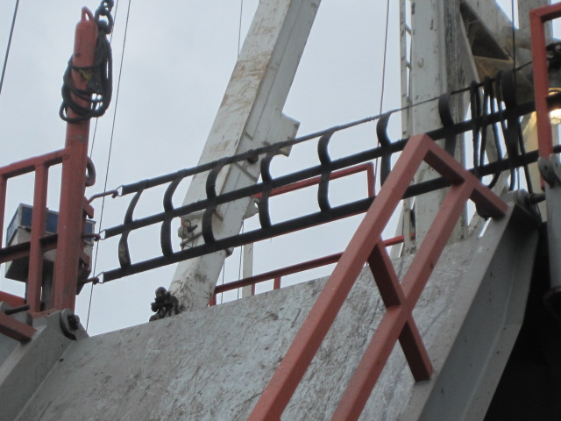
the v-door opening is a fall hazard if not properly guarded
the v-door opening is a fall hazard if not properly guarded
a gate or barrier like this one must be installed when the opening is not in use
Notes:
This photograph shows a v-door gate in place while the v-door is not in use. Workers are at risk for falling through the v-door opening and down the ramp. A gate or other type of barrier must be in place when the v-door is not in use.

Slide 11
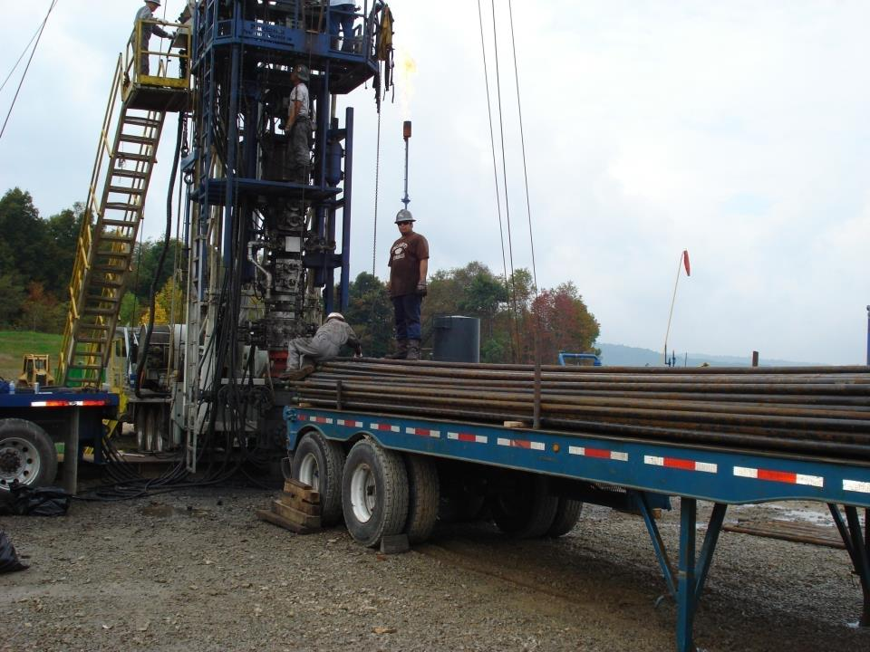
Working on a trailer
employees working on trailer with no means of fall protection
Notes:
These arrows point to workers working on top of a trailer.

Slide 12
worker without fall protection with possible fall of 18’
worker without fall protection with possible fall of 18’
Corrective Action: install a guardrail or use a PFAS
Notes:
This arrow points to a worker standing on a platform that is 18’ from the ground below without fall protection.
This worker could either wear a PFAS that is attached to a suitable anchor point or a install a guardrail could be installed behind the worker.

Slide 13
worker using the landing of a set of stairs as a work platform.
employee using the landing of a set of stairs as a working surface
Corrective Action: install a swinging gate (that meets guardrail requirements) on the stair opening
Notes:
This arrow points to a worker who is using the landing of a set of stairs as a work platform, operating the controls for the unit.
If the worker is using the platform as a working surface, it must be guarded on all sides. In this situation a gate should be used that can only swing into the platform area (not out onto the steps, so that the worker cannot accidently fall into the gate, opening it, and fall down the stairs). The gate must meet the requirements for a guardrail system.

Slide 14
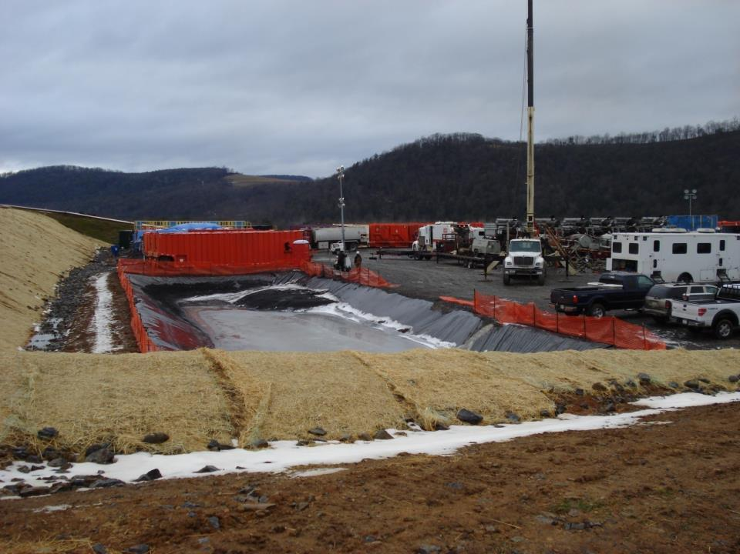
reserve pit fence
reserve pit fence down during frac job with a potential for fall into pit
Corrective Action: maintain reserve pit fences after rig leaves and until reclamation
Notes:
This photograph shows part of the reserve pit fence down during the fracing process.
The reserve pit fence should be maintained throughout the production process and until reclamation.

Slide 15
Open Pit
due to the slickness and slope of the plastic, a fall into the pit can occur, likely resulting in a worker drowning
it is strongly recommended that a harness and tag line be worn by the entrant at all times in case a rescue needs to be made
Notes:
This photograph shows the steep slope of the plastic of the reserve pit and how it can easily cause a fall.
When a worker passes through the fence into the pit area to perform an activity, it is highly recommended that the entrant wear a full-body harness with an attached tag line. If the entrant falls into the pit, another worker(s) can pull the entrant out of the pit to safety.

Slide 16
Fence by an open pit
if a worker falls into the fence, that worker still might fall into the pit
Corrective Action: set fence back at least 6’ from edge of pit
Notes:
This photograph shows a reserve pit fence that was built along the edge of the pit. If a worker falls into the fence, the fence can fall down with the worker and the worker can slide into the pit.
Fences used as warning barriers need to be set back at least 6’ from the edge.

Slide 17
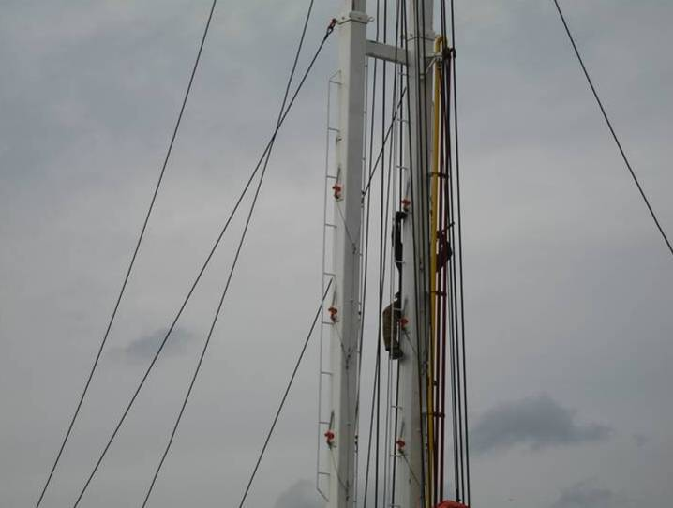
use a PFAS with a suitable anchor point
worker climbing the derrick of a service rig without fall protection
Corrective Action: use a PFAS with a suitable anchor point
Notes:
[1910.23(c)(1)]

Slide 18
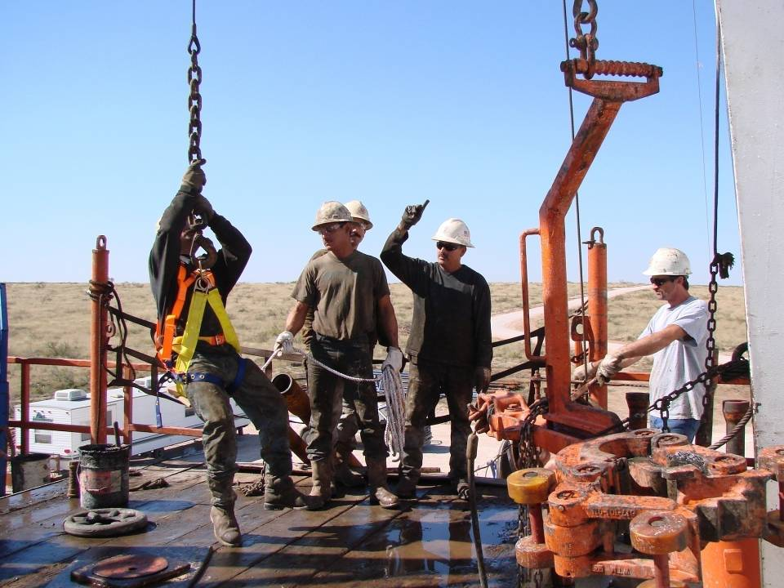
worker correctly using a boatswain’s chair
worker correctly using a boatswain’s chair
Notes:
This photograph shows a worker being lifted in a boatswain’s chair. This worker is in a seated position, another worker is controlling the lifted worker by means of a tag line, and another worker who can clearly view the lifted worker without obstruction is directing the worker on the controls for the lifting mechanism. Note that the boatswain’s chair itself is not an acceptable means of fall protection, but it must be a PFAS/boatswain’s chair combination. [1910.28(j)]

Slide 19
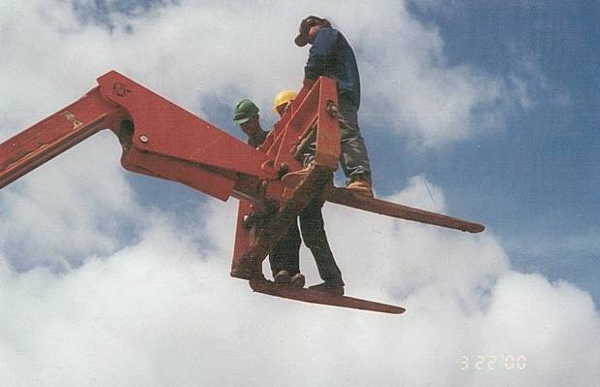
riding the Forks of a forklift.
work practices like these often end in tragedy for the worker and his family
Corrective Actions: never stand on forks or use makeshift baskets; always use proper lift baskets and a PFAS

Slide 20
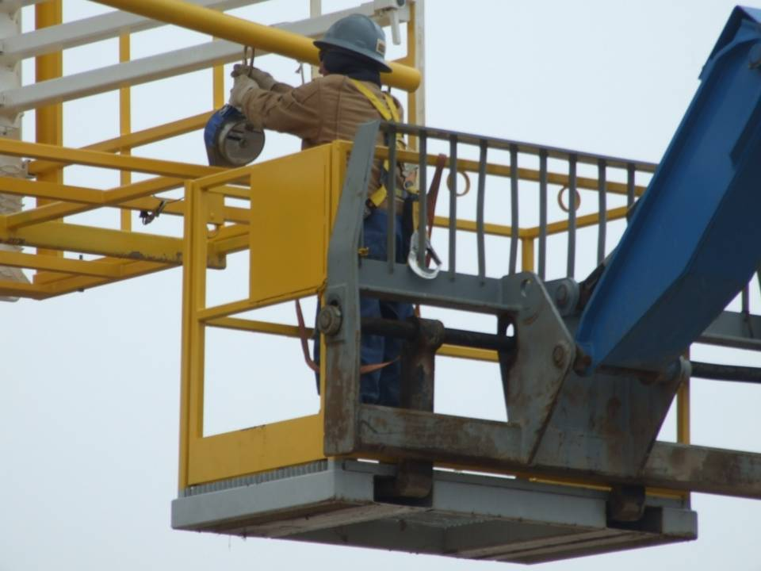
Working in an aerial lift
is this any better?
Notes:
This photograph shows a worker installing a retractable lanyard while in an approved personnel lift basket. There are some correct and incorrect actions displayed here.
Correct:
The worker is being lifted in an approved basket and is using a PFAS.
Incorrect:
The worker’s PFAS is tied off to an inadequate anchor point. The lanyard should be tied off to some point on the boom structure of the forklift. Also, the basket doesn’t appear to be attached to the forklift. The basket could become unattached from the forklift and free fall.

Slide 21
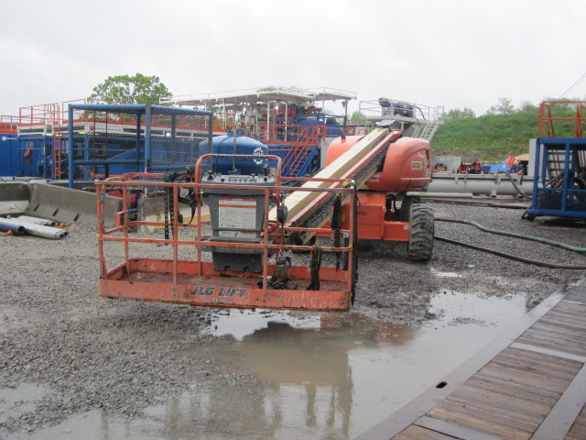
basket of an aerial lift
a worker can be thrown from or fall out of the basket of an aerial lift
always wear a PFAS while in the basket; attach PFAS to a suitable anchor point

Slide 22
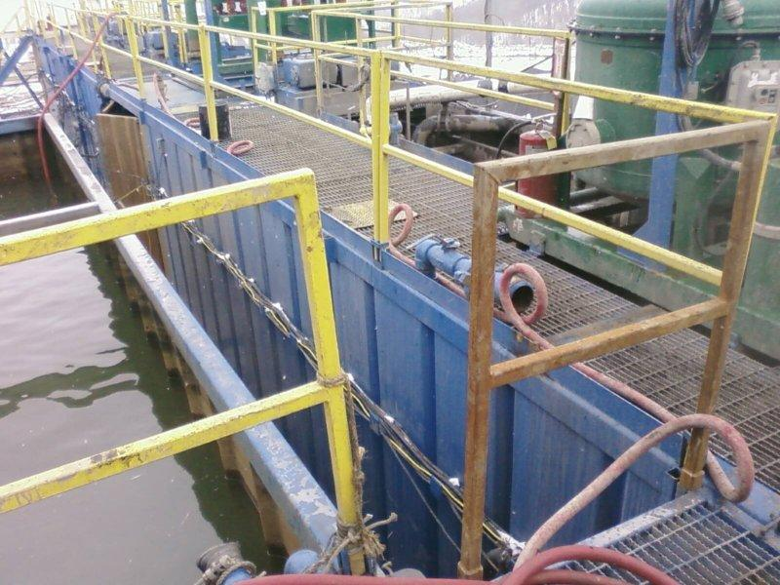
This photograph shows a gap in the guardrail system on a rig.
a gap in the guardrail system
Corrective Action: inform your supervisor that a potential for falls exists here
Notes:
This photograph shows a gap in the guardrail system on a rig. This photograph was taken during an OSHA inspection.
A worker should fix this issue if it is within a worker’s capabilities, otherwise a worker can inform the supervisor and come up with a plan to close the gap.

Slide 23
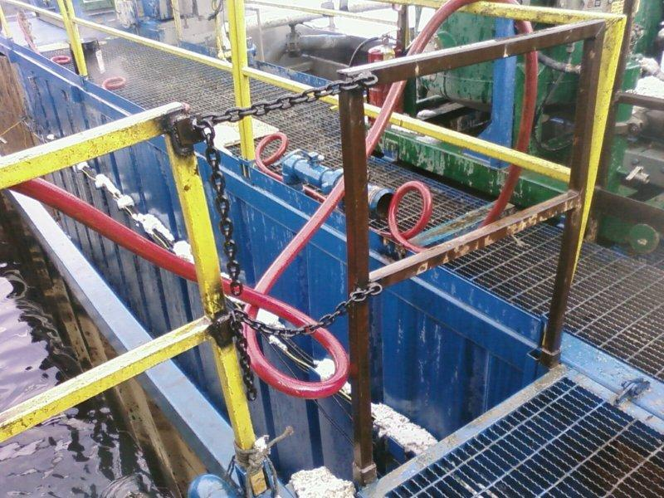
This photograph shows the company’s corrective action.
Notes:
This photograph shows the company’s corrective action.

Slide 24
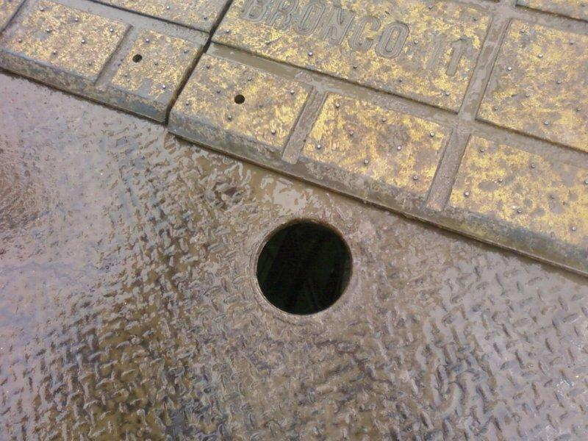
This photograph shows a floor hole which was left uncovered.
a floor hole that can cause a trip; materials can fall through and strike a worker below
Corrective Action: always replace covers over holes in rig floor when not in use
Notes:
This photograph shows a floor hole which was left uncovered. This photograph was from an OSHA inspection. A worker can trip on this hole or materials can fall through the hole onto another worker. [1910.23(8)]
A removable, metal hole cover should be placed to cover this hole.

Slide 25
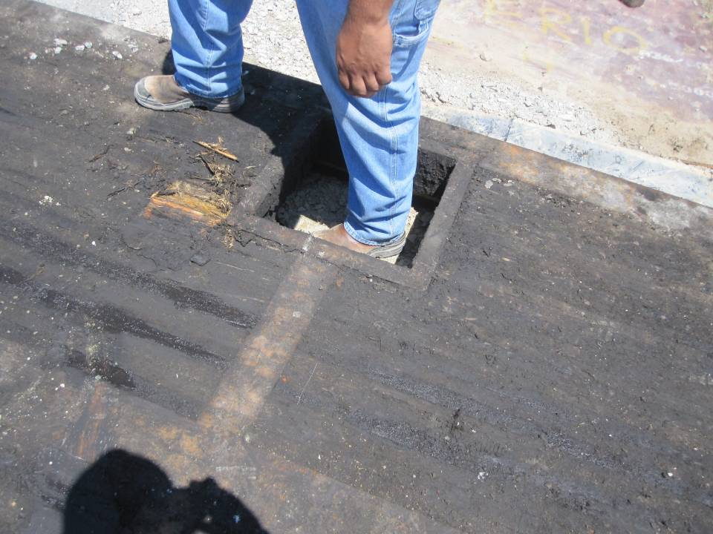
Walking into a hole
this opening can sneak up on a worker when walking backwards directing a load into position
Corrective Actions: place a cover over this opening

Slide 26
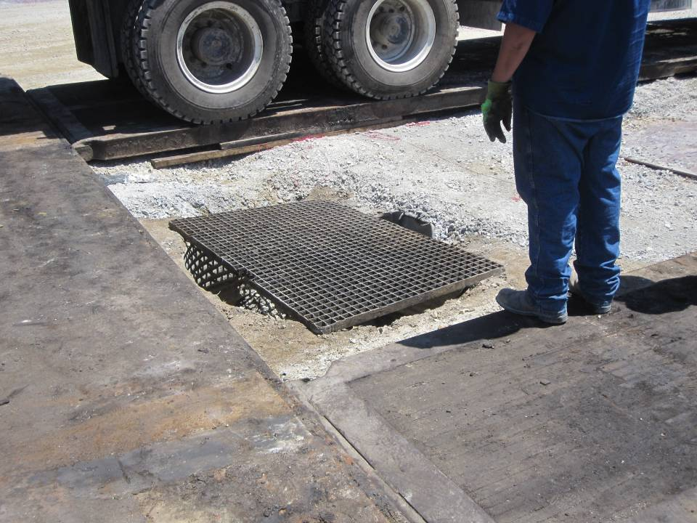
this is another example of a fall hazard
this is another example of a fall hazard
Corrective Action: cover the rest of the hole or cover entire hole with a larger grate
Notes:
This photograph shows a grate that was placed over a hole. There was still enough space on either side of the hole for a worker’s foot to get caught in and cause a fall.
The rest of the hole should be covered or a larger grate that can cover the entire opening of the hole should be placed.

Slide 27
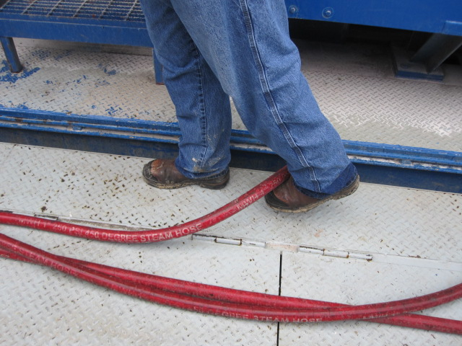
This photograph shows several runs of a steam hose that was left on the rig floor.
hoses and other equipment left on the rig floor are tripping hazards
Corrective Action: tuck away to prevent tripping or return to storage after use
Notes:
This photograph shows several runs of a steam hose that was left on the rig floor. This hose can cause a trip; housekeeping is needed here.
The hose should be tucked away to an area where workers are unlikely to trip over it or it should be returned to storage if it is not being used.

Slide 28
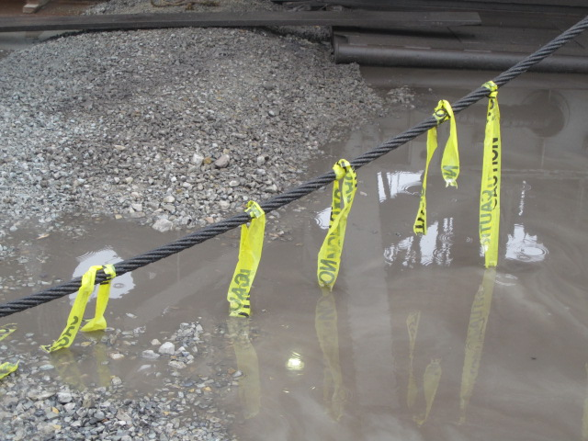
This photograph shows wire rope that has been marked with caution tape.
cables can cause a trip if a worker forgets or doesn’t know where they are
yellow caution tape was used here to indicate that there is a trip hazard
Notes:
This photograph shows wire rope that has been marked with caution tape. Sometimes these cables have to cross a walkway.

Slide 29
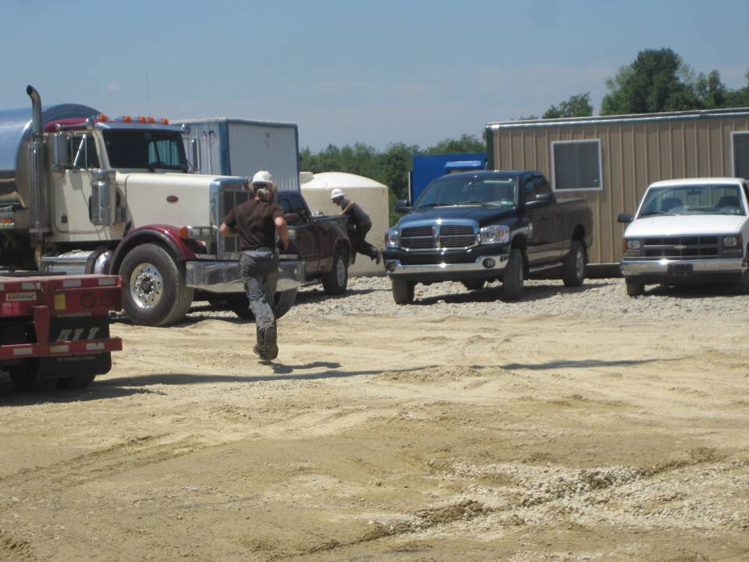
running on site is just not necessary
running on site is just not necessary
Corrective Action: walk, don’t run
Notes:
This photograph shows a worker running to get an item from the toolpusher. Running puts the worker at a greater risk for falling and getting struck by mobile equipment.

Slide 30
Your Employer Is Responsible For
Providing and maintaining safe access
Making sure that there are no unguarded surfaces 4 feet or more in height
Providing a personal fall arrest system (PFAS), training on and ensuring its use
Responding to and correcting hazards pointed out by you, the worker

Slide 31
You Are Responsible For
Inspecting your work area for fall hazards
Following all fall protection procedures your company has in place including wearing a personal fall arrest system (PFAS)
Correcting the hazards you are able to correct
Reporting to your supervisor the hazards you are unable to correct

Slide 32
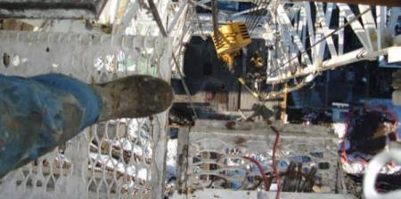
Case Study
Fall from derrick board: a worker grabbed the elevator and held on for a few minutes but then let go, grasping a 4.5” vertical pipe. The worker slid partially down the pipe joint until he reached the pipe collar from where he fell about 65’.
Notes:
A derrickman fell while holding on the elevator after attempting to latch a drill pipe from the fingers of the board. He had his harness on. Even though his company had a 100% tie off policy, he was not tied off. He lost his balance. He grabbed the elevator and held on for a few minutes but then let go, grasping a 4.5” vertical pipe. The worker slid partially down the pipe joint until he reached the pipe collar from where he fell about 65’.
Ask the class for 3-4 things that may have contributed to this worker losing his life.
Possible Answers: Losing his balance. Not following company policy. Wearing but not using his fall protection. Any others?
As the class for 3-4 recommendations for preventing a similar incident.
Possible Answers: Allows follow company policy. Always tie off. Any others?

Slide 33
Always Remember
Always use your fall protection when above 4’
Keep walking/working surfaces as clean and clear as possible
Walk, don’t run
Cover floor holes when not in use
Report any concerns to your supervisor

Slide 34
Memory Check
Fall protection is required at how many feet or more for general industry?
4
10
12
15
Notes:
The correct answer is a. 4.

Slide 35
Memory Check
What is a PFAS?
Personal Fall Ascent System
Partial Fall Ascent System
Personal Fall Arrest System
Partial Fall Arrest System
Notes:
The correct answer is c. Personal Fall Arrest System.

Slide 36
Memory Check
When ascending and descending a ladder or stairs, at least how many points of contact must you maintain?
1
2
3
4
Notes:
The correct answer is c. 3.

