Slide 1
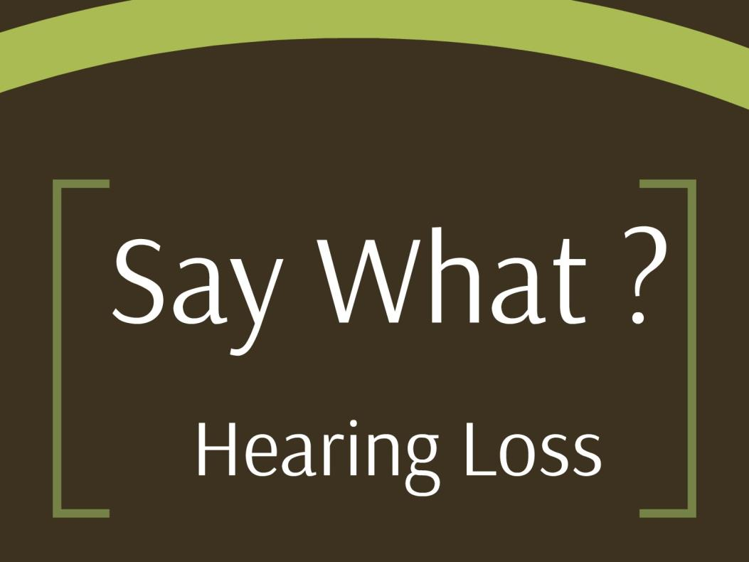
Say What?
Notes:
Say What? Have you heard anyone say that? That can be a sign of hearing loss that is why we decided to call this presentation by that title.

Slide 2

Farm Life
Notes:
Hearing loss in Agriculture is a common problem. This is a typical agriculture setting in the Midwest

Slide 3
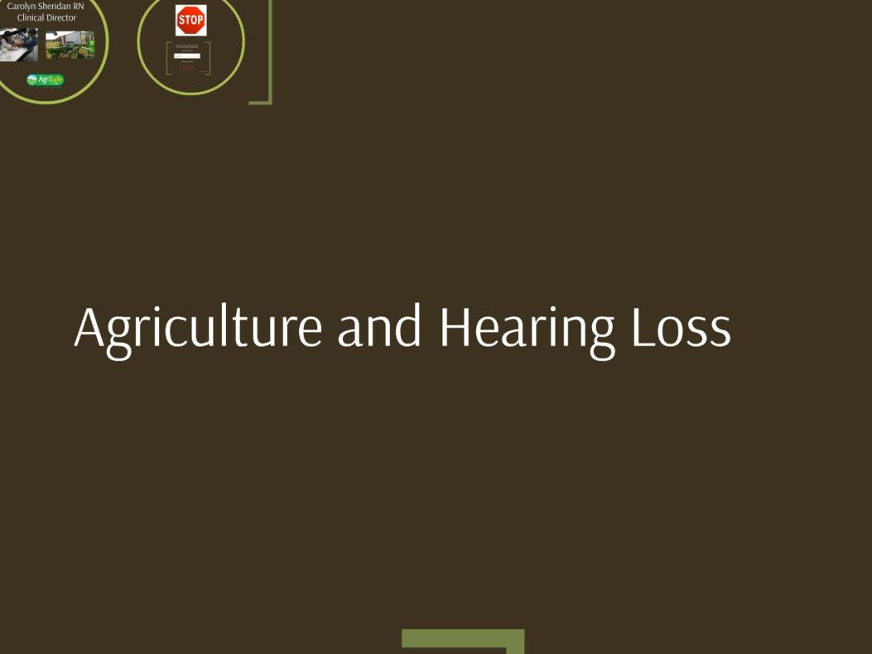
Agriculture and Hearing Loss
Notes:
I want you to think about the ways that hearing loss can occur in agriculture. What kind of agriculture are you or your family or friends involved in?

Slide 4
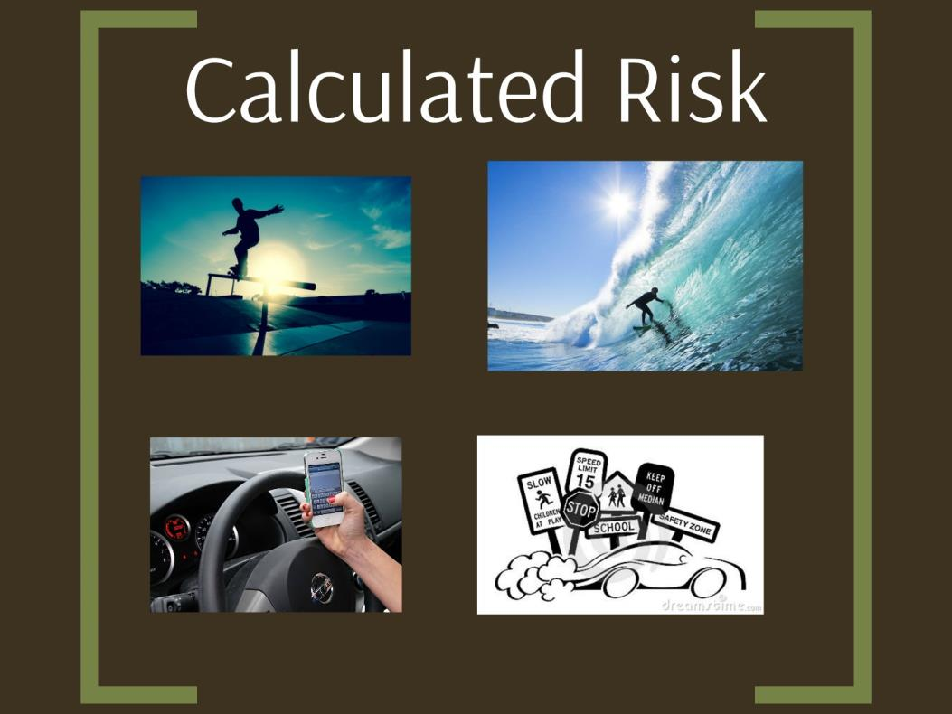
Calculated Risk
Notes:
Do you take calculated risks? Here are some examples. Can you think of an example of a calculated risk you have taken today or this week? Texting and driving? Speeding? Or something you have done for fun.

Slide 5
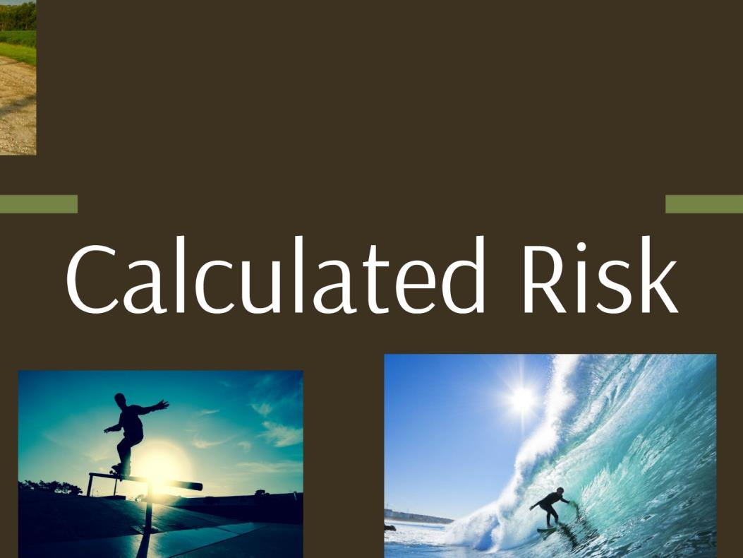
Calculated Risk
Notes:
Calculated Risks are a choice you make.

Slide 6
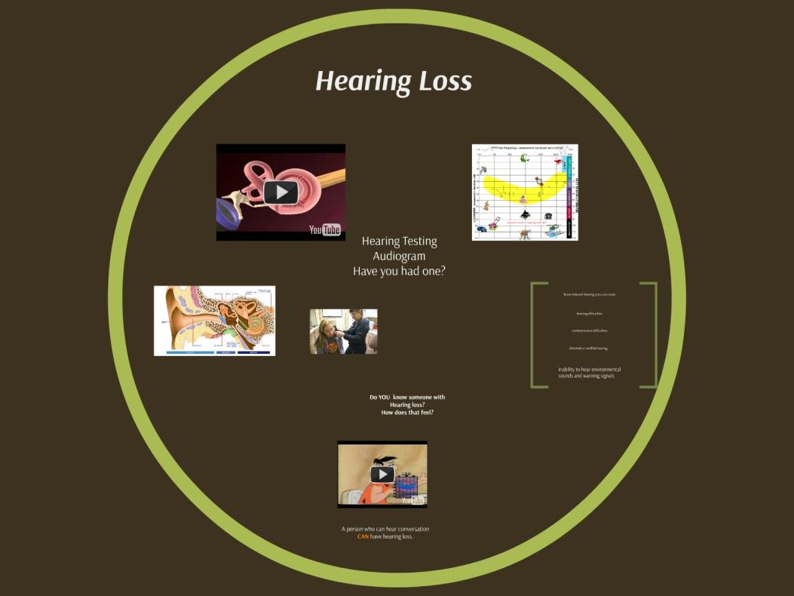
Hearling loss
Notes:
Hearing loss may be a result of you taking a calculated risk. Calculated Risks are a choice you make.

Slide 7
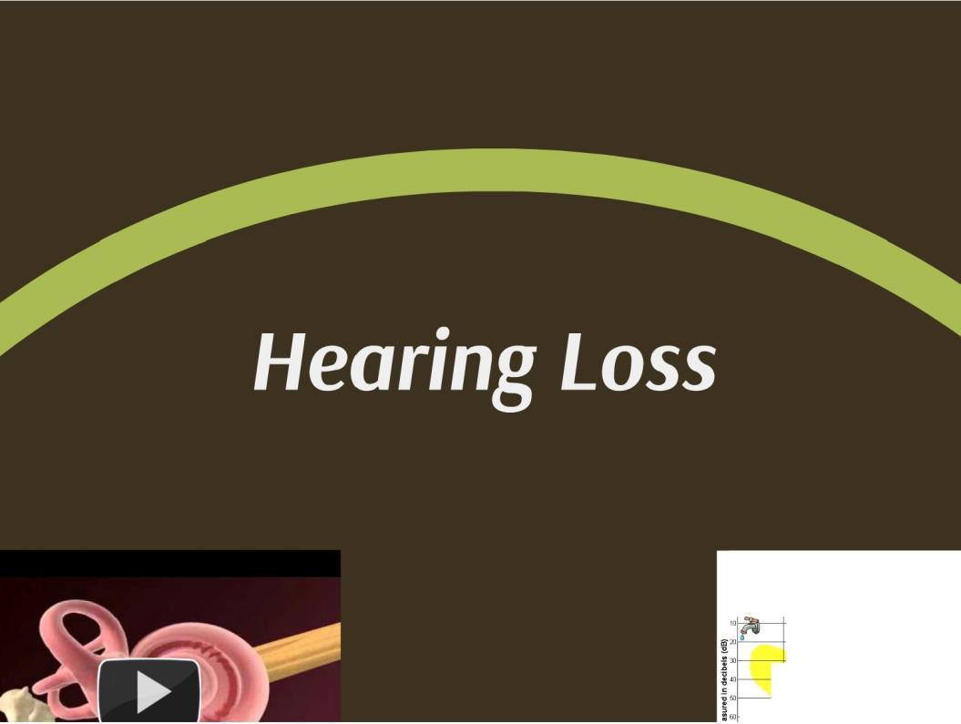

Hearing loss
Low
ITCH (or frequency)· measured In cycles per secon
250 500 000 2000
125
y
I J Liz
ng
ch
Sti
,..
Notes:
What is hearing loss?

Slide 8
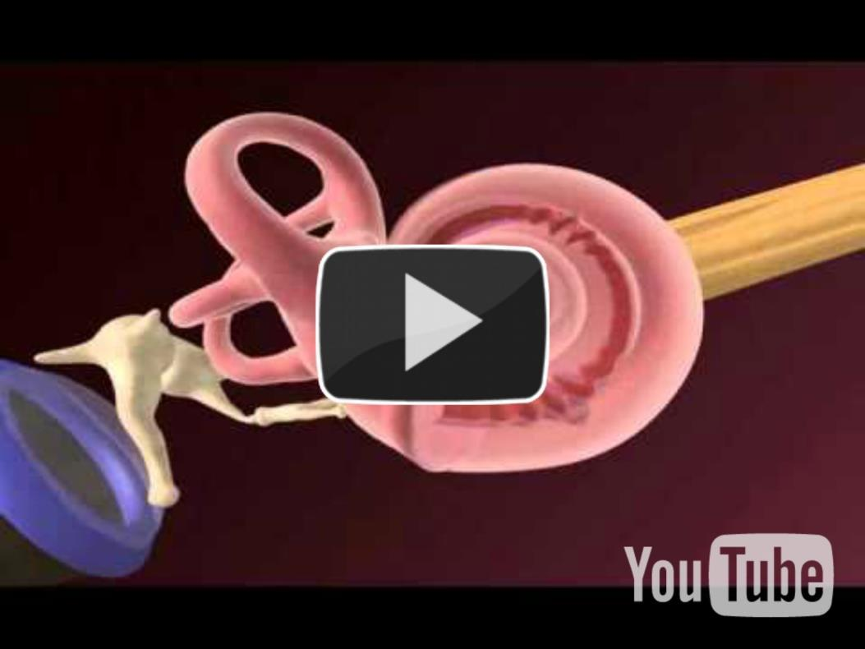
Play video
https://www.youtube.com/watch?v=2rhRo73F324
Notes:
Video explaining noise induced hearing loss. 30TU https://www.youtube.com/watch?v=2rhRo73F324 U30T
https://www.youtube.com/watch?v=2rhRo73F324

Slide 9
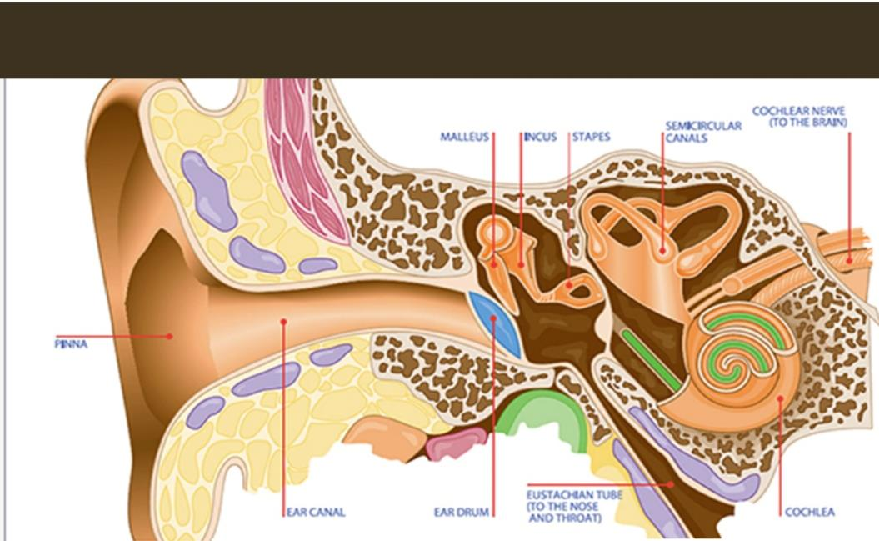

Ear Canell
\1R CAA
Notes:
Ear pathophysiology – focus on cochlea – small snail like structure in ear lined with hair cells that transmit sound.

Slide 10
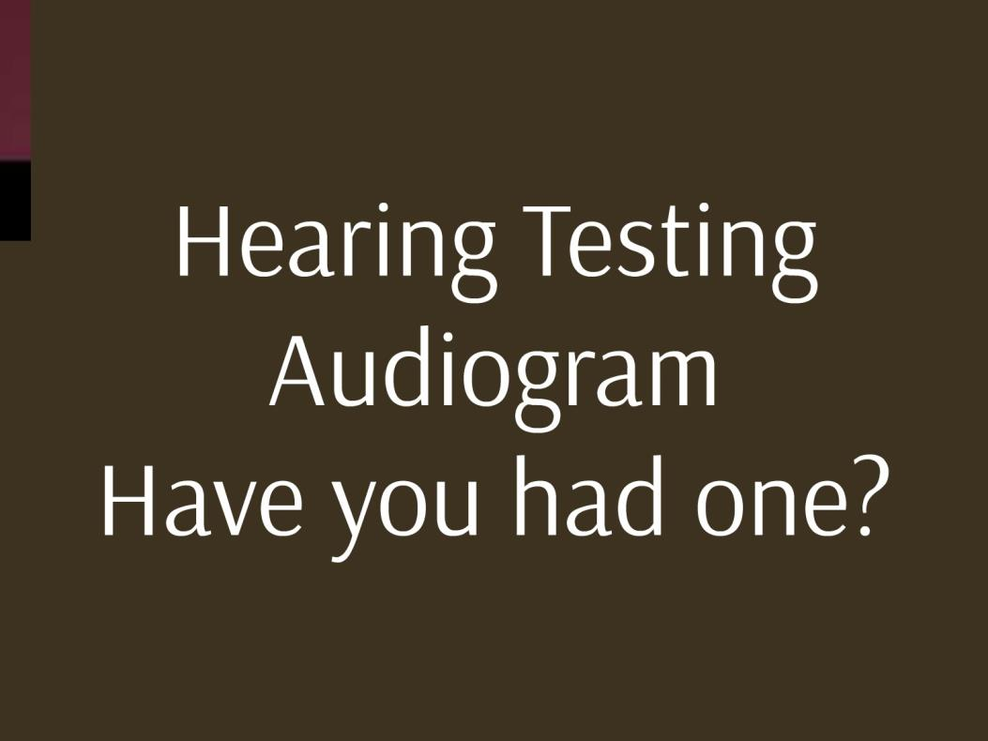
Hearing Test Audiogram
Notes:
A hearing test is a way that you can tell if you have hearing loss – have you had one?

Slide 11
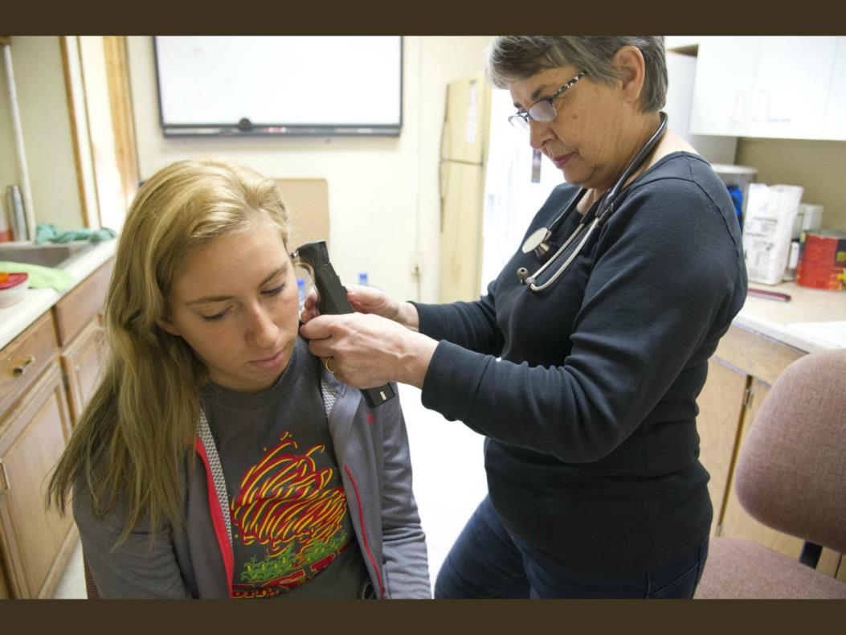
Looking in the ear
Notes:
Do you know what a speech banana is? We hear sounds related to speech in different frequencies (called Hertz). When you lose hearing in certain frequencies you lose the ability to hear different parts of speech (constants, vowels) Look at this speech banana and you can see what you might miss.

Slide 12
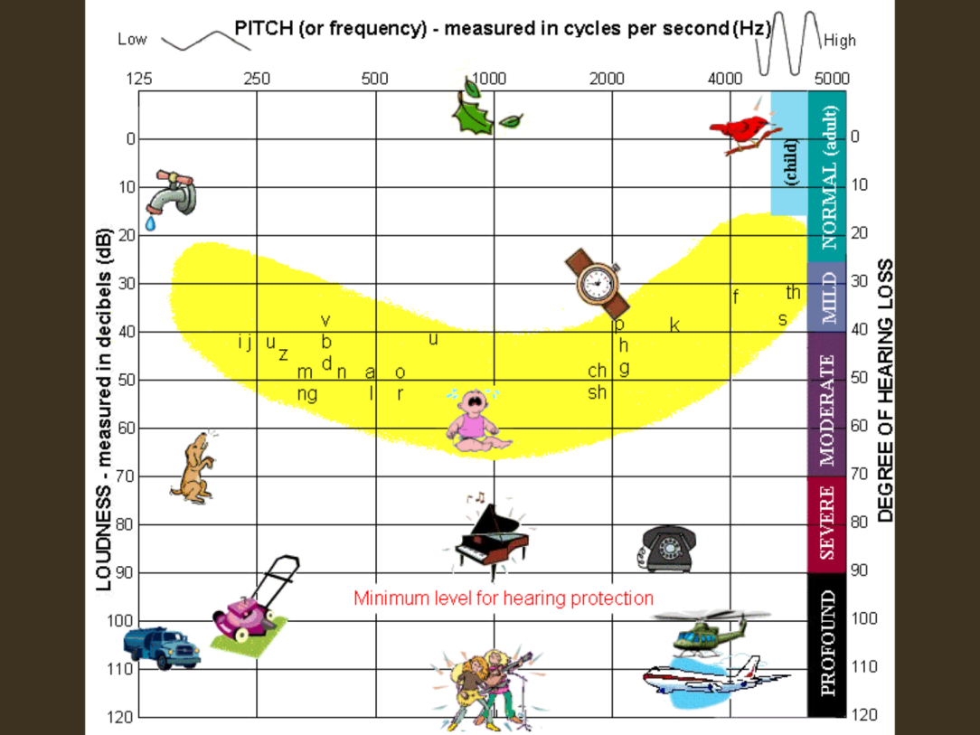
Pitch and Frequency

Slide 13
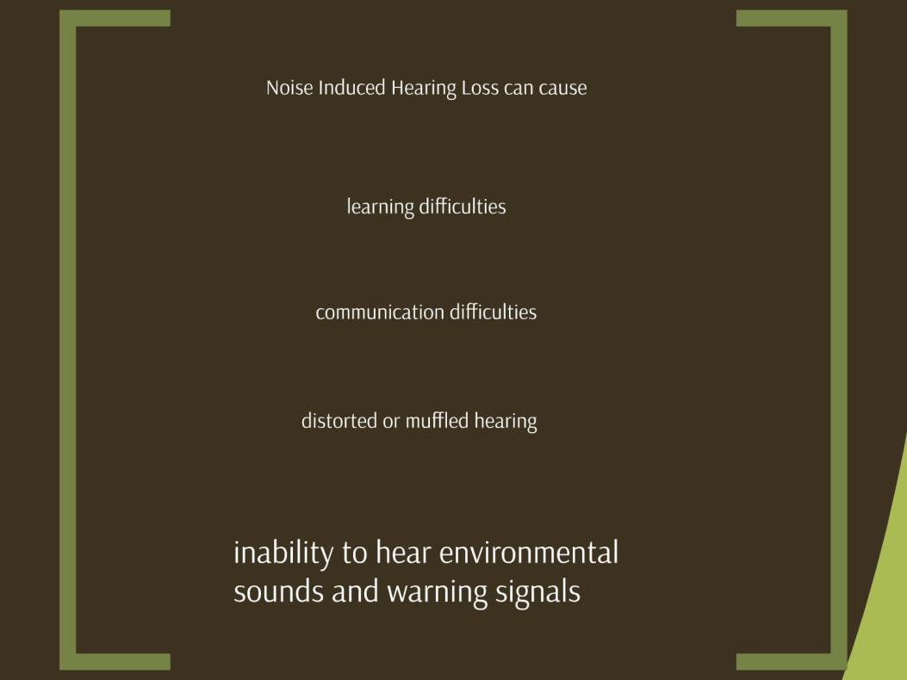
Effects of hearing loss
Notes:
Noise induced hearing loss can cause problems: learning difficulties, communication difficulties, distorted or muffled hearing, inability to hear environmental sounds and warning signals.

Slide 14
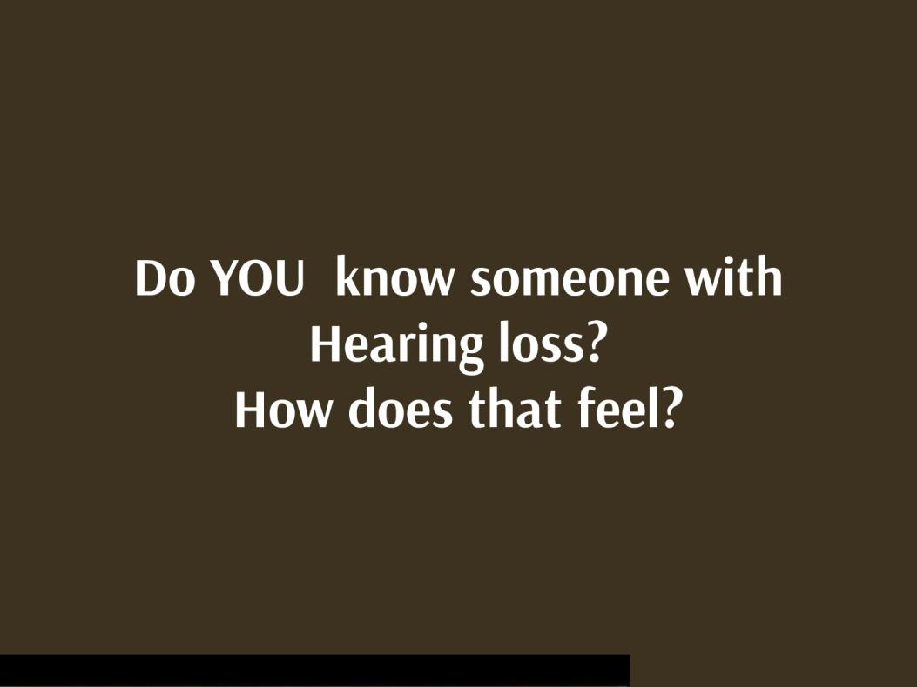
Do you know someone with hearing loss?
Notes:
Do you know someone with hearing loss? Your father, grandfather, mother, friend? How does that feel – what is it like to communicate.

Slide 15
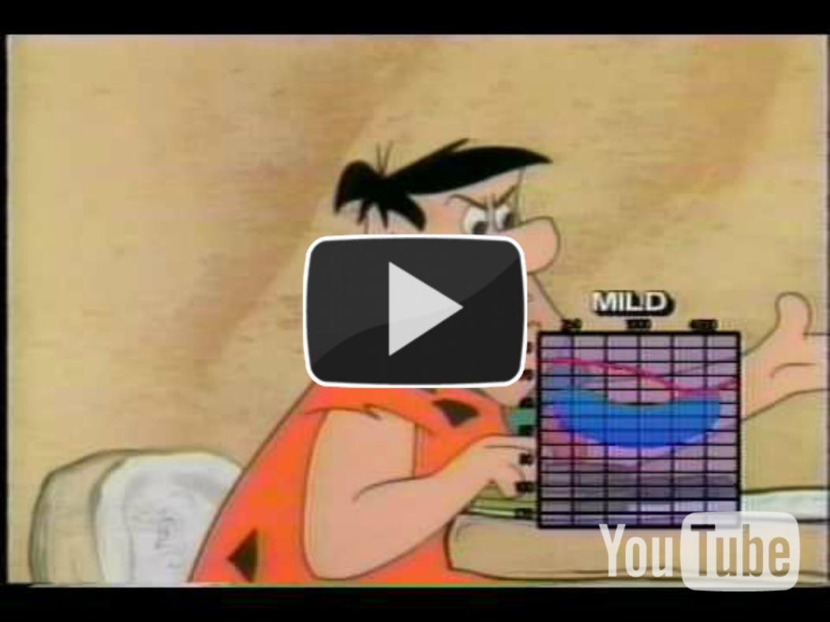
Fred Flintstone You Tube Video
This is a video that gives you an idea of what this is like. https://www.youtube.com/watch?v=ar1Dq-M2ok4

Slide 16
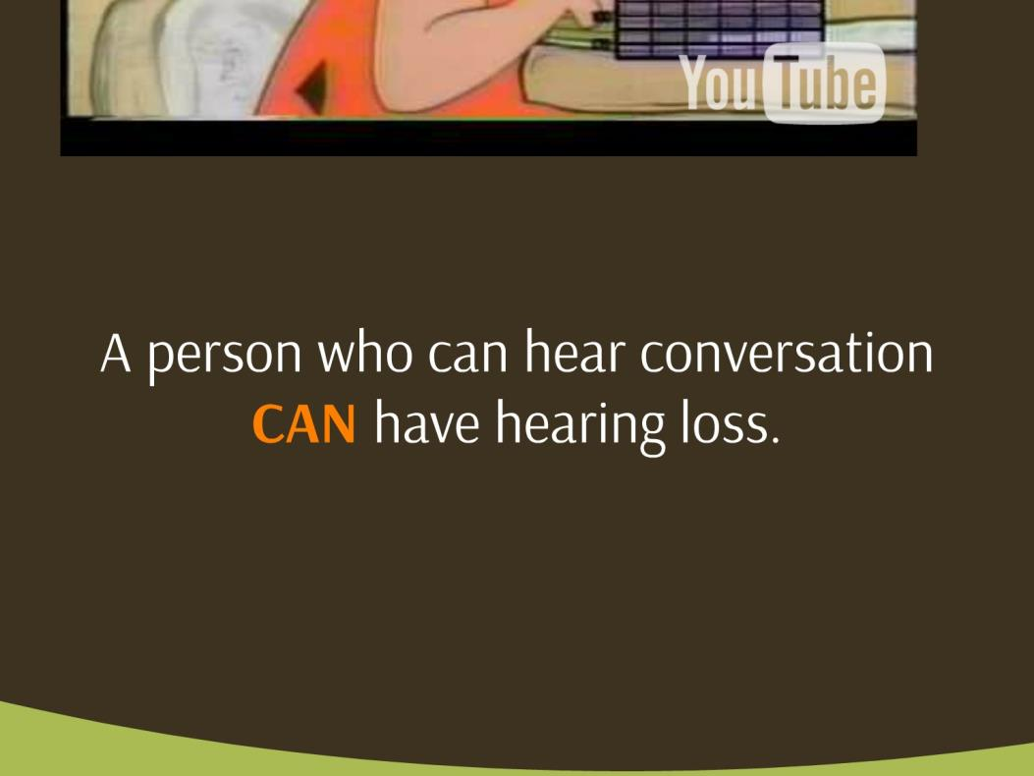
Hearing with Hearing loss
Notes:
Keep in mind that a person who has hearing loss CAN hear normal conversation. But this can be difficult for them.

Slide 17
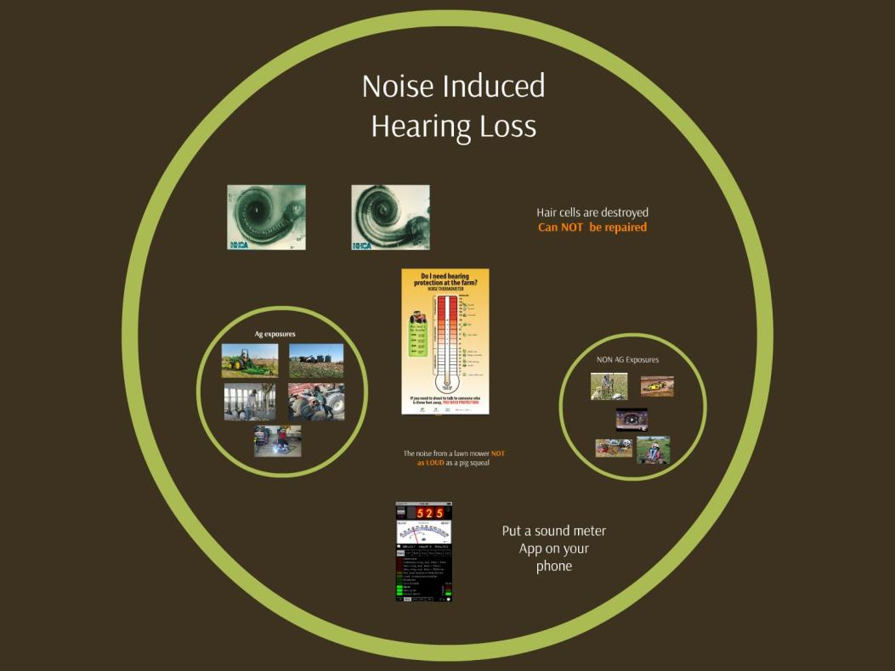
Noise induced hearing loss
Notes:
What should you know to prevent noise induced hearing loss?

Slide 18
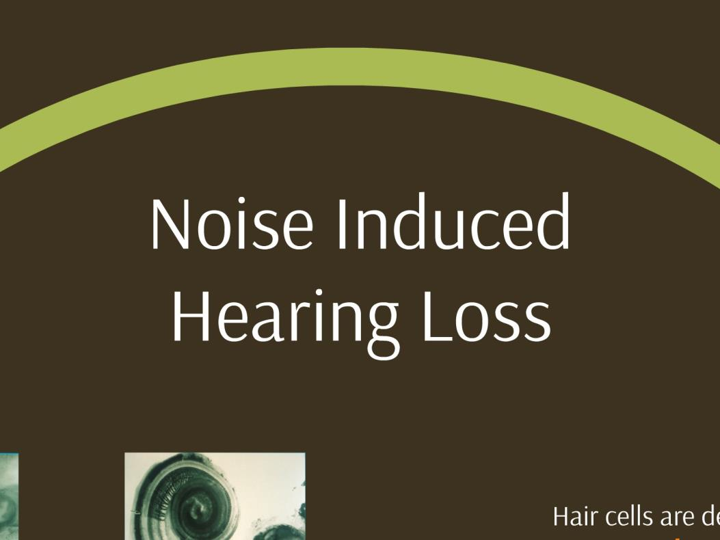
Noise induced hearing loss
Notes:
Noise induced hearing loss is different that hearing loss you get from a head injury, illness or something you are born with.

Slide 19
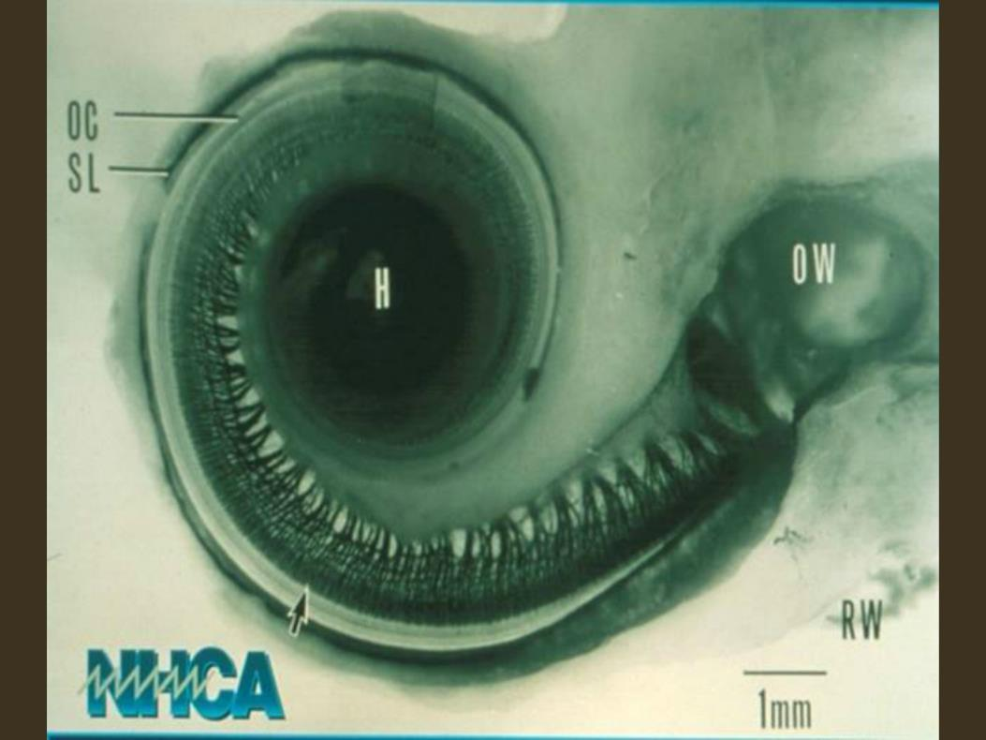
Normal Inner ear
Notes:
This is a picture of a normal cochlea. Lined with hair cells. These hair cells transmit sound. As sound comes in the ear these hair cells essentially bend over.

Slide 20
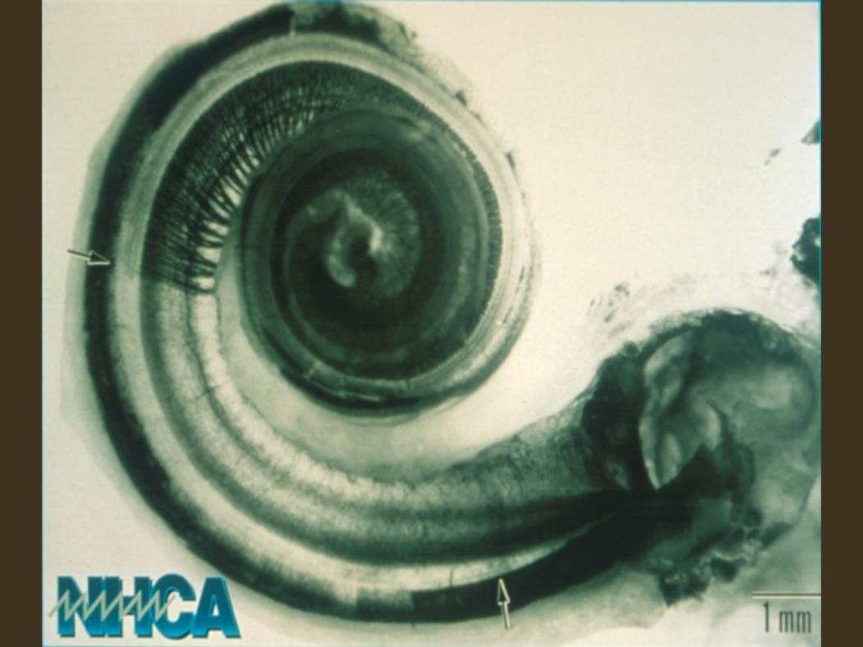
Inner ear with hearing loss
Notes:
This is a damaged cochlea. You can see that the hair cells are missing. This kind of damage is permanent.

Slide 21
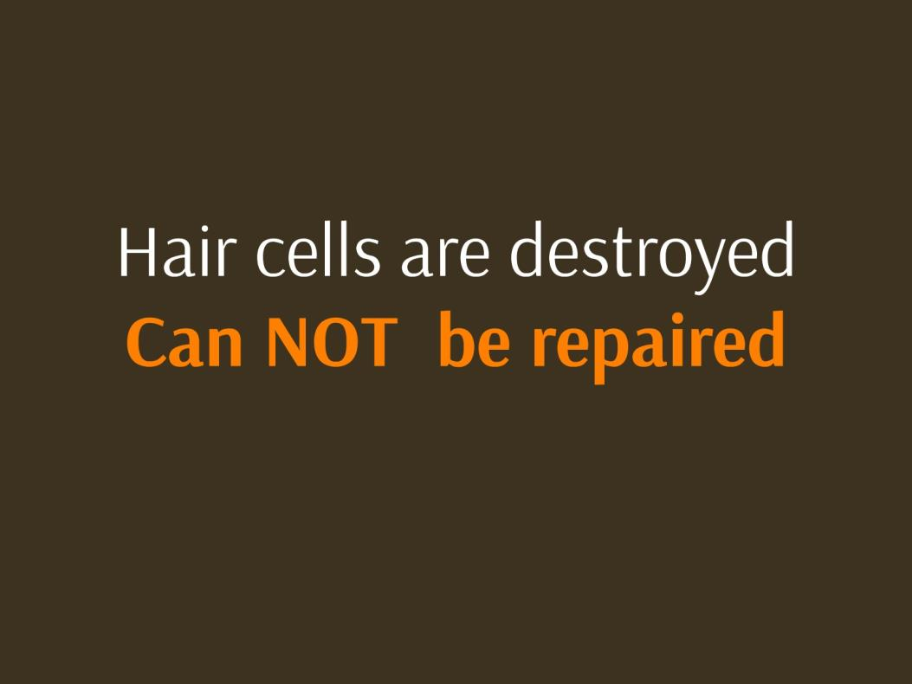
Destroyed ear hair cells can not be repaired
Notes:
These hair cells cannot be repaired. Noise induced hearing loss is permanent.

Slide 22
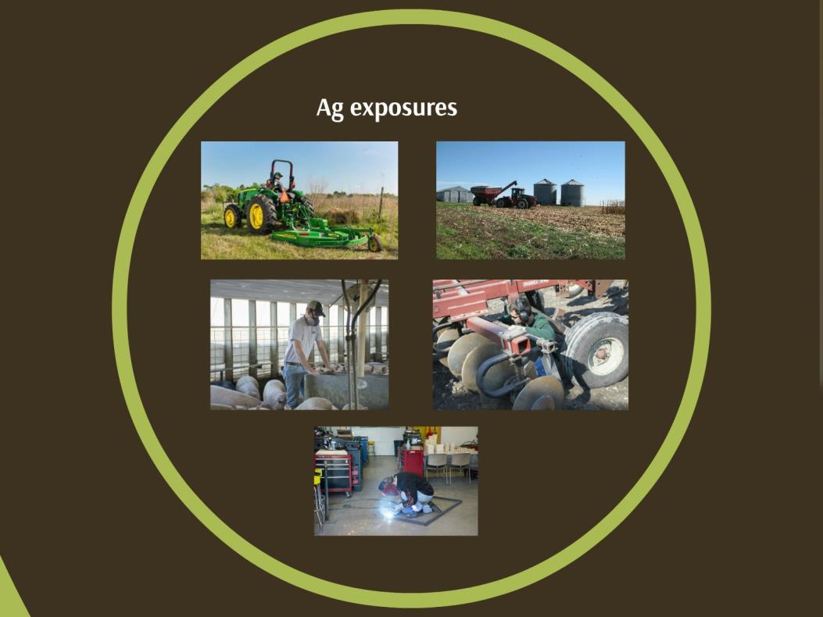
Exposure in Agriculture
Notes:
Noise exposures in agriculture are many. Machinery, mowers, animals, pig squeal is louder than a lawn mower, equipment, welding. Can you name some others?

Slide 23
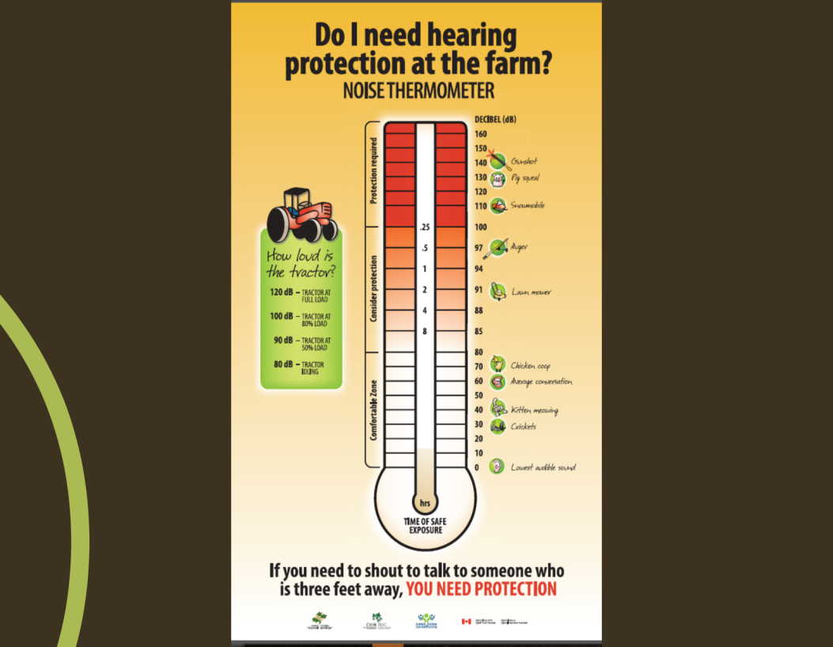
Do I need hearing protection on the farm?
Notes:
Noise thermometer show and important concept. You know you need protection based on how loud the noise is and how long you are exposed. For example if you are in noise that is 85 dB you can be in that noise for up to 8 hours but if that noise increases to 91 dB then you can only be in the environment for 2 hours. As you can see there are many exposures where you cannot be in the noise with our hearing protection for any period of time. Can you think of other examples that may be that loud?

Slide 24
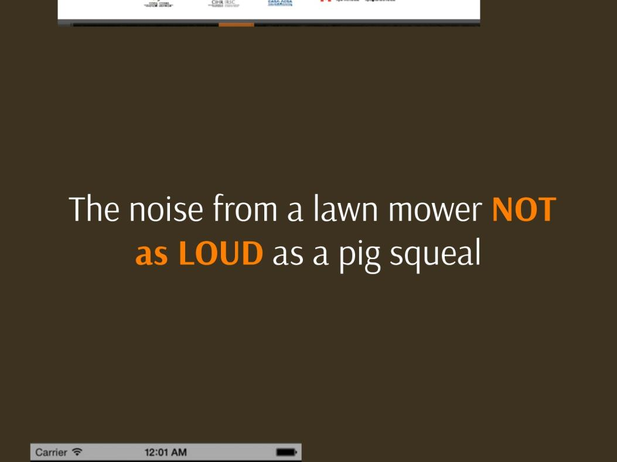
Lawn mover vs. pig squeal?
Notes:
Sometimes these noises are unexpected – for example pig squeals at 130 dB

Slide 25
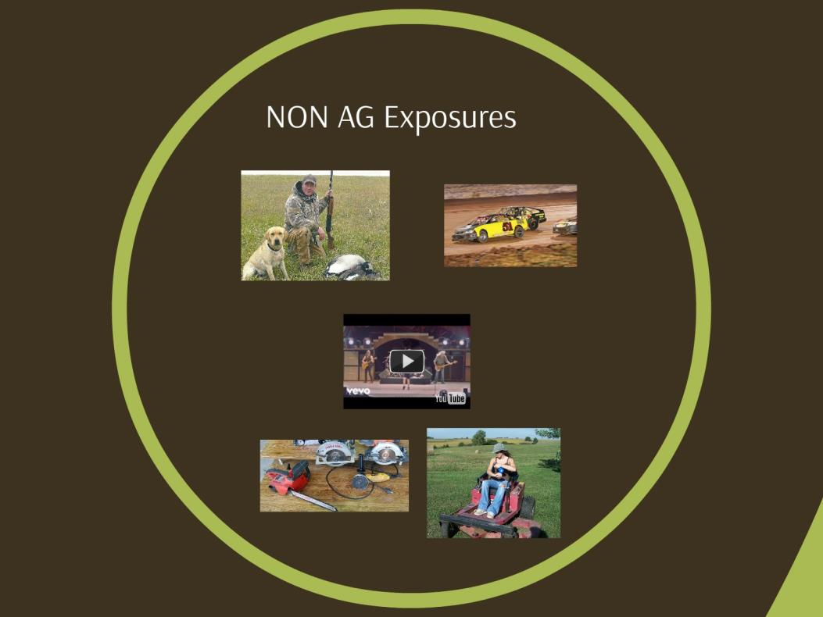
Non-ag exposures

Slide 26
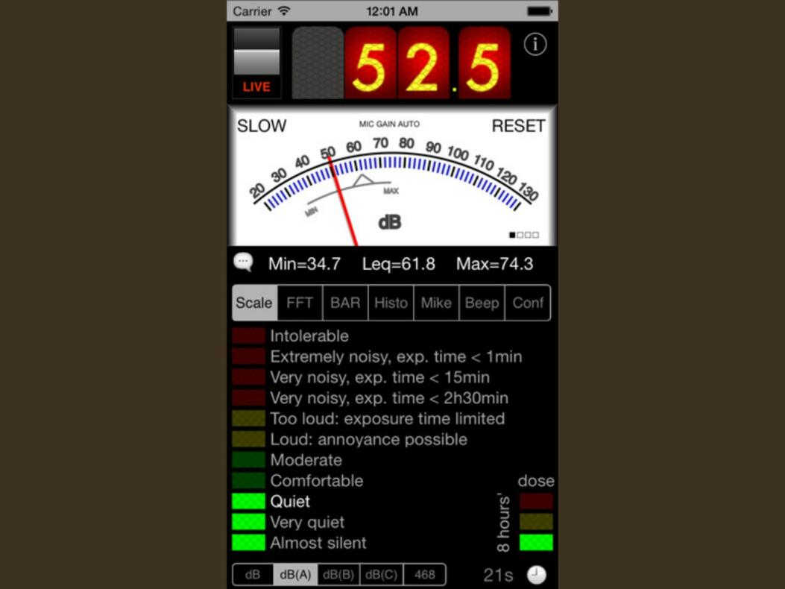
Decibel reading
Notes:
What about NON Ag exposures? Hunting –guns are an example of exposure that you should be wearing hearing protection at all times. How many of your shot guns? Car racing? Do you listen to music? Where do you listen to music? Power tools. Lawn mowing. Music is perhaps the biggest exposure that you have. https://www.youtube.com/watch?v=HQywr-PBR_o I also enjoy music but we all need to take a break – at least 5 minutes every hour. Step away from or turn down the music. Allow those hair cells to stand back up.

Slide 27

Sound meter phone apps
Notes:
There are ways to know what noise levels are: Sound meter aps. Take out your phone and download one now. They are free. Someone in the room – show me a sound meter ap. Here is the one I have.

Slide 28
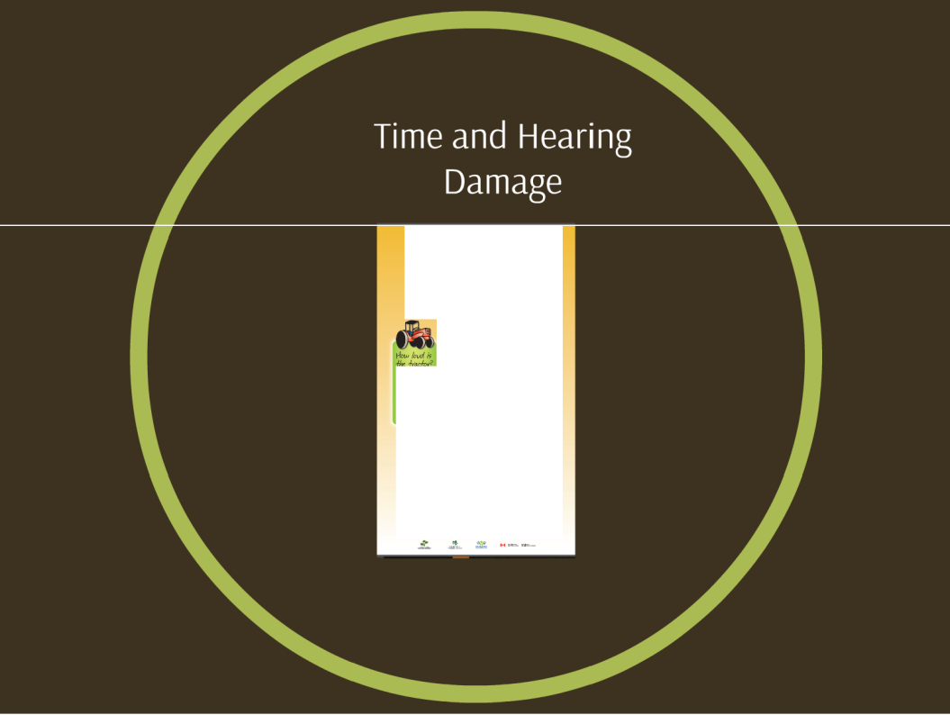
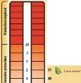

Time and hearing damage
Do Ineed hearing
protection atthe farm?
NOISETHERMOMETER
01;caa1"1
"'
"....._{9,,,}r..,.,.,,4..1,
"m'i)--·
"'
"P-·"Y"
tH• -r 1 •q
"'""'
lotA -rv1mfQ
IO'\.:U
"
90111 '_{w}"f.l_{u}lr._{u}•"1
•di- [·
:e°"J...-.
.. G .,,.,,..-
: --.
.. Q c-;o.
"10
t Q (.,....r'"'°"',,,...;
If you need to shout to talk to someonewho is three feetaway,YOU NEED PROTECTION
Notes:
Remember it is about the time you are exposed and the loudness of the noise. Know the common levels of noise and find out the ones you don’t know.

Slide 29
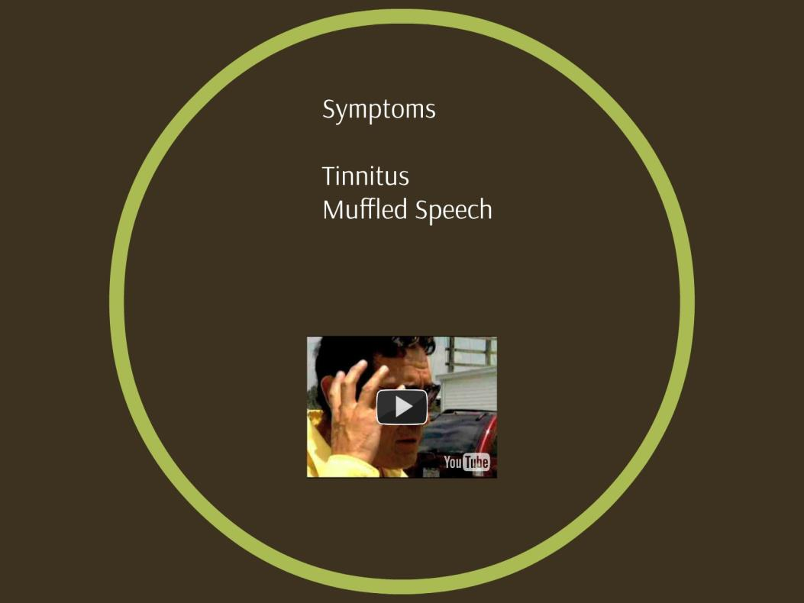
Symptoms of hearling loss
Notes:
Symptoms related to noise induced hearing loss.
Tinnitus (ringing in your ears) Muffled speech. How many of you have experienced this? When?

Slide 30
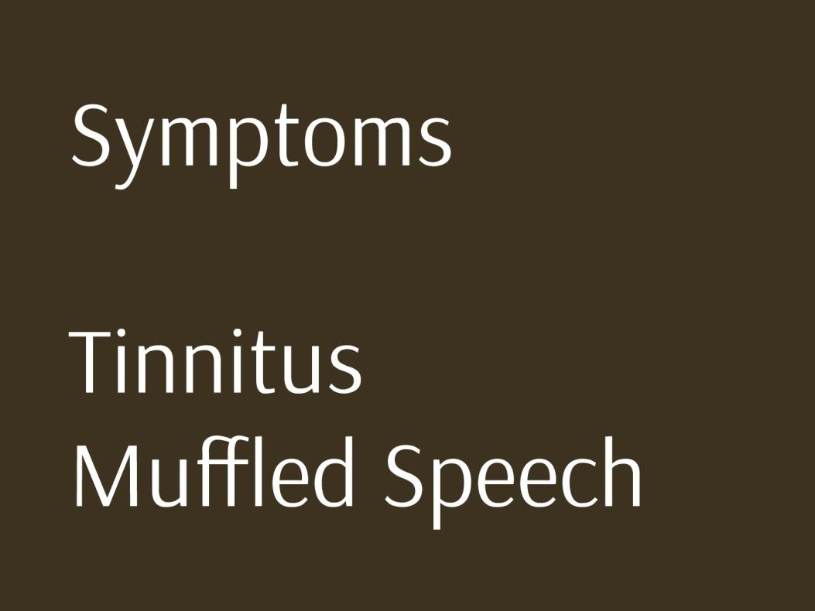
Sumptoms
Notes:
Tinnitus (ringing in your ears) Muffled speech. How many of you have experienced this? When?

Slide 31
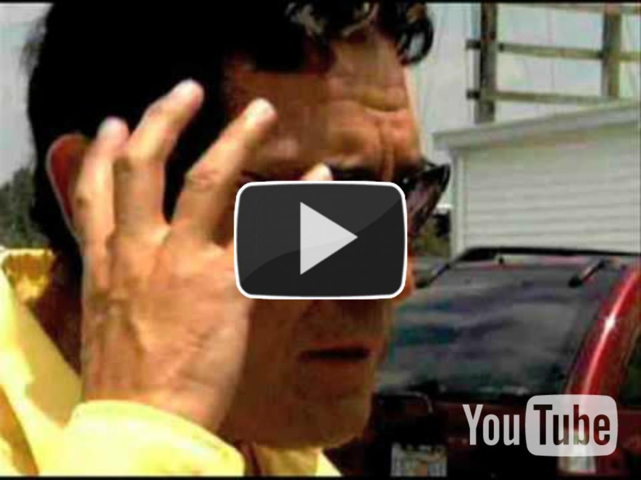
You Tube Video
https://www.youtube.com/watch?v=YyMxwalVdBU
Notes:
Video of what tinnitus sounds like. 30TUhttps://www.youtube.com/watch?v=YyMxwalVdBUU30T

Slide 32

Prevention Matters
Notes:
Prevention DOES matter! What does prevention look like for hearing loss?

Slide 33
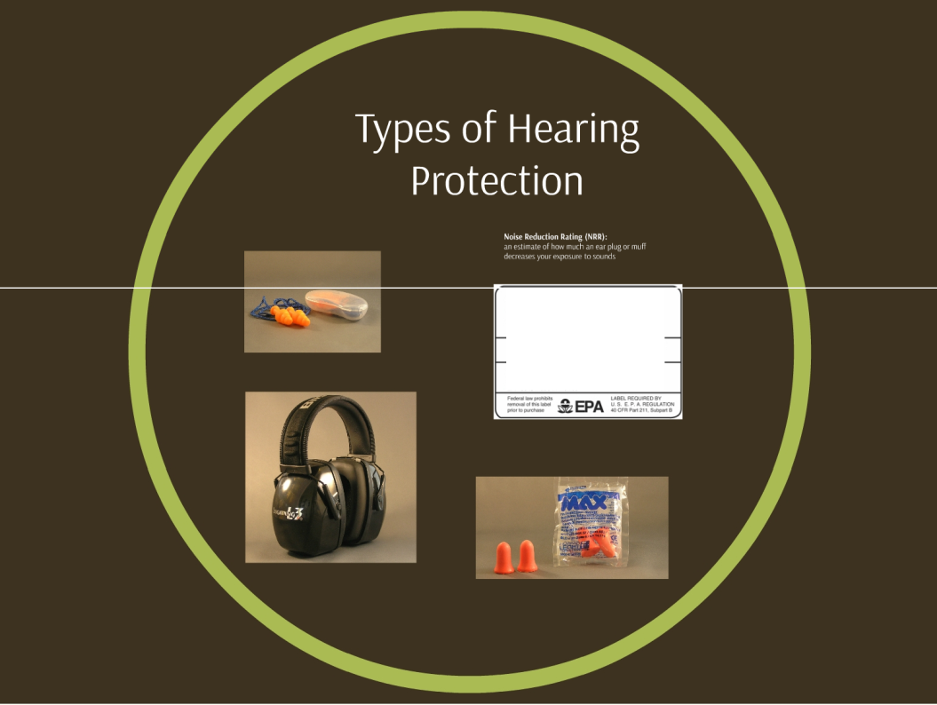
Hearing protection
Noise Reduction Rating
30 DECIBELS WHEN USED AS DIRECTED
THE RANGE OF "'°4.SE REOIJCTlON AAT'INGS FOA E>clSTaMO HEARINO PROTECTORS IS APPROXIMATELY 0 TO 30. (HIOMCA HUMKAS DENOTE GAEATtA £mCTIVC"lliSS)
-Leln<Mlries
Son Diogo, CA 112154
LPF·1 is made In USA LPF..30 is made inMe.11.ico
MOOElNO LPF
Notes:
Aside from staying out of the noise – there are different types of Hearing Protection

Slide 34
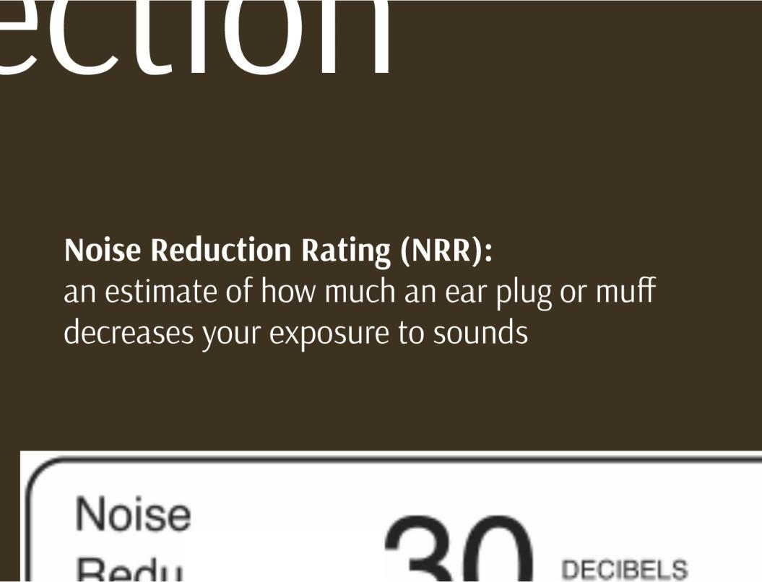
Noise reduction ratings
. .
r n
Notes:
Important facts: NRR = Noise Reduction Rate – this means it is an estimate of how much an ear plug or muff decreases your exposure to sounds.

Slide 35
Noise rating label
Notes:
Here is an example

Slide 36
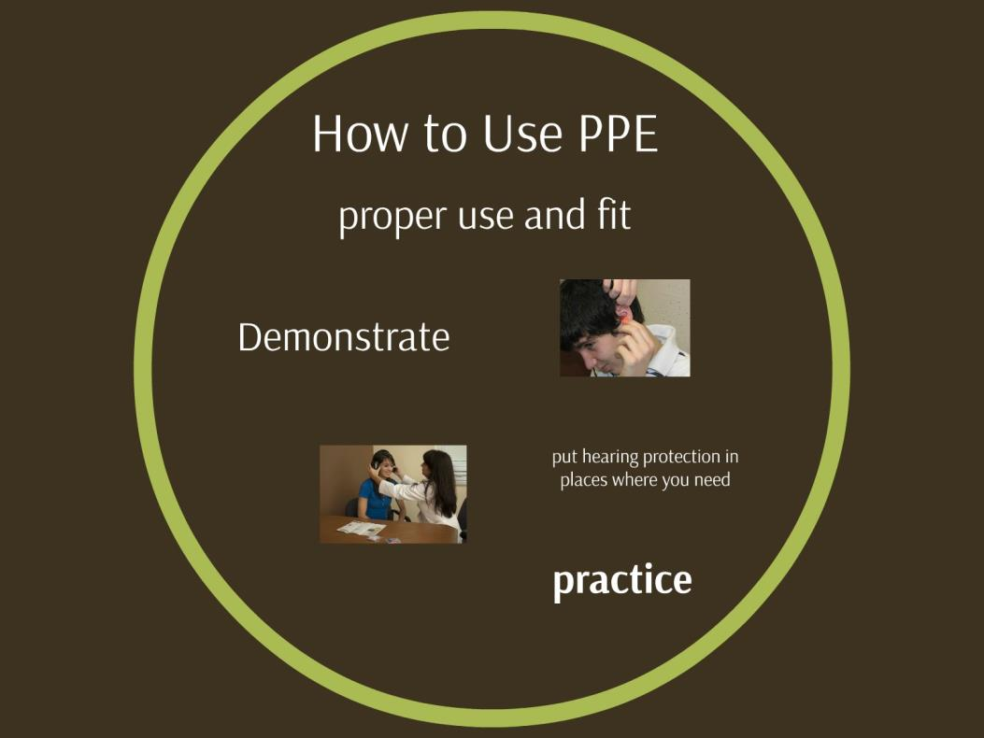
Proper used of PPE
Notes:
It is important to use PPE correctly.

Slide 37
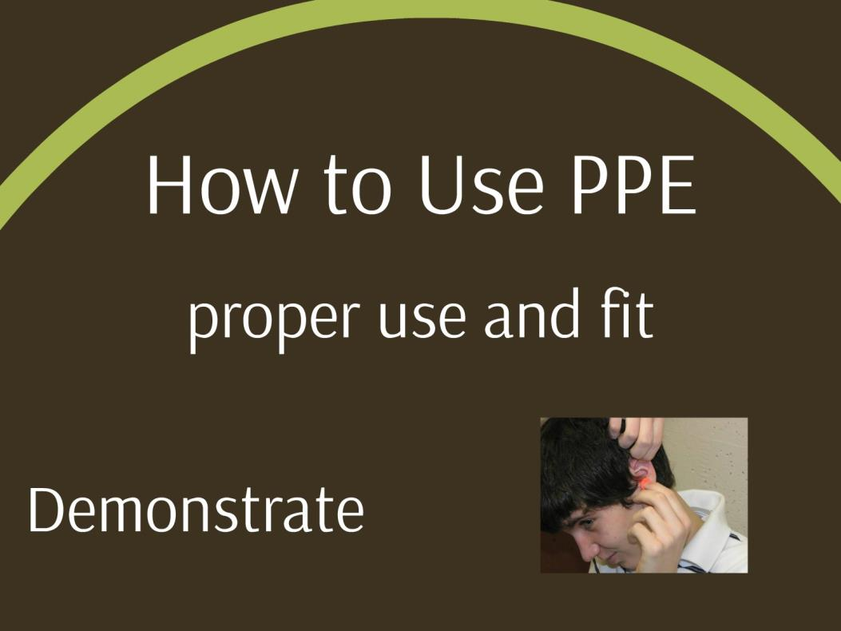
PPE demonstration
Notes:
Demonstration of proper insertion of ear plugs. Raise hand over you head and insert.

Slide 38
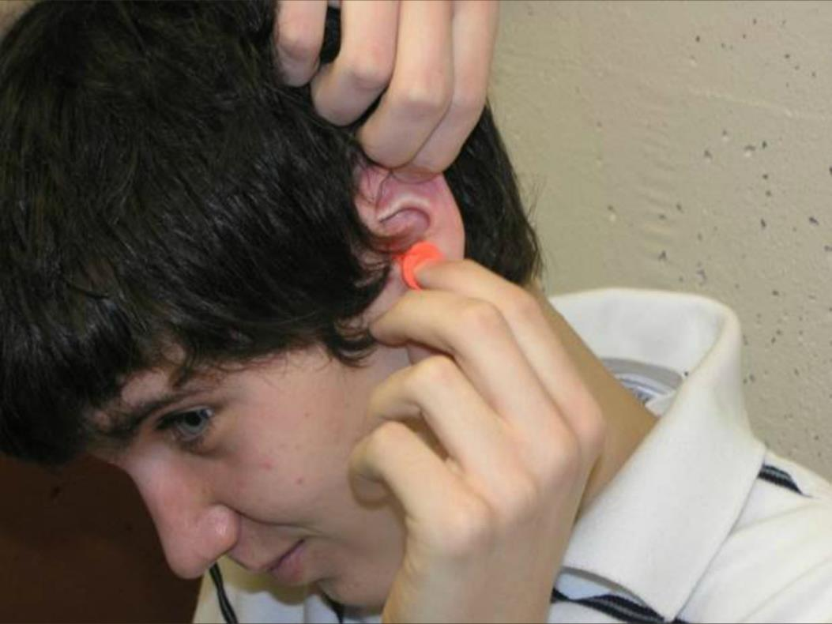
Proper insertions
Notes:
Demonstration of proper insertion of ear plugs. Raise hand over you head and insert.

Slide 39
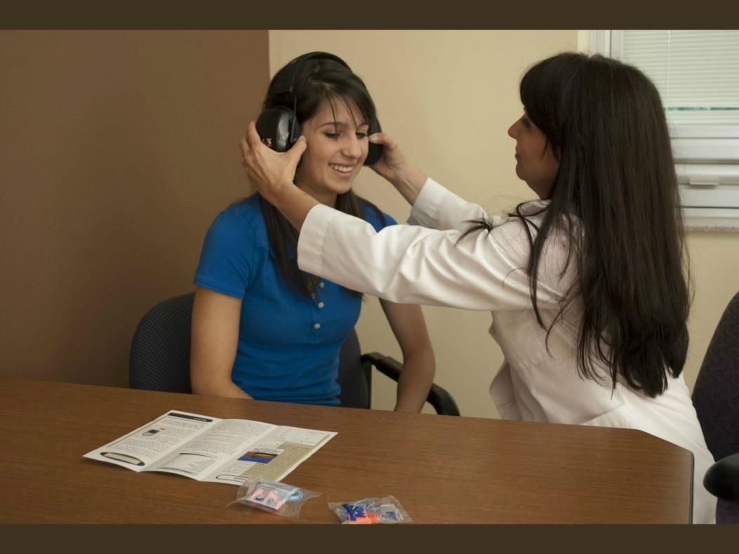
Fitting hearing muffs
Notes:
Ear muffs must fit correctly. There are many brands and types

Slide 40
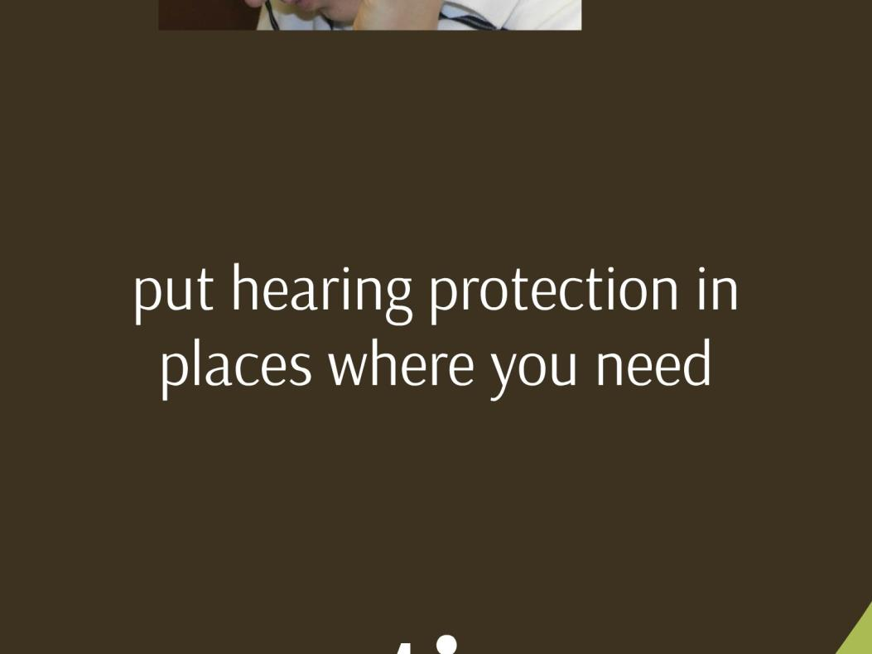
Access to hearing protection

Slide 41

Hearing loss prevention now
Notes:
NOW What? The top 5! 1. Noise induced hearing loss is preventable. 2. The result of hearing loss is function of sound level and exposure time. Noise over 85 dBA is hazardous. Know your exposures. 3. If you need to shout to talk to someone who is 3 feet away you need hearing protection. Down load a sound meter AP. 4. The best hearing protection is protection that you wear! Remember the 4 C’s --- a. Comfort b Convenient c. Communication, d. Caring Monitor your hearing health every 2 years with hearing testing.

Slide 42
Say What? Hearing loss
Notes:
Say What? Do not let hearing loss happen to you!

Slide 43

Workers Rights
Youhave the righl 10:
A sale and healthfulworkplace
Know aboul hazardous chemicals
Information aOOut injuriesand iltnesses in
your workplace
Train ng
Accoss Illhauird eposure and rnad1cal
reoords
File acomplaintwittl OSHA Participate in an OSHA inspection
Bo ftcc from retaliation for exercising safety and health rights
Complain or requaslhazard corracllon from employer
Notes:
It is important to know your rights as an employee

Slide 44

Employee Rights
Protecting lhe Peoplewho FeedAmeriea
You have the right to:
A safe and healthf ul workplace
Know about hazardous chemicals
Information about injuries and illnesses in your workplace
Complain or request hazard correction from employer
Notes:
Right to a safe work environment

Slide 45

Employee Rights
Protecting lhe Peoplewho FeedAmeriea
You have the right to:
Training
Access to hazard exposure and medical records
File a complaint with OSHA
Participate in an OSHA inspection
Be free from retaliation for exercising safety and health rights
Notes:
Right to training

Slide 46

Whistle Blower Protection Program
Notes:
Understand the whistle Blower protection program

Slide 47

OSHA Disclaimer
.-.....-........,....
SIJ'fhcw TranspOl'tiftionAsS1stM1C•Acf
{181) <byS)
To$mSQl'ICPsCtmtro1 Act C30 d
WWll'IPIH.Fr.J,dAll'krtion /'""'s.tmtlf MJd
Rf/form Act IMIMZ,,. CIHWIYl90da'f6>
Unfavorable Personnel Aebons
wtit:ton c:onl!)l*it lOU'IOCbSOi>t OSHA rogieln:ll
oraruoffic9 \Nhl-.n(l(lml)l.il nts mwvbe filllcl b¥ t1es1mno,otoetronk COfM'Ulie3dan, hand oonvorv dunnobusln006hOl.#'s.. us.mslltc:onflm'latton
SlillVicos.OJodwrlhirrty
.................._....
commete1al camer.The date oC the POStm<ttl(.
».:.
:1 •
SH-27642-SH5

Slide 48
Test questions
Pre and Post Test Questions
I need to be concerned about noise levels
  That are 85 decibels and above
  That are 90 Decibels and above
c. If I have to raise my voice if someone is 5 feet away
Hearing loss from noise
  Causes temporary damage to hair cells in my ear
  Can be improved when I stop being exposed to loud noises
c. Is related to the decibel level of the noise and time of exposure
d. Al I of the above except b
Hearing loss impacts my speech banana.
True / False/ I don't know
The noise from a lawn mower is the same as a pig squeal. True/ False
A person who can hear conversation does not have hearing loss. True/ False

Slide 49
Test questions Answer Key
Pre and Post Test ANSWER KEY
a. That are 85 decibels and above
c. Is related to the decibel level of the noise and time of exposure
True
False
False

Slide 50
Training evaluation
Evaluate the Training
Questions about the Instruction
  The instructor was well prepared.
  The instructor was knowledgeable on the subject matter
  I plan to share this information with my family and or friends
I will take steps to protect my hearing because of this training.

