Slide 1
RESPIRABLE CRYSTALLINE
SILICA
A Review of OSHA’s New Standard
(29. CFR. 1926.1153)

Slide 2
Acknowledgement
UNITED STATES
DEPARTMENT OF LABOR
Occupational Health and Safety Administration (OSHA)
Susan Harwood Training Grant
SH-29666-SH6
This material was produced under a grant (SH-29666-SH6) from the Occupational Health Administration, U.S. Department of Labor. It does not necessarily reflect the views or policies of the U.S. Department of Labor, nor does it mention of any trade names, commercial products, or organizations implying endorsement by the U.S. Government.
Notes:
This material was produced under a grant (SH-29666-SH6) from the Occupational Health Administration, U.S. Department of Labor, by Wayne State University. It does not necessarily reflect the views or policies of the U.S. Department of Labor; nor does it mention of any trade names, commercial products, or organizations implying endorsement by the U.S. Government.

Slide 3
Disclaimer
The materials presented herein are for information and awareness purposes. In no instances and under no conditions should they be used as a reference for compliance with the OSHA Respirable Crystalline Silica Standard ( 29 CFR 1926.1153). The link to obtain a copy of the standard is provided below.
OSHA RESPIRABLE CRYSTALLINE SILICA STANDARD (29 CFR 1926.1153)
Notes:
Wayne State University declares that the materials presented herein are for information and awareness purposes only. In no instances and under no conditions should they be used as a reference for compliance with the OSHA Respirable Crystalline Silica Standard ( 29 CFR 1926.1153). The link to obtain a copy of the standard can be found in OSHA RESPIRABLE CRYSTALLINE SILICA STANDARD (29 CFR 1926.1153).

Slide 4
Overview
    Introduction
      Worker Rights under OSH Act
      Respirable Crystalline Silica and Silica Exposures
      Silica Exposure Associated Health Risks
    New OSHA Standard on Respirable Crystalline Silica
      Permissible Exposure Limit and Action Level for Construction
      Scope and Definitions
      Compliance Dates
    Silica Exposure Control Methods for Construction
      Specified Exposure Control Methods
        Engineering Controls
        Workplace Controls
        Table 1 Details
Notes:
An overview of the whole respirable crystalline silica training is presented herein. This training covers workers rights under OSH Act, health hazards associated with silica exposure, specific workplace tasks that could expose employees to silica, and specific measures that can be implemented to protect employees from harmful exposure to silica. The contents of the new silica standard are covered in this presentation.

Slide 5
Overview – cont.
    Mandatory Requirements for Silica Exposure Control
      Respiratory Protection
      Housekeeping
      Written Exposure Control Plan and Competent Person
      Medical Surveillance
      Communication of Silica Hazards (HazCom)
      Recordkeeping
    Alternative Exposure Control Methods
      Exposure Assessment and Reassessment
      Performance and Scheduled Monitoring Options
      Methods of Sample Analysis
      Employee Notification
      Methods of Compliance – Hierarchy of Controls
      Ventilation (29 CFR 1926.57)
    Compliance Summary
Notes:
Refer to the notes under the previous slide.

Slide 6

Purpose of This Training
  OSHA has issued a new standard (CFR 1926.1153) to curb respirable crystalline silica related diseases in the US workers by limiting their exposure to respirable crystalline silica
  The training provided here aims at
    Increasing workers’ awareness of the serious health hazards of silica dust
    Providing the knowledge necessary to perform work safely when there is silica exposure, and ways to limit silica exposure to levels below the Permissible Exposure Limit (PEL)
Notes:
The training provided here aims at
Increasing workers’ awareness of the serious health hazards of silica dust
Providing the knowledge necessary to perform work safely when there is silica exposure, and ways to limit silica exposure to levels below the Permissible Exposure Limit (PEL)
Properly trained workers are more likely to realize the severity of silica hazards, and be prepared for identifying which work operations can lead to silica exposure, as well as knowing how they can work safely around crystalline silica-containing dust by using engineering and workplace controls, and personal protective equipment.

Slide 7
The Training Process – Step by Step
SIGN-UP
PRETEST
to measure trainee's existing knowledge
SILICA TRAINING MODULE COVERAGE
POSTTEST
to measure the knowledge gain
OPINION SURVEY
to give feedback for improvement
Notes:
A typical training session flowchart is presented above. Training starts with sign-up to collect demographic and background information on the trainees. This is followed by a pre-test consisting of 25 questions that aim to measure the existing knowledge level of the trainees on topics covered in the new respirable crystalline silica standard. This will establish a baseline that can be compared to the post test results to assess the effectiveness of the provided training. The third step in a typical session is the lecture part where the previously outlined module is covered slide by slide. After this, the trainees are given the posttest which is identical to the pretest. Improvement of scores from pretest to posttest will signify learning attributable to training. Lastly, trainees fill out the opinion survey designed to measure the trainees’ reaction to the training program and experience. This feedback is used to make an overall assessment of the training, and to establish strategies for improving the module, and training delivery.

Slide 8
SIGN-UP
PLEASE FILL OUT THE SIGN-UP SHEET
Notes:
Trainer distributes the sign-up sheet to the trainees.

Slide 9
PRETEST
PLEASE START THE PRETEST
( maximum 15 MIN)
Notes:
Trainer hands out the “Pretests” to the trainees.

Slide 10
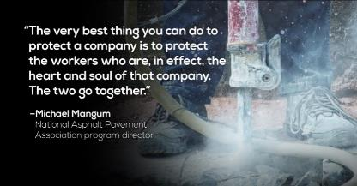
Worker Rights under OSH Act
Workers are entitled to safe and healthful working conditions. The OSH ACT provides workers with the right to:
    Ask OSHA to inspect their workplace
    Review employers’ records of work-related injuries and illnesses
    Get copies of their medical records
    Receive information and training about hazards and their prevention, using applicable OSHA standards.
Notes:
Workers are entitled to working conditions that do not pose a risk of serious harm to them. To help ensure a safe and healthful workplace, the OSH Act provides workers with the right to ask OSHA to inspect their workplace; use their rights under the law without fearing retaliation and/or discrimination; receive information and training about existing hazards, and the methods of prevention. Under the OSH Act, workers also have the right to ask for the OSHA standards that apply to their workplace; get copies of test results regarding the hazards in the workplace; review records of work-related injuries and illnesses; and get copies of their medical records.

Slide 11
Worker Rights under OSH Act – cont.
Workers may file a complaint with OSHA.
Employers may not retaliate by taking unfavorable personnel action against them for whistleblowing.
  For more information refer to the hyperlink below Whistleblowers’ Rights
Whistleblower laws require that complaints be filed with OSHA within certain time limits following the alleged retaliation.
Notes:
Workers may file a complaint with OSHA if the employer retaliates by taking unfavorable personnel action against them because workers are engaged in protected activity relating to workplace safety or health, asbestos in schools, cargo containers, airline, commercial motor carrier, consumer product, environmental, financial reform, food safety, health insurance reform, nuclear, pipeline, public transportation agency, railroad, maritime, motor vehicle safety, and securities laws.
Employers cannot punish workers in any way for:
Reporting an injury or illness;
Complaining to your employer, union, OSHA or other agencies about safety and health problems;
Filing safety and health grievances;
Participating in safety and health committees; or
Participating in OSHA inspections and other OSHA-related activities.
If it is believed that the employer retaliated against the worker because of exercising his/her legal rights as an employee, the worker must contact OSHA as soon as possible. the complaints must be filed within the legal time limits. An employee can file a complaint with OSHA by visiting or calling the local OSHA office or sending a written complaint to the closest OSHA regional or area office. Written complaints may be filed by facsimile, electronic communication, hand delivery during business hours, U.S. mail (confirmation services recommended), or other third-party commercial carrier.
If a worker is fired, demoted, transferred or discriminated against in any way for using his/her rights under the law, he/she must he/she must file a complaint with OSHA within 30 days.

Slide 12

Right to Know
Federal Hazard Communication Standard, Title 29, Part 1910.1200 of the Code of Federal Regulations (29 CFR 1910.1200) mandates that “Workers have the right to know and understand the hazardous chemicals they use and how to work with them safely.”
Employer must make this information available to
employees.
The hazard communication standard applies to any business, including manufacturers that use hazardous chemicals, regardless of the number of individuals employed.
Notes:
The Federal Hazard Communication Standard, Title 29, Part 1910.1200 of the Code of Federal Regulations (29 CFR 1910.1200) mandates that “Workers have the right to know and understand the hazardous chemicals they use, and how to work with them safely.” This regulation is designed to make information about hazardous chemicals that are present in work places available to exposed employees. The hazard communication standard applies to any business, including manufacturers that use hazardous chemicals, regardless of the number of individuals employed.

Slide 13

What is Respirable Crystalline Silica?
Crystalline silica is a common mineral found in many naturally occurring and man-made materials used at construction sites - Examples:
  Sand
  Concrete
  Brick
  Block
  Stone
  Mortar
Silicon Dioxide
SiO₂
Notes:
The term “silica” refers specifically to the compound silicon dioxide (SiO²). It is the most abundant compound in the earth’s crust, making up 59% of its total composition. (https://www.britannica.com/science/silica). Silica is a major component of sand, rock, and mineral ores. Silica in crystalline form has three varieties: quartz , tridymite and cristobalite. Quartz is by far the most abundant and the most common form of crystalline silica. Quartz (crystalline silica) is a common mineral found in many naturally occurring and man-made materials like sand, portland cement, concrete, brick, block, stone and mortar used at construction sites.

Slide 14
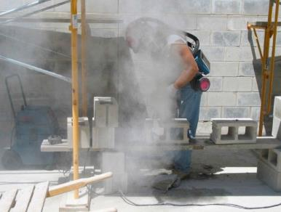
What is Respirable Crystalline Silica? – cont.
Respirable crystalline silica – very small particles (1/100 the size of beach sand or smaller), generated by high-energy operations like
  Cutting
  Sawing
  Grinding
  Drilling
  Crushing and abrasive blasting (of silica containing materials)
Handheld masonry saw without dust controls creates silica dust while cutting cinder blocks. (Photo courtesy of New Jersey Department of Health).
Notes:
Crystalline silica may become respirable sized particles (very small particles typically at least 100 times smaller than ordinary sand found on beaches or playgrounds) by high-energy operations like cutting, sawing, grinding, drilling and crushing silica containing material, stone, rock, concrete, brick, block and mortar, or when abrasive blasting with sand.

Slide 15
Silica Exposure
Industries, Occupations And Materials
INDUSTRY Do you work in any of these?
Abrasive blasting Asphalt pavement manufacturing Blast furnaces Cement manufacturing Ceramics, clay, and pottery Concrete mixing Concrete tunneling Construction (mainly cement, concrete work) Demolition Electronics industry Foundry industry: grinding, molding, shakeout, core room (High Risk) Hand molding, casting, and forming Jack hammer operations Manufacturing abrasives, paints, soaps, and glass Mining Repair or replacement of linings of rotary kilns and cupola furnaces Rolling and finishing mills Sandblasting (High Risk) Setting, laying, and repairing railroad track Steelwork Stone, brick, and concrete block cutting, blasting, chipping, grinding, and sawing Tunneling operations
OCCUPATIONS Are you one of these?
Brickmason / stonemason Construction laborer Crane and tower operator Crushing and grinding machine operator Furnace, kiln, non-food oven operator Grinding, abrading, buffing, and polishing machine operator Hand molder/shaper (not jeweler) Heavy-equipment mechanic Janitor or cleaner Machinist Metals/plastics machine operator Molding and casting machine operator Mining machine operator Miscellaneous material moving equipment operator Millwright Operating engineer Painter who sandblasts (High Risk) Production supervisor Rock driller (High Risk) Roof bolter (High Risk) Sandblaster (High Risk) Steelworker Welder/cutter
MATERIALS Are any of these involved?
Abrasives Coal Dust Concrete Dirt Filter Aids Graphite, natural Mica Mineral Products Paints Pavement Perlite Plant Materials Plastic Fillers Polishing Compounds Portland Cement Sands Silicates Slag Soapstone Soil
Source: OSHA’s Silica eTool
Notes:
If you can identify with any of the above terms in your industry or occupation, or the materials you work with, it is likely that there may be airborne silica around you, and you may be exposed to it. Note that new uses of silica continue to emerge. These include countertop manufacturing, finishing, and installation (Kramer et al. 2012; OSHA 2015), and hydraulic fracturing in the oil and gas industry (OSHA 2012). However, remember that there is potential for danger ONLY when crystalline silica particles are in the air. There may be materials that contain silica but if the operations on those materials do not generate dust, there is little chance of inhaling the silica. Likewise, there may be silica particles in the air even though you don't see any dust.

Slide 16
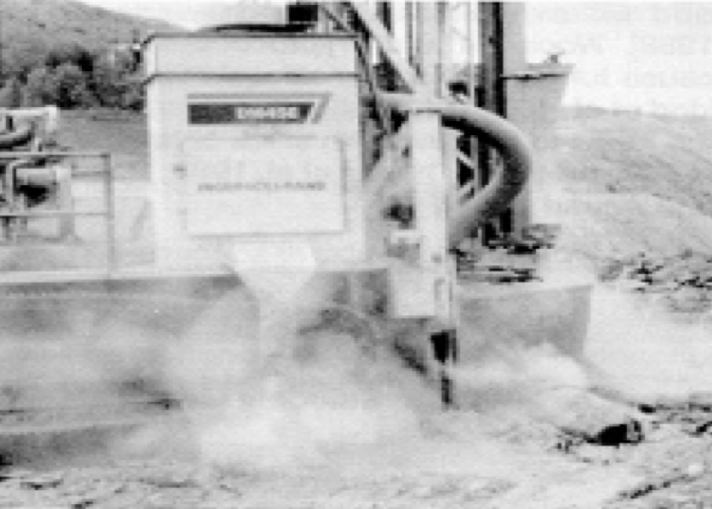
Construction Activities Likely to Cause Silica Exposure
Construction activities that may result in severe silica exposure include, but are not limited to:
  Jack hammering
  Masonry building construction
  Masonry or concrete building demolition
  Brick and concrete block cutting and sawing
  Tuckpointing
  Tunneling
  Earthwork and rock crushing
  Road construction and repair
  Rock/well drilling
  Abrasive blasting with sand or other silica- containing materials
  Abrasive blasting on silica-containing materials eg. concrete.
  Concrete mixing and drilling or mixing concrete for post holes
  Pouring concrete footers, slab foundation, and foundation walls
  Removing concrete form work.
  Others
Earth-drilling rigs operated with no dust controls may produce high levels of silica in the air. (Photo courtesy of NIOSH).
Notes:
Certain construction activities may result in severe silica exposure. These activities can be listed as: jack hammering, masonry building construction, demolition (masonry or concrete building), brick and concrete block cutting and sawing, tuck pointing and tunneling operations, earthwork and rock crushing, road construction and repair, rock/well drilling, abrasive blasting (Sand or blasting with other silica containing materials), blasting on silica-containing materials (e.g. concrete), concrete mixing and drilling or mixing concrete for post holes; pouring concrete footers ,slab foundations ,and foundation walls; removing concrete form work and others.

Slide 17

Warning!!!
ALWAYS REMEMBER
SILICA IS MORE THAN JUST A DUST !
Notes:
Construction workers should know that “Silica is more than just a dust !” Exposure to fine silica dust may have adverse health effects.

Slide 18

Health Risks Associated with Silica Exposure
Exposure to respirable crystalline silica has been linked to
  Silicosis – An irreversible, often disabling, and sometimes fatal fibrotic lung disease
    Typically occurs after many years of low to moderate exposures to silica dust.
    If one has silicosis, Tuberculosis (TB) may also be developed
  Lung cancer
    Occurs after exposures to very high concentrations of silica
  Chronic obstructive pulmonary disease (e.g., bronchitis )
  Kidney and immune system diseases
Notes:
Employers are required to protect their employees in construction from the hazards associated with silica exposure.
Workers exposed to respirable crystalline silica are at increased risk of developing serious adverse health effects. Exposure to fine (respirable sized) particles of crystalline forms of silica may lead to silicosis, an irreversible, often disabling, and sometimes fatal fibrotic lung disease. Other harmful or fatal consequences are lung cancer, chronic obstructive pulmonary disease (COPD), and activation of latent TB infections.
It should be understood that the higher the cumulative exposure of a worker, the higher the risk of health effects.

Slide 19
Types of Silicosis
There are 3 types of silicosis:
    Acute form:
  Intense exposure to respirable dust of high crystalline silica content for a relatively short period (few months to less than 2 years)
    Accelerated form:
  Resulting from about 5-15 years of heavy exposure to respirable dusts of high crystalline silica content
    Chronic form:
  Most common form
  Less intense exposure and usually more than 20 years
Source: Docket OSHA-2010-0034
Notes:
There are three different forms of silicosis: acute, accelerated, and chronic.
Acute silicosis is a rare disease caused by inhalation of extremely high (intense) levels of respirable crystalline silica particles and is almost always fatal.
Accelerated silicosis generally occurs within 5-15 years of exposure and results from heavy levels of exposure to respirable crystalline silica.
Chronic silicosis is the most common form of silicosis, which can result from less intense exposure; it occurs usually after more than 20 years of exposure to respirable crystalline silica.

Slide 20
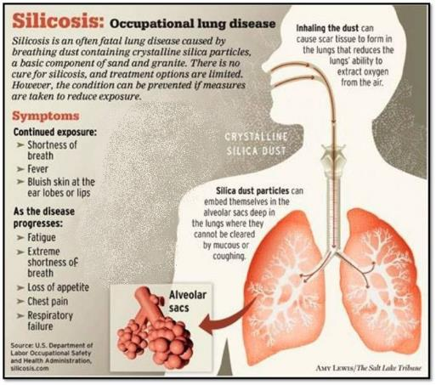
Symptoms of Silicosis
Symptoms of silicosis
  Shortness of breath
  Fever
  Bluish skin at the ear lobes or lips
Notes:
There are several stages of silicosis. Early stages may go completely unnoticed. Continued exposure may result in the exposed person noticing a shortness of breath upon exercising, possibly having fever and occasionally bluish skin at the ear lobes or lips. Silicosis makes a person more susceptible to infectious diseases of the lungs, like tuberculosis. Progression of the disease leads to fatigue, extreme shortness of breath, loss of appetite, pain in the chest, and respiratory failure, which all may lead eventually to death. Employees with these symptoms should immediately receive further evaluation and treatment.

Slide 21
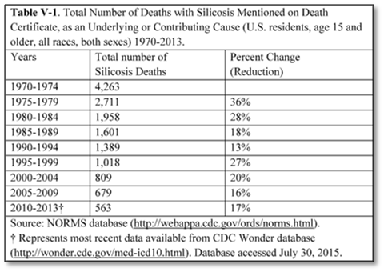
Silicosis Mortality Rate
Over time, silicosis-related mortality has diminished in the US but has not been stopped.
One of the biggest industry
concerns is that little or no
improvements have been
made since the 1990’s.
Especially in the past decade,
mortality rate for silicosis has
remained relatively constant.
Therefore, revamping
of related regulations
became necessary
Construction industry has led all others in silicosis mortality rate.
Source: Norms database (www.cdc.gov)
Notes:
According to the information published by the Centers for Disease Control and Prevention (CDC) between 1970 to 2013, silicosis was an underlying or contributing cause of death recorded on 14,991 death certificates. Further, Construction industry led all others in silicosis mortality rate. Over time, silicosis-related mortality has declined in the U.S., but has not been eliminated. We see a relatively stable trend especially in the past decade. Since the year 2000, there have been 100 to 150 silicosis cases in the US. (https://www.cdc.gov/mmwr/preview/mmwrhtml/mm6423a7.htm)
OSHA estimates that about two million construction workers are exposed to respirable crystalline silica in over 600,000 workplaces, and more than 840,000 of these workers are exposed to silica levels that exceed the new permissible exposure limit (PEL). (OSHA fact sheet; https://www.osha.gov/Publications/OSHA3681.pdf)

Slide 22
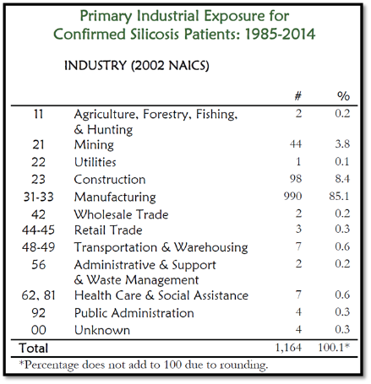
Silicosis Statistics
The predominant industries:
  Manufacturing (85%)
  Construction (8%)
  Mining (4%)
Notes:
An annual report published by NIOSH (National Institute for Occupational Safety & Health) indicates that silicosis cases are most prevalent in the manufacturing industry. Construction industry is the second highest industry relative to the number of confirmed silicosis patients between 1985 and 2014.
(http://www.oem.msu.edu/userfiles/file/Annual%20Reports/Silica/2014Silicosis_OLDSANNRPT.pdf)

Slide 23
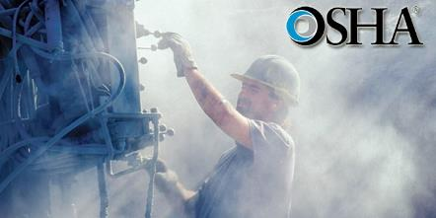
Authorities on Silica Regulation
Prevention and elimination of silicosis and silica-related disease in United States are priorities of
  National Institute for Occupational Safety and Health (NIOSH)
  Occupational Safety and Health Administration (OSHA)
  Mine Safety and Health Administration (MSHA)
  American Lung Association
Notes:
Prevention and elimination of silicosis and silica- related disease in the United States are priorities of National Institute for Occupational Safety and Health (NIOSH), Occupational Safety and Health Administration (OSHA), Mine Safety and Health Administration (MSHA), and the American Lung Association (ALA).
Educating workers about silicosis is crucial, since there may be lifelong health complications, including fatal consequences. For example, in the image presented above the worker is aware of importance of personal protective equipment usage, and he uses gloves, hard hat, as well as hearing protection. However, he misses an important PPE, a “respirator” to protect himself from heavy silica exposure. Also, the dust cloud visible in the picture most likely indicates that either the required engineering controls are not being used or are ineffective.

Slide 24
Silica Related OSHA Standards and Directive Applicable to Construction Industry
Several OSHA standards and directives cover operations that may expose workers to silica, including
  Air Contaminants (29 CFR 1910.1000)
  Hazard Communication (29 CFR 1910.1200)
  Respiratory Protection (29 CFR 1910.134)
  Ventilation (29 CFR 1926.57)
  Respirable Crystalline Silica (29 CFR 1926.1153)
OSHA’s Directive CPL 03-00-007 - National Emphasis Program- Crystalline Silica- has detailed information on
  Silica hazards
  Guidelines for air sampling
  Guidance on calculating PELs for dust containing silica
  Other compliance information (OSHA’s Directive CPL 03-00-007)
The new published standard dedicated solely to Respirable Crystalline Silica
Notes:
There are several OSHA standards and directives that cover operations that may expose workers to crystalline silica. These standards include Air Contaminants (29 CFR 1910.1000), Hazard Communication (29 CFR 1910.1200), Respiratory Protection (29 CFR 1910.134), and Ventilation (29 CFR 1926.57). Now, the new standard is dedicated solely to Respirable Crystalline Silica (29 CFR 1926.1153).
OSHA’s previous directive (Directive CPL 03-00-007 ), that covers policies and procedures to identify, reduce or eliminate the health hazards associated with occupational exposure to crystalline silica, has been the basis of implementing a National Emphasis Program. This directive provided information on the silica hazard, guidelines for air sampling, and guidance on calculating PELs for dust containing silica.

Slide 25
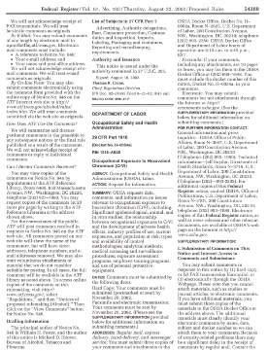
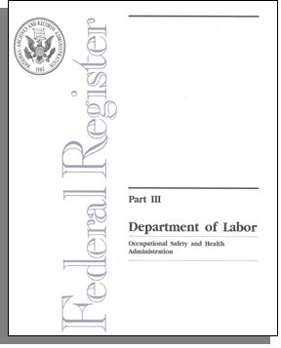
OSHA’s New Respirable Crystalline Silica Standard
Hazards associated with Silica exposure has been recognized since the 1930s
New rule updates silica exposure regulations previously established in 1971 for general industry
  Construction is now covered separately
OSHA estimates that the new standards will cut exposure for vulnerable workers as much as 5 times
Notes:
The U.S. Department of Labor first highlighted the hazards of respirable crystalline silica in the 1930s, after a wave of worker deaths. The department set standards to limit worker exposure in 1971, the year OSHA was created. It is believed, however, that the old/current standard is mostly outdated and doe not adequately protect workers from silica-related diseases. Furthermore, it is being observed that workers are being exposed to silica in new industries such as stone or artificial stone countertop fabrication and hydraulic fracturing. A full review of scientific evidence, industry consensus standards, and extensive stakeholder input provide the basis for the final rule, which was proposed in September 2013.
The new crystalline silica rule was issued due to the previous construction and shipyard PELs being based on an old method of measuring worker exposures to silica, which is no longer used today. Furthermore, the previous limits were inconsistent, allowing permissible levels for construction and shipyards to be more than twice as high as the levels in general industry. According to OSHA, the revised rule will reduce the risk of disease among workers who inhale respirable crystalline silica, will provide the same level of protection for all workers covered under the Act. (https://www.osha.gov/ silica/Silica_FAQs_2016-3-22.pdf)
OSHA estimates that the rule will save over 600 lives and prevent more than 900 new cases of silicosis each year, once its effects are fully realized. The Final Rule is projected to provide net benefits of about $7.7 billion, annually. (https://www.osha.gov/silica/)

Slide 26
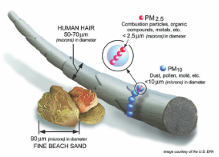
New OSHA Standard - Permissible Exposure Limit and Action Level for Construction Industry
50 μg/m³ TWA₈
in the air
Permissible Exposure Limit (PEL)
8-hour time-weighted average exposure limit (TWA₈)
Action Level
(AL)
25 μg/m³ TWA₈
in the air
Illustration: courtesy U.S. EPA
If dust containing silica is visible in the air, there is a higher likelihood/chance that permissible exposure limit (PEL) is exceeded !
Notes:
The standard requires employers to limit worker exposures to respirable crystalline silica and to take additional steps to protect workers.
It establishes a new Permissible Exposure Limit (PEL) and an Action Level (AL) averaged over an eight-hour workday. The previous Permissible Exposure Limit (PEL) was 100 micrograms per cubic meter (μg/m³ )for general industry; now it is 50 μg/m³ . This means that during the course of any 8-hour work shift, exposures can fluctuate, but the average exposure to respirable crystalline silica cannot exceed 50 μg/m³.
Action level is set to 25 μg/m³, which means where the concentration of an airborne silica is at or above the this level (25 μg/m³) for an 8-hour time weighted average, it will trigger the requirements for the application of the standard.
As a general rule, if dust containing silica is visible in the air, there is a higher likelihood/chance that permissible exposure limit (PEL) is already exceeded !

Slide 27
How Much Silica Dust is Too Much?
The safest amount of silica in the air is zero.
It only takes a very small amount of very fine respirable silica dust to create a health hazard.
DEMONSTRATION/ILLUSTRATION
Rule-of–thumb:
if dust containing silica is visible in the air, there is a higher chance of overexposure.
Notes:
It should be noted that not all dusts on construction sites contain silica, and silica is non-respirable, unless it is generated by disturbance resulting from Cutting, Sawing, Grinding, Drilling, Crushing and abrasive blasting of silica containing materials.
Recognizing that very small, respirable silica particles are hazardous, OSHA regulation 29 CFR 1926.1153 requires construction employers to keep worker exposures at or below the Permissible Exposure Limit (PEL) of 50 µg/m³ , or comply with specified exposure control methods when working with materials containing crystalline silica.
The safest amount of silica in the air is zero. However, due to nature of construction industry it is sometimes inevitable to get exposed to silica dust; therefore, workers should be trained on how to protect themselves from unacceptable levels of respirable crystalline silica exposure (i.e. above the Action Level, AL).

Slide 28

OSHA Silica Standard
Scope and Application
Applies to all occupational exposures to respirable crystalline silica in construction work
  Exception:
  The standard does not apply if the exposure is below the allowed AL as an 8-hour time-weighted average (TWA) under any foreseeable conditions
Notes:
The Respirable Crystalline Silica Standard (29 CFR. 1926.1153 applies to all related occupational exposures in construction work, except where employee exposure will remain below 25 micrograms per cubic meter in air, that is 25 μg/ m³ averaged over an 8-hour period (TWA) under any foreseeable conditions.

Slide 29
OSHA Silica Standard
Definitions
Permissible Exposure Limit (PEL): The maximum amount or concentration of a chemical that a worker may be exposed to under OSHA regulations. (50 μg/m³)
Time Weighted Average (TWA) : The time-weighted average exposure for the work shift.
Action Level: Exposures at or above this concentration (25 μg/m³ 8-hour TWA), trigger requirements for exposure assessment (std applies).
Competent Person: Designated person capable of identifying existing and foreseeable respirable crystalline silica hazards, and has authorization to take prompt corrective measures to eliminate/minimize them. Must have knowledge and ability to implement exposure control plan.
Notes:
The standard presents definitions for certain key words, which are as follows:
Permissible Exposure Limit (PEL): It is the maximum amount or concentration of a chemical that a worker may be exposed to under OSHA regulations. It means that over the course of any 8-hour work shift, exposures can fluctuate, but the average exposure to respirable crystalline silica cannot exceed this limit. The PEL applies to the three forms of respirable crystalline silica that are covered by the standard: quartz, cristobalite, and trydimite. Quartz is by far the most common form of crystalline silica found at construction workplaces, and in most cases, quartz will be the only form of respirable crystalline silica analyzed in air samples used to measure employee exposures. (50 μg/m³)
Time Weighted Average (TWA) : TWA is the time-weighted average exposure for the work shift. Its measurements account for variable exposure levels over the course of a work shift by averaging periods of higher and lower exposures. The TWA exposure for an 8-hour work shift is calculated using a simple formula: TWA = (Ca Ta + Cb Tb . . . Cn Tn) ÷ 8 Where C is the concentration during any period of time (T) where the concentration remains constant; and T is the duration in hours of the exposure at the concentration (C)
Action Level: Exposures at or above this concentration (25 μg/m³ 8-hour TWA), trigger requirements for exposure assessment (std applies).
Competent Person: Designated person capable of identifying existing and foreseeable respirable crystalline silica hazards, and has authorization to take prompt corrective measures to eliminate/minimize them. Must have knowledge and ability to implement exposure control plan.

Slide 30
OSHA’s Silica Standard
Definitions
Employee Exposure: Exposure to airborne respirable crystalline silica if employees were not using a respirator.
High - Efficiency Particulate Air (HEPA) Filter: 99.97 percent efficient in removing mono-dispersed particles of 0.3 μm in diameter (used for vacuuming in housekeeping)
Objective Data: Information demonstrating employee exposure to respirable crystalline silica from a particular product, material, process, task, or activity examples.
  Data must reflect workplace conditions (types of material, control methods, work practices, and environmental conditions in the employer’s current operations)
Notes:
Employee Exposure: Exposure to airborne respirable crystalline silica if employees were not using a respirator.
High - Efficiency Particulate Air (HEPA) Filter: 99.97 percent efficient in removing mono-dispersed particles of 0.3 μm in diameter (used for vacuuming in housekeeping)
Objective Data: information, such as air monitoring data from industrywide surveys or calculations based on the composition of a substance, demonstrating employee exposure to respirable crystalline silica associated with a particular product or material or a specific process, task, or activity.

Slide 31

OSHA’s Silica Standard
Definitions – cont.
Physician or Other Licensed Health Care Professional [PLHCP]: An individual whose legally permitted scope of practice (i.e., license, registration, or certification) allows him/ her to independently provide or be delegated the responsibility to provide some or all of the particular health care services.
Specialist: An American Board Certified Specialist in Pulmonary Disease or Occupational Medicine.
Notes:
Physician or Other Licensed Health Care Professional [PLHCP]: An individual whose legally permitted scope of practice (i.e., license, registration, or certification) allows him or her to independently provide or be delegated the responsibility to provide some or all of the particular healthcare services required by this standard.
Specialist: An American Board Certified Specialist in Pulmonary Disease or Occupational Medicine.

Slide 32
When are Employers Required to Comply with the New Standard?
The Final Rule has been in effect since June 23, 2016 for all industries, after which industries have one to five years to comply with most requirements, based on following schedule:
  Construction - June 23, 2017, one year after effective date
    Enforcement now begins on September 23, 2017
  General Industry and Maritime - June 23, 2018, two years after effective date
For construction, all obligations for compliance commence one year after effective date, with the exception that certain requirements for laboratory analysis commence two years after effective date
In the oil and gas industry, obligation for engineering controls commences 5 years after effective date for hydraulic fracturing operations
In general industry and maritime, obligation for employers to offer medical surveillance commences
  2 years after effective date for employees exposed above PEL
  4 years after effective date for employees exposed at or above action level
Notes:
The Final Rule has been in effect since June 23, 2016 for all industries, after which industries have one to five years to comply with most requirements,. Initially compliance schedule was as follows: Construction - June 23, 2017, one year after effective date; and for the General Industry and Maritime - June 23, 2018, two years after effective date.
With an OSHA National News Release on April 6, 2017, the announcement was made to delay the enforcement of the crystalline silica standard that applies to the construction industry to conduct additional outreach and provide educational materials and guidance for employers. The new enforcement date is Sept. 23, 2017, three months after the original date.
All obligations for compliance commence by the enforcement due date for the construction industry, with the exception that certain requirements for laboratory analysis commence two years after the effective date.
For the oil and gas industry, obligation for engineering controls commences 5 years after the effective date for hydraulic fracturing operations.
In general industry and maritime, obligation for employers to offer medical surveillance commences
2 years after effective date for employees exposed above PEL
4 years after effective date for employees exposed at or above action level

Slide 33
Silica Exposure Control Methods for Construction
The first step for an employer is to determine if the standard applies to his/her work.
If the work is covered by the standard, the new standard provides flexible alternatives. Employers can either choose;
  Specified exposure control methods
    Use a control method laid out in Table 1 of the construction standard; or
  Alternative exposure control methods
    Measure workers’ exposure to silica and independently decide which dust control methods work best to limit exposures to the PEL in their workplaces
Notes:
The first step for an employer is to determine if the standard applies to his/her work. If an employer answers “no” to the question “Could employees be exposed to respirable crystalline silica at or above 25 µg/m3 as an 8-hour TWA under any foreseeable conditions, including the failure of engineering controls, while performing construction activities?” , no further action is required under the new silica standard. However, if the answer is “yes”, then that work is covered by the standard and must comply with its requirements.
Employers have two options for limiting employee exposure to respirable crystalline silica:
Specified exposure control methods which requires employers to fully and properly implement protections for the tasks or equipment listed in Table 1 of the standard
Alternative exposure control methods. An employer who chooses this option must determine the levels of respirable crystalline silica that employees are exposed to, and must further independently decide on and use engineering and work practice controls to limit employee exposures to a PEL of 50 micrograms per cubic meter of air (50 μg/m3) as an 8-hour time-weighted average (TWA). This employer must also supplement the controls with respiratory protection when necessary.

Slide 34
OSHA’s Silica Standard
Specified Exposure Control Methods
Table 1 ( can be viewed at https://www.osha.gov/pls/oshaweb/owadisp.show _document?p_table= STANDARDS&p_id=1270)
  Lists 18 common tasks covering various types of tools or equipment found on construction sites
  Describes the engineering controls (Specified Exposure Control Methods) when working with materials containing silica
Employers who comply with Table 1 are not required to conduct exposure assessments, or comply with the PEL threshold for those employees engaged in tasks creating exposures.
  Complying with Table 1 means fully and properly implementing the engineering controls
Notes:
The specified exposure control method of the standard is essentially covered in Table 1. This table lists 18 common tasks/equipment using various types of tools or equipment found on construction sites. It specifies the engineering controls for the tasks based on the location and the duration of the exposure.
Employers who choose to follow Table 1 for any given task are required to fully and properly implement the engineering controls for each employee engaged in tasks which are creating silica exposures.
It should be noted that employers who comply with Table 1 by fully and properly implementing its recommendations, are not required to conduct exposure assessments or comply with a PEL requirement for their employees.

Slide 35
OSHA’s Silica Standard
Specified Exposure Control Methods – cont.
Employees engaged in Table 1 tasks include
  the equipment operator; helpers, laborers and other employees who are assisting with the task; or any other employee responsible for completing the task.
“Fully and properly implemented” means
  controls are in place, are properly operated and maintained according to manufacturers’ instructions, and employees understand how to use them.
Notes:
Employees engaged in any Table 1 task are the equipment operator, helpers, laborers and other employees who are assisting with the task, or any other employee responsible for completing the task. When Table 1 requires respiratory protection, employers must provide respirators to all employees engaged in the task.
Implementing Table 1 “Fully and properly” means controls are in place; the tools and equipment are properly operated and maintained according to manufacturers’ instructions; and employees understand how to use them. A small amount of dust can be expected from the equipment when it is operating according to the manufacturer’s intent; however, a noticeable increase in dust generation during the task is a sign that engineering controls are not effective and not operating correctly. When this happens, prompt corrective actions are required

Slide 36
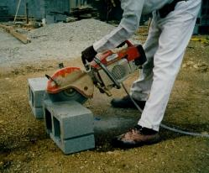
Engineering Controls for Silica Exposure
If silica is generated, OSHA requires engineering controls involving a mechanical process to eliminate exposure to silica dust
2 main methods are used to control silica dust while operating
Integrated Water Delivery Systems (IWDS)
  Water is supplied to equipment by
    a pressurized container,
    a constant water source e.g. a hose connected to a faucet
  Using water will usually reduce levels to below the PEL in construction activities
Vacuum Dust Collection Systems (VDCS)
  Good method for reducing silica exposures, but may not reliably keep exposure below PEL
  VDCSs include dust collector (hood or shroud), vacuum, hose and filter(s).
Handheld masonry saw using water for dust control while cutting cinder blocks. (Photo courtesy of New Jersey Department of Health).
Notes:
If silica is generated, OSHA requires engineering controls to eliminate exposure to silica dust. Two main methods are used to control silica dust while conducting tasks. These methods are:
Integrated Water Delivery Systems (IWDS): This is commonly known as the wet method. In this method, water is supplied to the equipment by a pressurized container or a constant water source (e.g., a hose connected to a faucet). The water delivery system usually includes a nozzle for spraying water. Using water will usually reduce dust levels to below the PEL in construction activities. Wet cutting is the most effective method for controlling silica dust generated during certain tasks because it controls the exposure at its source.
Vacuum Dust Collection Systems (VDCS): Using vacuum for dust collection is a good method for reducing silica exposures. Vacuum dust collection systems include dust collector (hood or shroud), vacuum, hose and filter(s). Note that compared to the wet method, a vacuum system may not reliably keep exposures below PEL.
When wet methods cannot be implemented, an alternative is use of vacuum dust collection systems (VDCS), or vice versa.

Slide 37
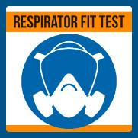
Engineering Controls for Silica Exposure – cont.
Respiratory Protection - LAST LINE OF DEFENSE
When VDCSs and wet cutting are not feasible, or do not reduce silica exposures to PEL, workers need respiratory protection.
  Respirators must fit properly to prevent leaks around the edges
  Fit-testing must be done with the same make, model, style, and size of respirator that will be used before first wearing a respirator
  Only wear the model and size of respirator that you were fit tested with
  It is not permitted to have
    Facial hair that comes between the sealing surface of the facepiece and the face or that interferes with valve function
    Any condition that interferes with the face-to-facepiece seal or valve function
Notes:
Employers who follow the specified exposure control methods listed in Table 1 must provide respiratory protection where required by Table 1. Employers who follow alternative exposure control methods must provide respiratory protection:
Where exposures exceed the PEL during periods necessary to install or implement feasible engineering and work practice controls; and/or
Where exposures exceed the PEL during tasks, such as some maintenance and repair tasks, for which engineering and work practice controls are not feasible; and/or
During tasks in which the employer has implemented all feasible engineering and work practice controls but exposures remain above the PEL.
When vacuum dust collection systems and/or wet methods are not feasible or do not reduce silica exposures to PEL, workers need respiratory protection as a last line of defense. Respirators must fit properly to prevent leaks around the edges. Fit-testing must be done with the same make, model, style, and size of respirator that will be used before first wearing a respirator. Fit testing may be conducted by using quantitative method or qualitative method. Employees must only wear the model and size of respirator that they fit tested with. Employers should not permit employees to have facial hair that comes between the sealing surface of the facepiece and the face or that interferes with valve function or any condition that interferes with the face-to-facepiece seal or valve function.

Slide 38
Engineering Controls for Silica Exposure -
Integrated Water Delivery Systems
IWDS are required for several types of equipment
  - when using such tools and equipment
  An adequate supply of water for dust suppression is needed (at the flow rates specified by the manufacturer)
  The spray nozzle must be working properly to apply water at the point of dust generation
  The spray nozzle should not be clogged or damaged
  All hoses and connections must be intact.
Handheld masonry saw using water for dust control while cutting cinder blocks. (Photo courtesy of New Jersey Department of Health).
Notes:
Integrated water systems (IWDS) are required for several types of equipment. IWDS must be developed specifically for the type of tool in use so they will apply water at the appropriate dust emission points based on tool configuration, and do not interfere with other tool components or safety devices. To effectively minimize dust emissions for tasks with the wet method
an adequate supply of water for dust suppression is needed (at the flow rates specified by the manufacturer);
the spray nozzle must be working properly to apply water at the point of dust generation;
the spray nozzle should not be clogged or damaged; and
all hoses and connections must be intact.

Slide 39
Engineering Controls for Silica Exposure
Integrated Water Delivery Systems – cont.
When using wet methods, effective control of the dust depends on the following factors
  Dust particle size
  Dust particle velocity
    Higher the velocity, higher the flow rate
  Spray nozzle size and location
  Use of surfactants or other binders
  Environmental factors (water hardness, humidity, weather, etc.)
Therefore, it is necessary to follow manufacturers’ instructions when determining the required flow rate for dust suppression systems.
Handheld masonry saw using water for dust control while cutting cinder blocks. (Photo courtesy of New Jersey Department of Health).
Notes:
When using wet methods, effective control of the dust depends on the following factors
Dust particle size
Dust particle velocity
Note that higher the velocity is the higher the flow rate should be
Spray nozzle size and location
Use of surfactants or other binders
Environmental factors (water hardness, humidity, weather, etc.)
Therefore, it is necessary to follow manufacturers’ instructions when determining the required flow rate for dust suppression systems.

Slide 40
Engineering Controls for Silica Exposure
Integrated Water Delivery Systems – cont.
Also;
  Limit the secondary exposure by cleaning up any slurry generated, and the procedure should be described in the employer’s Written Exposure Control Plan
  In cold temperatures, where there is a risk of water freezing, additional work practices should be followed
    e.g., insulating drums, wrapping drums with ice melting heat tape, or environmentally-friendly antifreeze additives
  Electrical Safety - Use ground-fault circuit interrupters (GFCIs) and watertight, sealable electrical connectors for electric tools and equipment on construction sites
Handheld masonry saw using water for dust control while cutting cinder blocks. (Photo courtesy of New Jersey Department of Health).
Notes:
Workers should dispose of water containing silica (slurry) in a way that prevents the silica from becoming re-suspended in the air in order to limit the secondary exposure, If the silica is allowed to become airborne, it can contribute to employee exposures. Freezing temperatures complicate the use of water. In cold temperatures, where there is a risk of water freezing, additional work practices should be followed to prevent water from freezing; which include insulating drums, wrapping drums with ice melting heat tape, or using environmentally-friendly antifreeze additives. Adding environmentally –friendly additives will not only prevent supply water from freezing, but will also prevent the water from freezing on the ground. This is a good way to prevent slipping hazards, as well. As an alternative, chipping away the ice, or using deicing compounds or sand may be used to control the slipping hazards.
When using wet methods for dust control, ground-fault circuit interrupters (GFCIs) and watertight, sealable electrical connectors for electric tools and equipment provide for electrical safety.

Slide 41
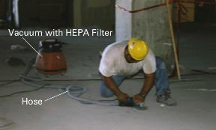
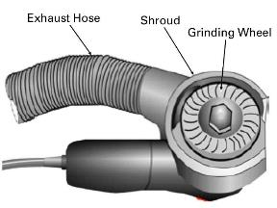
Engineering Controls for Silica Exposure - Vacuum Dust Collection Systems
Commercially available dust collection systems (i.e., Local Exhaust Ventilation) are required for several equipment
  Must effectively capture dust generated by the tool being used
  Must not introduce new hazards, such as obstructing or interfering with safety mechanisms
VDCSs include a dust collector (hood or shroud), vacuum, hose and filter(s)
  Use a vacuum with enough suction to capture dust at the cutting point.
  Use a HEPA filter in the vacuum exhaust, and a pre-filter or cyclonic separator to improve vacuum efficiency.
  Use a hose size recommended by the manufacturer.
  Use a hood or shroud that is recommended by the manufacturer.
Grinder with attached VDCS. (Photo courtesy of the University of Washington). Detail of grinder with VDCS attachment. (Courtesy of NIOSH).
Source: OSHA Small Entity Compliance Guide for the Construction Silica Standard
Notes:
When wet methods cannot be implemented, an alternative is the use of vacuum dust collection (VDC) systems. VDC systems can be purchased as a kit. This system includes a dust collector (hood or shroud), vacuum, hose, and filter(s). These vacuum dust collection systems must effectively capture dust generated by the tool being used and must not introduce new hazards, such as obstructing or interfering with safety mechanisms.
In order for a vacuum dust collection system to be effective, one must use
a vacuum with enough suction to capture dust at the cutting point;
a HEPA filter in the vacuum exhaust, and a pre-filter or cyclonic separator to improve vacuum efficiency;
a hose size recommended by the manufacturer; and
a hood or shroud that is recommended by the manufacturer.

Slide 42
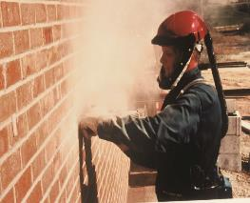
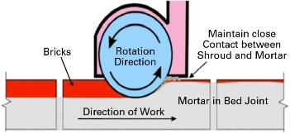
Engineering Controls for Silica Exposure - Vacuum Dust Collection Systems – cont.
For best results, employees must
  Keep the vacuum hose clear and free of debris, kinks and tight bends
  Follow the manufacturer’s directions on how to reduce dust buildup on the filter.
  Change vacuum-collection bags as needed.
  Set up a regular schedule for filter cleaning and maintenance.
  Avoid exposure to dust when changing vacuum bags and cleaning or replacing air filters.
  Keep the grinder at the appropriate angle.
Worker grinding without dust controls. Note the use of shielded Powered Air-Purifying Respirator. (Photo courtesy of CPWR).
Minimizing the gap between the shroud and uncut mortar. (Illustration courtesy of NIOSH).
Notes:
For best results with vacuum dust collection systems, employees must
make sure that all hoses are clear and free of debris, kinks and tight bends and cracks;
ensure that appropriate filters and dust bags are in good condition and changed or emptied as needed (may be necessary several times per shift under some circumstances);
check the entire system daily for signs of poor dust capture or dust leaks;
use high-efficiency (HEPA) filters for maximum dust control;
review manufacturers’ operating specifications and recommendations for their equipment; and
Avoid exposure to dust when changing vacuum bags and cleaning or replacing air filters.

Slide 43
Workplace Controls for Silica Exposure
Along with the engineering controls, OSHA also requires workplace controls to eliminate exposure to silica dust
Safety program and training
  Employers must train employees covered by the standard on
    Health hazards associated with silica exposure
    Specific workplace tasks that could expose employees to silica
    Specific measures the employer is implementing to protect employees
    The contents of the silica standard.
  Training must be provided at the time employees are assigned to a position involving exposure to silica
  Additional training must be provided if
    the employer asks an employee to perform a task that is new to that employee
    the employer introduces new protections
    an employee is working in a manner that suggests he or she has forgotten what was learned in training.
Notes:
Along with the engineering controls, OSHA also requires workplace controls to eliminate exposure to silica dust. One of the administrative controls is the safety program and training. Under the Respirable Crystalline Silica Standard, employers must train employees covered by the standard on
Health hazards associated with silica exposure
Specific workplace tasks that could expose employees to silica
Specific measures the employer is implementing to protect employees
The contents of the silica standard 29 CFR 1926.1153
The training must be provided at the time employees are assigned to a position involving exposure to silica. The employer must make sure that employees trained under the silica standard can demonstrate knowledge and understanding of the standard. Additional training must be provided if the employer asks an employee to perform a task that is new to that employee, and/or when the employer introduces new protection methods and/or an employee is working in a manner that suggests he or she has forgotten what was learned in a previous training. The silica standard does not require the employer to use any particular method for training employees. Employers could use methods such as hands-on training, videotapes, slide presentations, classroom instruction, informal discussions during safety meetings, written materials, or any combination of these methods to train employees.
Employers must cover the cost of training and must pay employees for the time spent in training.

Slide 44
Workplace Controls for Silica Exposure – cont.
Housekeeping
  Standard limits the use of certain cleaning methods to prevent unnecessary exposures to employees
  When likely to contribute to exposure, employers must not allow
    Dry brushing or dry sweeping
    Using compressed air for cleaning of surfaces or clothing, unless accompanied by a ventilation system that effectively captures the dust
    The above methods can be used, when other methods such as wet sweeping and/or HEPA-filtered vacuuming are not feasible, the employer must be able to show why cleaning methods that decrease employee exposures are not feasible
Regulated Areas for Construction
  Restrictions for access to work areas, to minimize numbers of employees exposed to respirable crystalline silica
Notes:
As another workplace control; the standard requires all construction employers covered by the standard, including those who fully and properly implement the control methods specified in Table 1, to avoid certain housekeeping practices. Cleaning methods such as dry sweeping, dry brushing, and use of compressed air can cause respirable crystalline silica dust to become airborne and be inhaled by employees. Therefore, the silica standard limits the use of these cleaning methods to prevent unnecessary exposures to employees. Standard states that, when it is likely to contribute to employee exposure to respirable crystalline silica, employers MUST NOT ALLOW
dry brushing or dry sweeping, unless methods such as wet sweeping and HEPA-filtered vacuuming are not feasible;
cleaning of surfaces or clothing with compressed air, unless the compressed air is used together with a ventilation system that effectively captures the dust cloud, or no other cleaning method is feasible.
Employers are required to use other cleaning methods such as wet sweeping and HEPA- filtered vacuums whenever feasible, because such methods reduce employee exposures. Employers are not required to follow these housekeeping requirements when cleaning ordinary soil, large debris, and non-silica- containing materials, such as sawdust.
To prevent unnecessary exposure; the standard also requires employers to regulate areas of concern by restricting access to areas of potential high exposure. Scheduling certain tasks when others are not around, telling employees to stay out of areas where dust is generated, moving employees to an area where they are not exposed to dust, or posting warning signs are some examples of regulating the exposure areas.

Slide 45
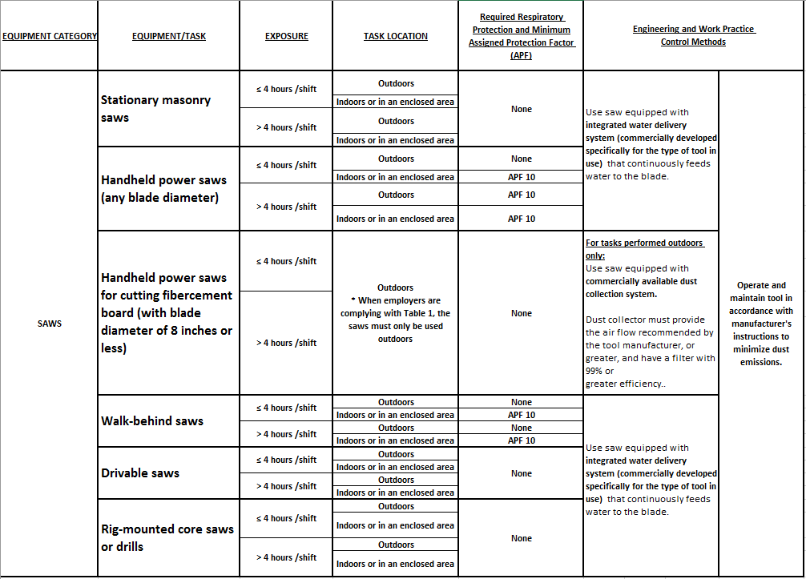
TABLE 1 Summary -
Silica Control Compliance for Construction
Notes:
For each employee engaged in a task in Table 1, employers who choose to follow the Table for that task are required to fully and properly implement the engineering controls, work practices, and respiratory protection specified in Table 1. Table 1 lists 18 common tasks using various types of tools or equipment found on construction sites. These equipment/tasks are:
Stationary masonry saws; hand held power saws; walk-behind saws; drivable saws;
Rig-mounted core saws or drills; handheld and stand-mounted drills (including impact and rotary hammer drills);
Dowel drilling rigs; vehicle-mounted drilling rigs;
Jack hammers and hand held powered chipping tools;
Hand held grinders; walk-behind milling machines and floor grinders;
Drivable milling machines;
Crushing machines; and
Heavy equipment and utility vehicles when used to abrade or fracture silica-containing materials (such as hoe-ramming or rock ripping) or during demolition activities, and for tasks such as grading and excavating.
If an employer can not find the equipment used for a job or task in Table 1 , s/he will need to follow the alternative method of exposure controls.

Slide 46
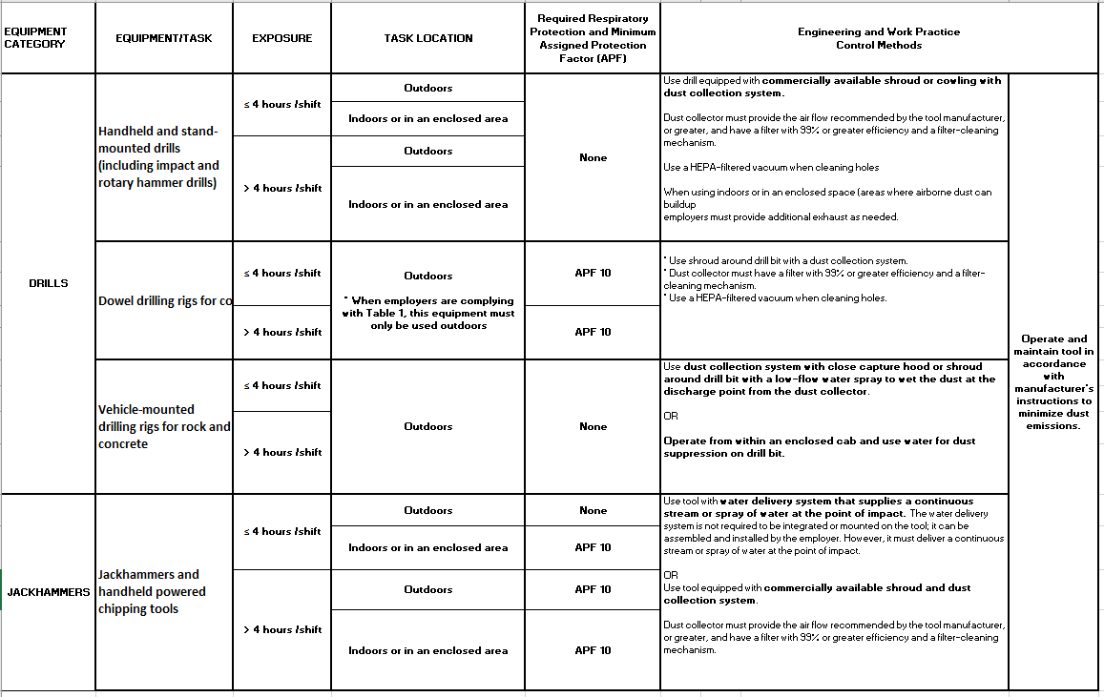
TABLE 1 Summary -
Silica Control Compliance for Construction – cont.
Notes:
See also the notes on the previous slide (No. 45).
Respirator requirements in Table 1 are indicated by task duration and task location, as “less than or equal to 4 hours/shift” or “greater than 4 hours/shift”. Each of the following scenarios is considered a “shift” for purposes of determining the maximum amount of time that an employee may spend on tasks covered in Table 1 without respiratory protection:
A standard 8-hour work period;
A day with a break between work periods (e.g., four hours on, two hours off, four hours on);
Work periods longer than eight hours;
Double shifts within a single day; and
A work period spanning two calendar days (e.g., 8 p.m. until 4 a.m.)
Note that the task duration time starts when the operator begins using the tool, and continues to be counted until he/she completes the task.
Several Table 1 entries distinguish between locations of tasks performed as “outdoors” or “indoors, or in an enclosed area.” Indoors or in an enclosed areas” mean areas where airborne dust can build up unless additional exhaust is used. Employers following Table 1 are required to provide a means of exhaust as needed to minimize the accumulation of dusts generated by tasks performed in these areas. Exhaust system necessary may include portable fans (box fans, floor fans, axial fans), portable ventilation systems, or other systems that increase air movement and assist in the removal and dispersion of airborne dust.

Slide 47
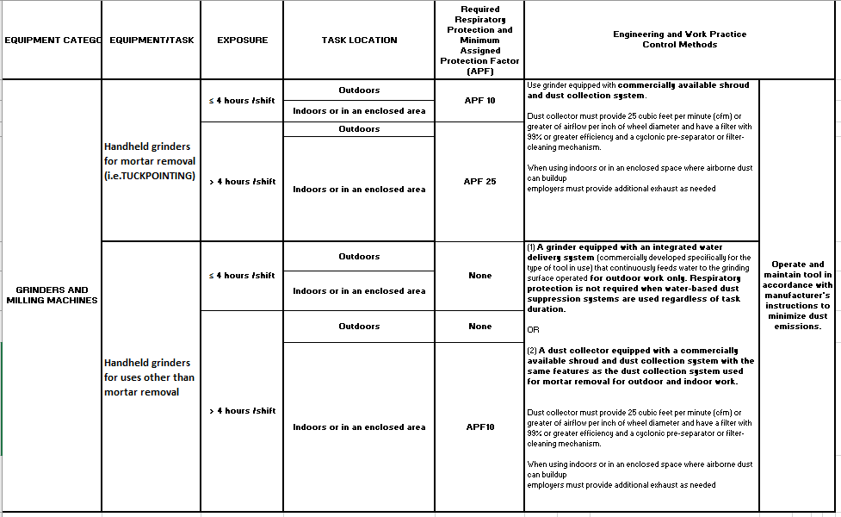
TABLE 1 Summary -
Silica Control Compliance for Construction – cont.
Notes:
See the notes on the previous slide (No. 45).

Slide 48
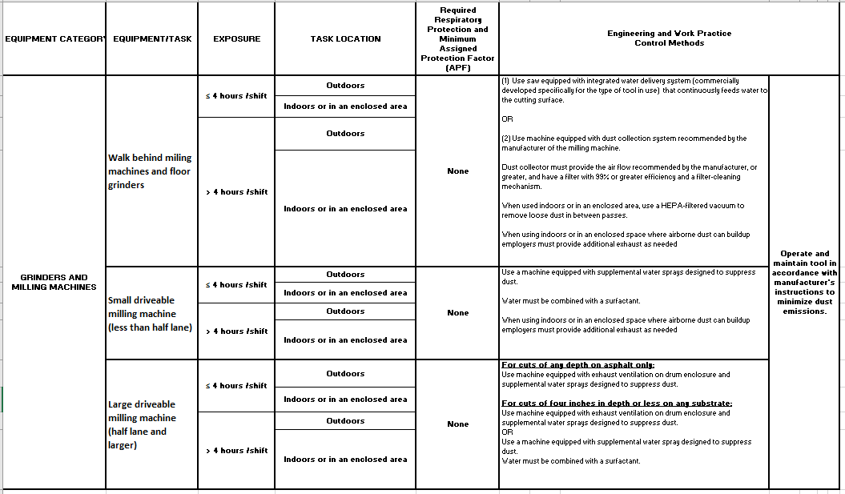
TABLE 1 Summary -
Silica Control Compliance for Construction – cont.
Notes:
See the notes on the previous slide (No. 45).

Slide 49
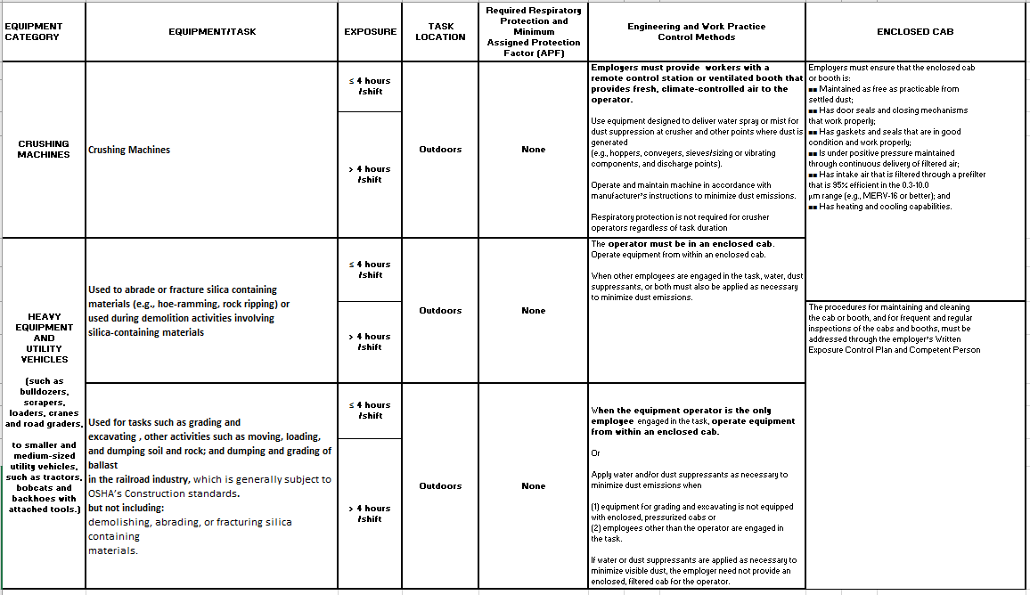
TABLE 1 Summary -
Silica Control Compliance for Construction – cont.
Earthmoving using a dozer equipped with enclosed operator cab.
DISLAIMER: This Table is for training and awareness purposes only. It should not be used as a standard for compliance purposes.
Notes:
See the notes on the previous slide (No. 45).

Slide 50
Mandatory Requirements for Silica Exposure Control – Detailed Summary
All construction employers covered by the standard are required to
  Establish and implement a written exposure control plan that identifies tasks that involve exposure and methods used to protect workers, including procedures to restrict access to work areas where high exposures may occur
    Provide respiratory protection when required;
  Designate a competent person to implement written exposure control plan
  Restrict housekeeping practices that expose workers to silica, where feasible alternatives are available
  Offer medical exams including chest X-rays and lung function tests
    Every three years for workers who are required by the standard to wear a respirator for 30 or more days per year
  Train workers on work operations that result in silica exposure and ways to limit exposure
  Keep records of workers’ silica exposure and medical exams
Notes:
All employers covered by the standard (generating silica exposure at or above AL - 25 μg/m³ ) are required to comply with the following mandatory requirements, whether they use Table 1 or Alternative Method of Exposure Controls. They must
Establish and implement a Written Exposure Control Plan, including respiratory protection as needed, and designate a competent person to oversee activities under that plan;
Restrict housekeeping practices that expose employees to respirable crystalline silica where feasible alternatives are available;
Offer medical exams to employees who will be required to wear a respirator under the standard for 30 or more days a year;
Communicate hazards and train employees; and
Keep records of medical examinations of workers; additionally, the worker’s silica exposure assessments if they are following the alternative control method.

Slide 51
Respiratory Protection
Must comply with requirements of the Silica Standard and with OSHA’s Respiratory Protection Standard (29 CFR 1910.134).
Assigned Protection Factor (APF) means the workplace level of respiratory protection that a respirator or class of respirators is expected to provide to employees when the employer implements a continuing, effective respiratory protection program as specified by the Respiratory Protection Standard.
EMPLOYERS MUST PROVIDE
AND EMPLOYEES MUST USE
APPROPRIATE RESPIRATOR (APF)
IF IT IS REQUIRED BY THE SILICA STANDARD
OR
ENGINEERING CONTROLS CAN NOT GET EXPOSURES BELOW PEL
Notes:
To comply with the silica standard, employers must provide employees with appropriate respirators with specified Assigned Protection Factor (APF) where required. Assigned Protection Factor (APF) signifies the workplace level of respiratory protection that a respirator or class of respirators is expected to provide to employees, when the employer implements a continuing, effective respiratory protection program in compliance with the Respiratory Protection Standard (29 CFR 1910.134).
Employers following the specified exposure control methods must provide the respiratory protection as required in Table 1.
Employers who follow alternative exposure control methods must provide respiratory protection
where exposures exceed the PEL during periods necessary to install or implement feasible engineering and work practice controls; and/or
where exposures exceed the PEL during tasks for which engineering and work practice controls are not feasible, and/or
during tasks in which the employer has implemented all feasible engineering and work practice controls but exposures remain above the PEL.

Slide 52

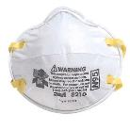
Compliance with OSHA 29 CFR 1910.134 – Respiratory Protection Standard
Providing employees with appropriate respirators requires compliance with OSHA 29 CFR 1910.134 - Respiratory Protection Standard, which requires
  A written respiratory protection program
  Medical evaluation to determine if the employee is fit to wear a respirator
  Employee Training in proper use, limitations, and storage of the respirator selected for use
  Fit testing to determine that the respirator selected for use fits properly
  Procedures and schedules for respirator maintenance
APF=10
Needs to be fit tested
Notes:
Where respirator use is required, employers must comply with all requirements of the Respiratory Protection standard (OSHA 29 CFR 1910.134). These requirements are summarized as follows:
A written respiratory protection program must be in place.
There must be medical evaluation to determine if the employee is fit to wear a respirator
Training must be provided to employees on proper use, limitations, and storage of the respirator selected for use.
Fit testing must be done to determine that the respirator selected for use fits properly.
Procedures and schedules must be implemented for respirator maintenance.

Slide 53
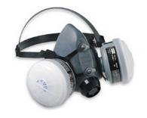
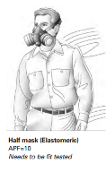
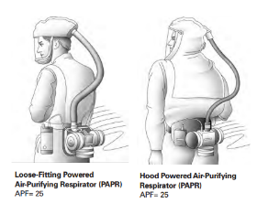

Respiratory Protection – cont.
Table 1 specifies the type or class of required respirator that is expected to be provided to employees with a minimum assigned protection factor (APF)
  Air-purifying respirator with dust cartridge
  Supplied air respirator
Employer shall ensure that all filters and cartridges used in workplace are labeled and color coded
Labels must be NIOSH approved
Notes:
When employers follow Table 1, there are two types/classes of required respirator expected to be provided to employees with a minimum assigned protection factor (APF). These are:
APF 10: Air-purifying respirator with dust cartridge (e.g. half-facepiece or disposable respirator); and
APF 25: Supplied air respirator (e.g loose-fitting powered air-purifying respirator or hood powered air purifying respirator)
All respirators must have NIOSH approved labels. Furthermore, employers shall ensure that all filters and cartridges are labeled and color coded.

Slide 54
Respiratory Protection – cont.
In implementing Table 1, respiratory protection is required under the following conditions according to the new Respirable Silica Standard
  Where exposures exceed the PEL during periods necessary to install or implement feasible engineering and work practice controls
  Where exposures exceed the PEL during tasks, such as some maintenance and repair tasks, for which engineering and work practice controls are not feasible
Notes:
When employers follow Table 1, they must provide respiratory protection whenever usage is specified. Paragraph (d)(3)(i)(A) of the Respiratory Protection Standard (29 CFR 1910.134) includes a table that can be used to determine the type or class of respirator that will mandate a particular APF. While employers can determine the type of respirator that would meet the required minimum APF specified by Table 1, they also have the flexibility to provide a respirator of higher level of protection to those employees who request one, or require the employees to use a more protective respirator.

Slide 55
Written Exposure Control Plan
All employers covered by the standard must develop and implement a Written Exposure Control Plan. (SAMPLES can be generated at Silica-safe.org or can be viewed in OSHA Small Business Compliance Guide)
  This includes employers who fully and properly implement the specified exposure controls in Table 1.
Written exposure control plans must include and describe
  Tasks involving exposure to silica
  Engineering controls, work practices, and respiratory protection for each task
  Housekeeping methods used to limit exposure
  Procedures used to restrict access to work areas, when necessary, to limit the number of employees exposed to respirable crystalline silica
The Plan must be reviewed and evaluated at least once a year and updated as necessary
It must be available to each employee covered by the standard, their designated representative, and representatives from OSHA or NIOSH, upon request.
Notes:
All employers covered by the standard must develop and implement a Written Exposure Control Plan. This plan must be reviewed and evaluated at least once a year and updated as necessary. Also, it must be available to each employee covered by the standard, their designated representative, and representatives from OSHA or NIOSH, upon request. Sample Written Exposure Control Plans can be generated at the Center for Construction Research and Training (CPWR) website www.silica-safe.org.
Below is a list of what the employer must include in each section of the written exposure control plan, with general examples of the types of information that could be included.
The plan must include a description of workplace tasks involving exposures to respirable crystalline silica. Employers must list all tasks that employees perform that could expose them to respirable crystalline silica dust. This section could also describe the equipment used and factors that affect exposures, such as types of silica-containing materials handled in those tasks (concrete or tile), weather conditions (wind or humidity), soil types (clay versus rock), and if tasks are done outdoors versus indoors or in enclosed locations.
The plan must include a description of engineering controls, work practices, and respiratory protection used to limit employee exposure to respirable crystalline silica for each task. For each task that employees perform, employers must describe types of controls used, like a dust collector with manufacturer’s recommended air flow and a HEPA filter with 99 percent efficiency, effective work practices, as in checking that water nozzles are not plugged, and if required, appropriate respiratory protection, like a respirator with an APF of 10. Employers could also describe signs that controls are not working effectively, such as an increase in visible dust. This section of the written exposure control plan is especially important for construction employers who use controls in Table 1, because they are not required to measure exposures to make sure that controls are working. Therefore, including information such as manufacturer’s instructions for operating and maintaining tools to decrease dust, when possible, demonstrates that the employer has a complete understanding of those instructions and is using them to control dust. Describing those instructions in the written exposure control plans also lets employees know what the employer needs to do to protect them.
The plan must include a description of the housekeeping methods used to limit employee exposure to respirable crystalline silica. In this part of the written exposure control plan, employers must list acceptable cleaning methods that will be used to prevent employees from being exposed and any protections that are needed if certain cleaning methods have to be used. This section must be in compliance with the Housekeeping section of the standard requirements. This section of the written plan would include cleaning methods that are acceptable (wet sweeping), cleaning methods that are unacceptable because acceptable cleaning methods are not feasible (dry sweeping), and special instructions (use local exhaust ventilation if compressed air must be used). Hygiene-related subjects, such as not using compressed air to clean clothing, could also be addressed in this section of the written exposure control plan.
The plan must include a description of the procedures used to restrict access to work areas, when necessary, to limit the number of employees exposed to respirable crystalline silica and the levels to which they are exposed, including exposures generated by other employers or self-employed workers. This part of the plan must describe how the employer restricts access to prevent exposures, such as: Scheduling certain tasks when others are not around, posting warning signs etc. Employers following the alternative exposure control methods approach must restrict access where an exposure assessment shows that exposures are above the PEL. When following Table 1, employers must restrict access when employees are engaged in tasks that require respirator use under Table 1. The employer or competent person must also restrict access, when needed, for exposures generated by another employer or self-employed person.

Slide 56
Written Exposure Control Plan – Competent Person
The employer must designate a competent person to implement the written exposure control plan
Competent person is an individual capable of
  Identifying existing and foreseeable silica hazards;
  Is authorized to promptly eliminate or minimize these hazards; and
  Has the knowledge and ability to implement the written exposure control plan.
He/she makes frequent and regular inspections of job sites, materials, and equipment
The standard does not require specific training for a competent person.
COMPETENT PERSON
Notes:
Under the crystalline silica standard, the employer must designate a competent person to frequently and regularly inspect job sites, materials, and equipment to implement the written exposure control plan. A competent person is defined as an individual who is capable of
Identifying existing and foreseeable silica hazards;
Is authorized to promptly eliminate or minimize these hazards; and
Has the knowledge and ability to implement the written exposure control plan.
An employer can designate any of his/her employees as a competent person as long as they meet the above capabilities. The standard does not require specific training for a competent person. The employer is responsible for determining what training is necessary to provide the scope and nature of the knowledge and ability for the competent person, so the written exposure plan can be successfully implemented.

Slide 57
Medical Surveillance
Employers must offer medical examination to workers who will be required to wear a respirator under the standard for 30 or more days a year.
Medical Surveillance is intended to
  Identify respirable crystalline silica-related diseases so that employees with those diseases can take actions to protect their health
  Determine if an employee has any condition, such as a lung disease, that might make him or her more sensitive to respirable crystalline silica exposure
  Determine the employee’s fitness to use respirators
  Note that it is different than medical evaluations needed to comply with OSHA 1910.134
Medical Examination
Notes:
The standard specifies which employees must be offered medical surveillance, when and how often the examinations must offered, and the tests that make up the medical examinations. Medical surveillance must be provided at no cost to employees, and at a reasonable time and place.
Employers must make an initial and periodic medical examination available to employees who will be required by the silica standard to wear a respirator for 30 or more days per year in the upcoming year (the next 365 days). If the employee is required to wear a respirator at any time during a day, that counts as one day of respirator use. Also, respirator use with past employers does not count toward the 30-day threshold.
Medical surveillance is intended to identify respirable crystalline silica-related diseases so that employees with those diseases can take actions to protect their health; also such surveillance will help to determine if an employee has any condition that might make him/her more sensitive to silica exposure. Note that this medical surveillance is different than the medical evaluation needed to comply with the Respiratory Protection Standard - OSHA 1910.134.

Slide 58
Medical Surveillance – cont.
What are included in the medical examination?
  Medical and work history
  Physical exam
  Chest X-Ray
  Lung function test
  Any other tests deemed appropriate by the PLHCP (as medically necessary and related to respirable crystalline silica exposure)
    Tuberculosis Test (TB test)
Frequency of Medical Examinations
  Within 30 days of initial assignment
  Every three years from the last examination, or more frequently if recommended by the PLHCP, if the employee will continue to perform tasks that require respirator use under the silica standard for 30 or more days per year
Notes:
The employer must ensure that the examining PLHCP has a copy of the standard and must provide the PLHCP with
A description of the employee’s past, current, and future duties as they relate to respirable crystalline silica exposure; the employee’s past, current, and future levels of exposure to respirable crystalline silica. If the employer does not have information on the employee’s past or current exposure level because they are following Table 1 and are not required to measure exposures, the employer can indicate if the employee is likely to be exposed at or above the PEL.
A description of any personal protective equipment used, or to be used, by the employee, including when and for how long the employee has used or will use that equipment; and
Information from records of employment- related medical examinations previously provided to the employee and currently within the control of the employer.
During a medical examination the PLHCP will conduct the following procedures:
Medical and work history on the past, present, and anticipated exposure to respirable crystalline silica, and any history of respiratory system dysfunction, tuberculosis, as well as smoking status.
Physical exam focusing on the respiratory system
Chest X-Ray: A certified physician must read the X-rays following certain procedures to determine if it shows signs of any disease such as silicosis
Lung function test (spirometry) : This includes forced vital capacity (the total amount of air that is forcefully blown out after taking a full breath), forced expiratory volume in one second (the amount of air forcefully blown out in the first second), and FEV1/FVC ratio (the speed of air that is forcefully blown out), administered by a spirometry technician with a current certificate from a NIOSH- approved spirometry course.
Any other tests deemed appropriate by the PLHCP (as medically necessary and related to respirable crystalline silica exposure); e.g. Tuberculosis Test (TB test): Testing for latent tuberculosis infection
Employers must offer medical examinations within 30 days of initial assignment (the day the employee starts working in a job/ task in which he or she will be required by the silica standard to wear a respirator for 30 or more days per year), unless the employee has had an examination that meets the requirements of the silica standard within the last three years. After that, every three years from the employee’s last examination that met the requirements of the silica standard, or more frequently if recommended by the PLHCP, if the employee will continue to perform tasks that require respirator use under the silica standard for 30 or more days per year.

Slide 59
Medical Surveillance - Requirements
The standard requires a written medical report be provided to the employee as well as detailed information related to employee's health, any work restrictions, and recommendations for any further evaluation or treatment.
  The employer does not receive a copy of this report.
    HIPAA (Health Insurance Portability and Accountability Act of 1996)
The standard requires employer to obtain a written medical opinion from PLHCP
  the date of the examination;
  a statement that the examination has met the requirements of the silica standard; and
  any recommended limitations on the employee’s use of respirators.
Sample Medical Forms
in
Appendix B of the Standard
If employee provides written authorization, written opinion provided to employer may also include recommended limitations on employee's exposure to respirable crystalline silica, and referral to a specialist.
Notes:
The employer must ensure that the PLHCP explains the results of the medical examination to the employee and gives the employee a written medical report within 30 days of each medical examination performed. Only the employee receives the written medical report, and the employer does not receive a copy of this report. The report must contain:
A description of the medical examination results, including any medical condition(s) that would place the employee at increased risk of material impairment of health from exposure to respirable crystalline silica (any health condition that might make the employee more sensitive to exposure). The report must also describe any medical conditions that require further evaluation or treatment;
Any recommended limitations on the employee’s use of respirators;
Any recommended limitations on respirable crystalline silica exposure; and
A statement that the employee should be examined by a specialist if the chest X-ray ( from the B-reader) provided under the silica standard shows evidence of silicosis in employees exposed to silica or if the PLHCP otherwise recommends referral to a specialist.
The standard requires employer to obtain a written medical opinion from physicians or licensed health care professionals within 30 days of the medical examination. This must contain only the following information: the date of the examination; a statement that the examination has met the requirements of the silica standard; and any recommended limitations on the employee’s use of respirators. Appendix B of the standard provides sample medical forms.
If employee provides written authorization written opinion provided to employer may also include recommended limitations on employee's exposure to respirable crystalline silica, and referral to a specialist.

Slide 60

Communication of Silica Hazards
Employers are required to comply with OSHA Hazard Communication Standard- HCS (29 CFR 1910.1200).
  HCS requires employers to inform employees about hazardous chemicals in the workplace, such as respirable crystalline silica, through their written hazard communication programs.
Written hazard communication programs must describe how the requirements for container labels, safety data sheets (SDSs), and employee training will be met.
Employers must address at least the health hazards on cancer, lung effects, immune system effects, and kidney effects as part of the hazard communication program for respirable crystalline silica.
Notes:
Employers are required to comply with the OSHA Hazard Communication Standard- HCS (29 CFR 1910.1200). HCS requires employers to inform employees about hazardous chemicals in the workplace, such as respirable crystalline silica, through their written hazard communication programs. Written hazard communication programs must describe how requirements for container labels, safety data sheets (SDSs), and employee training will be met. As part of their hazard communication program for respirable crystalline silica, employers must address at least the following health hazards: cancer, lung effects, immune system effects, and kidney effects.

Slide 61
Communication of Silica Hazards – cont.
Under the HCS, employers must
    Inform employees about the general requirements of HCS
    Train employees on how the presence or release of hazardous chemicals in the work area is detected
    Train employees on the details of the workplace-specific hazard communication program developed by the employer, such as container labels, the workplace labeling system, SDSs, and how employees can get and use hazard information.
Employers must make a copy of the respirable crystalline silica standard available to each employee covered by the standard at no cost to the employee.
Notes:
Under HCS, employers must
Inform employees about the general requirements of HCS
Train employees on how the presence or release of hazardous chemicals in the work area can be detected
Train employees on the details of the workplace-specific hazard communication program developed by the employer, including container labels, the workplace labeling system, SDSs, and how employees can get and use hazard information.
Under HCS, employers must make a copy of the respirable crystalline silica standard available to each employee covered by the standard at no cost to the employee. This could simply involve allowing employees to view a printed or electronic copy in a reasonable location.

Slide 62
Communication of Silica Hazards - Safety Data Sheets (SDS)
SDSs contain data for all materials or products containing hazardous substances
If a material or product contains crystalline silica in quantities greater than 0.1%, there must be a safety data sheet for it
Manufacturer's responsibility: Manufacturers must obtain or develop a safety data sheet for each hazardous chemical they produce or import
Employer's responsibility: Employers must ensure access to safety data sheets for all hazardous materials at the workplace
SILICA CONTAINING MATERIALS
SAFETY DATA SHEET
(SDS)
Notes:
Safety Data Sheets contain data for all materials or products containing hazardous substances. If a material or product contains crystalline silica in quantities greater than 0.1%, there must be a safety data sheet for it
Manufacturer's responsibility: Manufacturers must obtain or develop a safety data sheet for each hazardous chemical they produce or import
Employer's responsibility: Employers must ensure access to safety data sheets for all hazardous materials in the workplace.

Slide 63
Recordkeeping
Per OSHA’s Access to Employee Exposure and Medical Records regulation (29 CFR 1910.1020), employers must maintain records for
  Medical records (PLHCP written medical opinion to employer)
  Air monitoring data - if employers perform air monitoring to comply with the standard.
  Objective data - if employer relies on objective data
Exposure and medical records must be kept and made available to
  Employees, their representatives, and OSHA
  RECORDS TO MAINTAIN
  Air monitoring data - if employers perform air monitoring to comply with the standard.
  Objective data - if employer relies on objective data
  Medical records
Notes:
Records can demonstrate employer compliance with the standard, and can assist in diagnosing and identifying workplace- related illnesses. Therefore, as appropriate, employers are required to make and keep accurate records of air monitoring data and objective data used to assess employee exposures to respirable crystalline silica under the standard, as well as records of medical surveillance provided under the standard.
Exposure and medical records must be kept and made available to employees, their representatives, and OSHA per OSHA’s Access to Employee Exposure and Medical Records regulation (29 CFR 1910.1020). Exposure records (including air monitoring and objective data) must be kept for at least 30 years, and medical records must be kept for at least the duration of employment, plus 30 years.

Slide 64
Alternative Silica Exposure Controls
Employers opting for not to implementing Table 1 must follow the alternative exposure control methods approach
This approach involves
  • Assessing employee exposure to silica
  Limiting exposure to the PEL using feasible engineering and work practice controls
  Providing respiratory protection when necessary.
Notes:
Employers who conduct tasks not listed in Table 1, or do not fully and properly implement the engineering controls, work practices, and respiratory protection described in Table 1 of the specified exposure control methods approach, must follow the alternative exposure control methods approach. This approach involves:
Assessing employee exposure to silica;
Limiting exposure to the PEL using feasible engineering and work practice controls; and
Providing respiratory protection when necessary.

Slide 65
Exposure Assessment
Employers following alternative exposure control methods must assess the 8-hour TWA exposure for each employee
Purposes of assessing employee exposures include
  Identifying where exposures are occurring
  Helping the employer select control methods and ensure their effectiveness
  Preventing employees from being exposed to silica above the PEL
  Providing employees with information about their exposure levels
  Giving the PLHCP performing medical examinations information about employee exposures
Notes:
Exposure assessment requires construction employers following alternative exposure control methods to assess the 8-hour TWA exposure for each employee who is or may reasonably be expected to be exposed to respirable crystalline silica at or above the action level of 25 μg/m³ as an 8-hour TWA. The main purposes of assessing employee exposures are:
Identifying where exposures are occurring;
Helping the employer select control methods and ensure their effectiveness;
Preventing employees from being exposed to silica above the PEL;
Providing employees with information about their exposure levels; and
Giving the PLHCP performing medical examinations information about employee exposures.

Slide 66
TWA Exposure Calculation
The TWA exposure for an 8-hour work shift is calculated as
TWA = (Ca Ta + Cb Tb+ . . . +Cn Tn) ÷ 8
where C is the silica concentration (µg/m³), and T is the exposure duration (in hours) at concentration C
Example:
Given: 2 hours exposure at 100 µg/m³; 2 hours exposure at 50 µg/m³; and 4 hours exposure at 10 µg/m³
TWA = (2 x 100 + 2 x 50 + 4 x 10) ÷ 8 = 42.5 µg/m³
Because 42.5 µg/m³ is higher than 25 µg/m³, this employee’s TWA exposure would be above the action level, but below the PEL of 50 µg/m³.
Notes:
Both the PEL and the action level are expressed as TWA exposures. TWA measurements account for variable exposure levels over the course of a work shift by averaging periods of higher and lower exposures. The TWA exposure for an 8-hour work shift is calculated using a simple formula: TWA = (Ca Ta + Cb Tb . . . Cn Tn) ÷ 8
Where: TWA is the time-weighted average exposure for the work shift; C is the concentration during any period of time (T) where the concentration remains constant; and T is the duration in hours of the exposure at the concentration (C)
Based on the calculated TWA; an employer can decide where they stand in terms of Action Level and Permissible Exposure Limit.

Slide 67

Exposure Assessment Options
The standard applies to the three forms of respirable crystalline silica that are covered by the standard
  • Quartz - by far the most common form of silica found in construction
  • Cristobalite (less common)
  • Trydimite (less common)
Options for assessing exposures are
  • Performance option
  • Scheduled monitoring option
Notes:
The PEL applies to the three forms of respirable crystalline silica that are covered by the standard: quartz, cristobalite, and trydimite. Quartz is by far the most common form of crystalline silica found on construction workplaces, and in most cases, quartz will be the only form of respirable crystalline silica analyzed in air samples used to measure employee exposures.
The standard allows employers to choose between two options for assessing exposures: The performance option; or The scheduled monitoring option.

Slide 68
Exposure Assessment – Performance Option
Performance Option gives flexibility to determine silica exposure for each employee based on any combination of air monitoring data or objective data (must reflect workplace conditions)
  Air monitoring data are obtained by following the procedures and requirements in Appendix A of the Standard
  Objective data is information that demonstrates employee exposure to silica associated with a particular product or material, or a specific process, task, or activity.
Examples of objective data
  • Air monitoring data from industry-wide surveys
  • Historic air monitoring data
  • Calculations based on the composition of a substance
Notes:
The performance option gives employers flexibility to determine the 8-hour TWA exposure for each employee based on any combination of air monitoring data or objective data. Both data can effectively characterize employee exposures to respirable crystalline silica.
Air monitoring data: Such data are obtained through the results of air monitoring conducted and analyzed according to the procedures and requirements in Appendix A under the responsibility of the employer to meet the requirements of the standard.
Objective data: This type of data encompasses information that demonstrates employee exposure to respirable crystalline silica, associated with a particular product or material, or a specific process, task, or activity. Air monitoring data from industry-wide surveys, historic air monitoring data, calculations based on the composition of a substance are some examples of objective data.

Slide 69
Performance Option - Employer Responsibilities
Employers under the Performance Option must
  Conduct the exposure assessment before work begins
  Reassess exposures whenever a change in production, process, control equipment, personnel, or work practices may reasonably be expected
  Be able to demonstrate that employee exposures have been accurately characterized
  Make sure that the exposure assessment reflects the exposures of employees on each shift, for each job classification, in each work area
Notes:
Employers who choose to asses exposure based on the performance option must conduct exposure assessment before work begins. Whenever a change in production, process, control equipment, personnel, or work practices may reasonably be expected likely to result in new or higher exposure at or above the action level, employers must reassess the exposure. Also, employers must be able to demonstrate that employee exposures have been accurately characterized. Furthermore, employers must make sure that the exposure assessment reflects the exposure of employees on each shift, for each job classification, in each work area.

Slide 70
Exposure Assessment – Scheduled Monitoring Option
This option guides employers as to when and how often they must perform exposure monitoring to measure employee exposures.
Under this option, employers must make sure that
  Results represent the employee’s TWA exposure to silica over an eight-hour workday
  Samples are collected from the employee’s breathing zone
  Samples are collected outside respirators so that they represent the exposure that would occur without the use of the respirator
  Initial monitoring is conducted as soon as work begins, so exposure levels and control measures can be determined
  Exposure monitoring includes, at a minimum, one full-shift sample taken for each job function in each job classification, in each work area, and on each shift.
  Characterizing each employee’s exposure may involve monitoring all exposed employees, or a smaller number of employees (using representative sampling).
Notes:
The scheduled monitoring option lets employers know when and how often they must perform exposure monitoring to measure employee exposures. Employers selecting the scheduled monitoring option must ensure that
Results represent the employee’s TWA exposure to silica over an eight-hour workday;
Samples are collected from the employee’s breathing zone;
Samples are collected outside respirators so that they represent the exposure that would occur without the use of the respirator;
Initial monitoring is conducted as soon as work begins, so exposure levels and control measures can be determined;
Exposure monitoring includes, at a minimum, one full-shift sample taken for each job function in each job classification, in each work area, and on each shift; and
It is important to note that characterizing each employee’s exposure may involve monitoring all exposed employees, or a smaller number of employees (using representative sampling). Representative monitoring is allowed when several employees perform the same job on the same shift and under the same conditions.

Slide 71
Scheduling Option - Monitoring Frequency
Under the scheduled monitoring option, decision on the frequency of monitoring depends on the results of initial monitoring
If the initial monitoring shows exposures are below the action level, no further monitoring is required
Between AL and PEL, the employer must repeat monitoring within six months of the most recent monitoring
Above the PEL, the employer must repeat monitoring within three months of the most recent monitoring.
Notes:
Under the scheduled monitoring option, how often monitoring must be done depends on the results of initial monitoring, and thereafter, any required further monitoring. If the initial monitoring shows exposures are
below the action level, no further monitoring is required;
between AL and PEL, the employer must repeat monitoring within six months of the most recent monitoring
above the PEL, the employer must repeat monitoring within three months of the most recent monitoring.
When two non-initial monitoring results are taken consecutively, at least 7 days apart but within 6 months of each other, and results are below the action level, employers may stop monitoring employees represented by those results, as long as no changes occur that could reasonably be expected to result in new or additional exposures at or above the action level.

Slide 72
Reassessment of Exposures
Employer must reassess exposures whenever a change in production, process, control equipment, personnel, or work practices may occur, potentially resulting in increased exposure to silica at or above the action level (AL).
Employers do not have to conduct additional monitoring simply because a change has occurred, unless the AL threshold is exceeded.
Example - Reassessment is not required when a task is moved from an indoor to an outdoor location, or when a product is replaced with that has lower silica content (check SDS to determine % silica) keeping the same process.
Note that the reverse is not true! Moving from outdoor to indoor location, or a new product with higher silica concentration may critically change employee exposure requiring reassessment.
Notes:
The employer must reassess exposures whenever a change in production, process, control equipment, personnel, or work practices may occur, potentially resulting in increased exposure to silica at or above the action level (AL).
Employers do not have to conduct additional monitoring simply because a change has occurred, so long as the change is not reasonably expected to result in new or additional exposures to respirable crystalline silica at or above AL. For example, reassessment is not required when a task is moved from an indoor to an outdoor location, or when a product is replaced with another product that has lower crystalline silica content ( based on Safety Data Sheet - % silica) in the same process. However, if a task is being moved from outdoors to indoors; or when a product is replaced with another product that has higher crystalline silica content then a reassessment will be necessary.

Slide 73

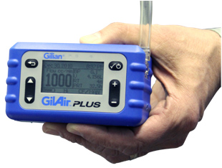
Methods of Sample Analysis
Employers must make sure that all air samples taken to meet the requirements of the Silica Standard are analyzed by a laboratory that follows the procedures given in Appendix A of the Standard.
Notes:
Appendix A of the silica standard lists laboratory procedures for measuring respirable crystalline silica contained in air samples. Employers must make sure that all air samples taken in a way that meets the requirements of the standard, and analyzed by a laboratory that follows the procedures given in Appendix A. If employers hire an approved/certified outside laboratory to perform the analyses for respirable crystalline silica, they can rely on results provided by that laboratory, which is known to follow the protocols in Appendix A.

Slide 74
Employee Notification
Employers must notify each affected employee of the results of the exposure assessment within 5 working days of completing it.
  “Affected” means all employees whose exposures were assessed, including employees whose exposures were represented by other employees’ exposure measurements, and those whose exposure assessments were based on objective data.
Employers must either notify each employee in writing or post the results in a location accessible to all affected employees
Notes:
Employers must notify each affected employee of the results of the exposure assessment within 5 working days of completing it. Affected employees are those whose exposures were assessed, as well as those employees whose exposures were represented by other employees’ exposure measurements, and those employees whose exposure assessments were based on objective data. Exposures can be characterized and reported as a range (for example, between the action level and the PEL). Exposure notification for each employee must be either in writing or posting the results in a location that all affected employees can access.

Slide 75
Employee Notification with Corrective Action
When an exposure assessment reveals exposures above the PEL, the written notification must also describe the corrective action the employer is taking to reduce employee exposures to or below the PEL.
Corrective actions include engineering controls. However, if engineering controls are not feasible or the employer needs more than 5 days to identify the right engineering controls, respiratory protection is the corrective action that would be described in the written notification.
Notes:
When an exposure assessment reveals exposures above the PEL, the written notification must also describe the corrective action the employer is taking to reduce employee exposures to or below the PEL.
Corrective actions include engineering controls. However, if engineering controls are not feasible or the employer needs more than 5 days to identify the right engineering controls, respiratory protection is the corrective action that would be described in the written notification.

Slide 76
Observation of Monitoring
The employer must let affected employees or their designated representatives observe any air monitoring of employee exposure to silica.
When needed, employer must provide protective clothing and/or equipment (i.e. respirator) at no cost to the observer, and make sure that the observer uses such clothing or equipment.
  If observation can be done from outside the hazardous areas, no protective clothing or equipment would be needed.
Notes:
The employer must let affected employees or their designated representatives observe any air monitoring of employee exposure to silica. When needed, employer must provide protective clothing and/or equipment (i.e. respirator) at no cost to the observer and make sure that the observer uses such clothing or equipment. If the observer does not need to enter an area to effectively view the monitoring, no protective clothing or equipment would be needed.

Slide 77
Methods of Compliance
The methods of compliance section of the standard requires employers to protect employees following the hierarchy of controls, which relies on
  Engineering and work practice controls for reducing exposures, and only allows for respirator use, in addition to those controls, when feasible engineering controls cannot reduce employee exposures to levels below PEL
  Even when employers demonstrate the infeasibility of engineering and workplace controls, they must still use feasible controls to reduce exposures to the lowest possible level, and then use respiratory protection along with those controls.
Notes:
Employers must use engineering and work practice controls to reduce and keep employee exposure to respirable crystalline silica to or below the PEL. If feasible engineering and work practice controls are not effective in reducing employee exposures to or below the PEL, employers must still use feasible controls to reduce exposures to the lowest possible level and then use respiratory protection along with those controls.

Slide 78
Methods of Compliance – cont.
Employers who follow either of the exposure control methods (Table 1 or alternative) must provide respiratory protection.
Respiratory protection is necessary under the following conditions
  Where exposures exceed the PEL during periods necessary to implement feasible engineering and work practice controls
  Where exposures exceed the PEL during tasks, such as some maintenance and repair tasks, for which engineering and work practice controls are not feasible
Notes:
Employers who follow either of the exposure control methods (Table 1 or alternative) must provide respiratory protection.
Respiratory protection is necessary under the following conditions
Where exposures exceed the PEL during periods necessary to implement feasible engineering and work practice controls; and/or
Where exposures exceed the PEL during tasks, such as some maintenance and repair tasks, for which engineering and work practice controls are not feasible.

Slide 79
Abrasive Blasting
The Methods of Compliance section also cross-references other OSHA standards that apply to abrasive blasting.
In addition to complying with requirements to use engineering controls and work practices according to the hierarchy of controls, construction employers that conduct abrasive blasting operations using silica-containing blasting agents or conduct abrasive blasting on structures that contain silica must also comply with other relevant standards, such as the ventilation standard for construction (29 CFR 1926.57), which contains requirements for ventilation and personal protective equipment, including respirators.
Notes:
In addition to complying with requirements to use engineering controls and work practices according to the hierarchy of controls, construction employers that conduct abrasive blasting operations using silica-containing blasting agents or conduct abrasive blasting on structures that contain silica must also comply with other relevant standards, such as the ventilation standard for construction (29 CFR 1926.57). This standard is simply a cross- reference that construction employers must comply with when conducting abrasive blasting, and it contains requirements for ventilation and personal protective equipment, including respirators.

Slide 80
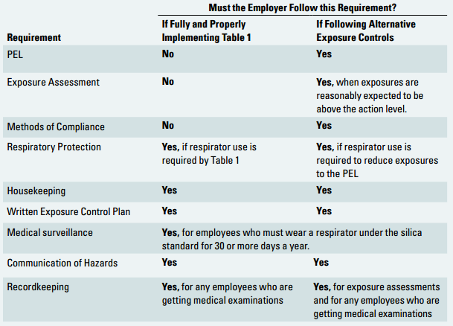
COMPLIANCE WITH THE STANDARD - A SUMMARY
Source: OSHA Small Entity Compliance Guide for the Construction Silica Standard
Notes:
Prior to meeting the requirements of the Respirable Crystalline Silica Standard, employers must determine whether the silica standard applies to their jobsites. If the employees can be exposed to respirable crystalline silica at or above 25 µg/m3 as an 8-hour TWA under any foreseeable conditions, while performing construction activities, then s/he has a choice for complying with the standard by using either the specified exposure control methods (Table 1) or the alternative exposure control methods.
The roadmap presented in the above slide displays the requirements that the employer must meet under the standard, based on the compliance method they follow.

Slide 81
Additional Resources
Additional resources for trainees:
    OSHA Silica Website <https://www.osha.gov/silica/>
    OSHA silica exposure brochure <https://www.osha.gov/dte/library/silicosis/si_gi.pdf>
    OSHA Safety and Health Topics Page
    <https://www.osha.gov/dsg/topics/silicacrystalline/index.html>
    OSHA Small Business Compliance Guide
    <https://www.osha.gov/Publications/OSHA3902.pdf>
    CPWR Silica Website <https://www.silica-safe.org>
Notes:
Further information can be gathered from the sources and documentations presented above.

Slide 82
ANY QUESTIONS?

Slide 83
POSTTEST
PLEASE START THE POSTTEST
(15 MIN)
SILICA TRAINING
Notes:
Trainer distributes the handout “Posttest” to the trainees.

Slide 84
Q/A SESSION
INTERACTIVE
POSTTEST Q/A
(PLEASE GRADE YOUR
PRETEST AND POSTTEST)
SILICA TRAINING
Notes:
Trainer asks trainees to grade pretest and the posttest while giving the correct answer to each question. If trainees have any questions or request further clarification on any question, trainer answers and explains these questions.

Slide 85
OPINION SURVEY
PLEASE FILLOUT THE OPINION SURVEY
AND
HAND IN THE TRAINING PACKAGE TO THE TRAINING COORDINATOR
SILICA TRAINING
Notes:
Trainer distributes the handout “Opinion Survey” to the trainees. Once a trainee finishes the opinion survey, all of the handouts are collected from trainees (sign-up, pre-test, post-test and the opinion survey).

Slide 86
THANK YOU!

