Slide 1
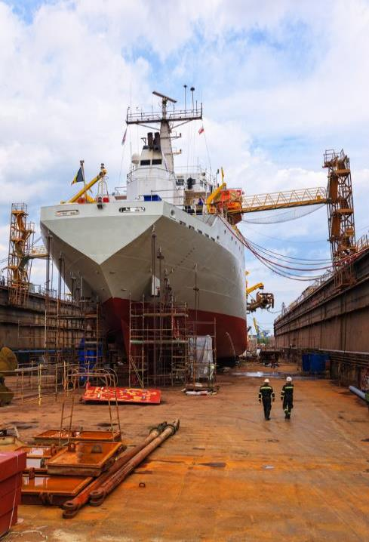

Most Frequently Cited Serious Violations
Maritime Industry FY2023
OSHA Federal Standards
October 1, 2022 – September 30, 2023

Slide 2
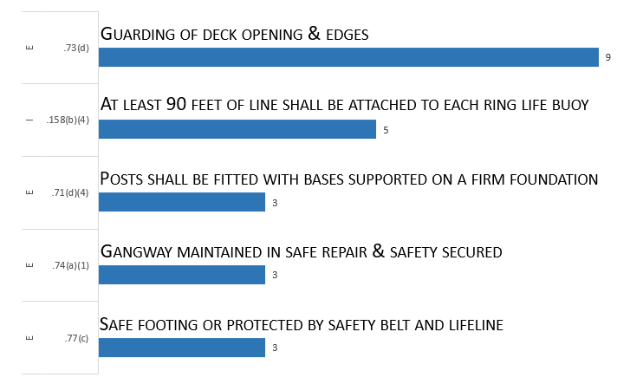
Most Frequently Cited Serious Violations in
Shipyard Employment FY 2023
29 CFR 1915

Slide 3
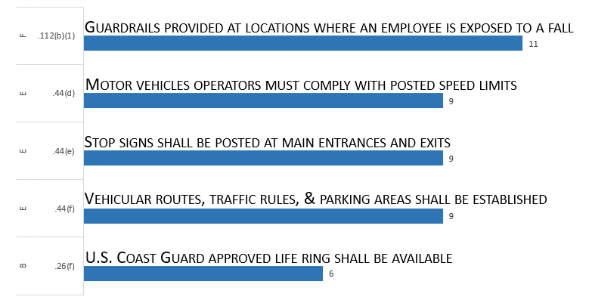
Most Frequently Cited Serious Violations in
Marine Terminals FY 2023
29 CFR 1917

Slide 4
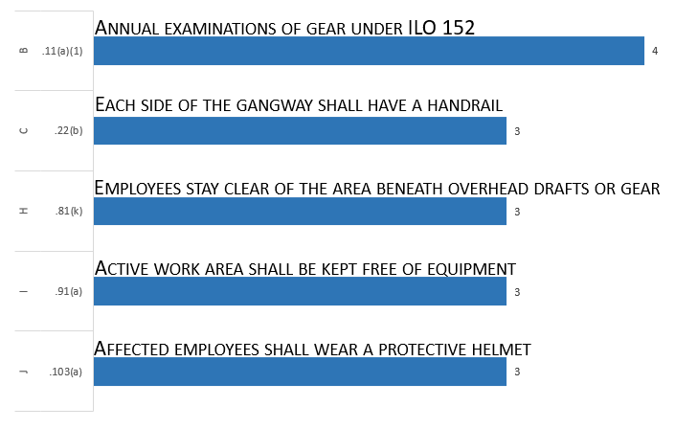
Most Frequently Cited Serious Violations in
Longshoring FY 2023
29 CFR 1918

