Slide 1

The OSHA Alliance Program

Slide 2
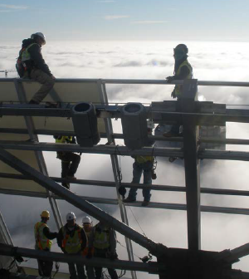
OSHA is committed to a balanced approach to meet its worker safety and health mission
Standards
Enforcement
Compliance Assistance and Training

Slide 3





OSHA works with employer and worker groups through its Cooperative Programs
Alliance Program
OSHA Strategic Partnership Program
Voluntary Protection Programs (VPP)
OSHA Challenge
On-Site Consultation Program & Safety and Health Achievement Recognition Program (SHARP)

Slide 4

Alliances foster collaborative relationships
Between:
OSHA National, Regional, or Area Offices, and
Employer and worker groups (trade or professional associations, unions, consulates, community and faith-based groups, and government agencies)
To:
Build trust
Encourage information sharing
Promote education

Slide 5
Alliances are formalized through an agreement
Initial agreements: two years
Renewals: up to five years
Follow standard template with the following overall goals:
  Raising awareness: outreach and communication
  Training and education
No enforcement exemptions for participants

Slide 6
Successful Alliances may be promoted to Ambassador
Eligibility after successful completion of an initial agreement and one renewal
Continued collaboration with OSHA through established relationship
“Evergreen” with no expiration date
Fewer reporting requirements

Slide 7
Alliances agree to several “fundamental requirements”
Committing time and resources to accomplish Alliance goals
Disseminating information to stakeholders on OSHA’s initiatives and resources
Engaging with and encouraging member participation in OSHA outreach campaigns
Bringing together employer, worker, and agency perspective in Alliance activities

Slide 8
Number of Active Alliances

Slide 9
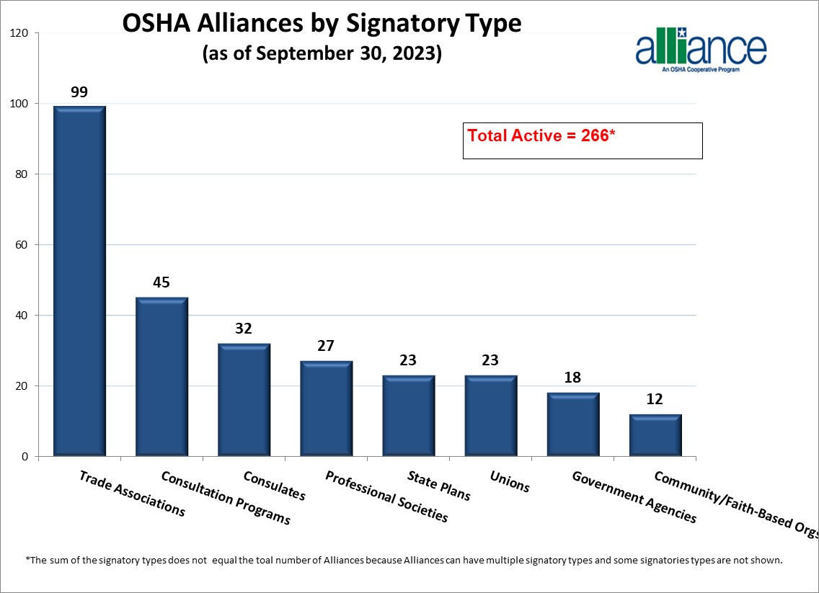
A variety of organizations sign Alliances with OSHA

Slide 10
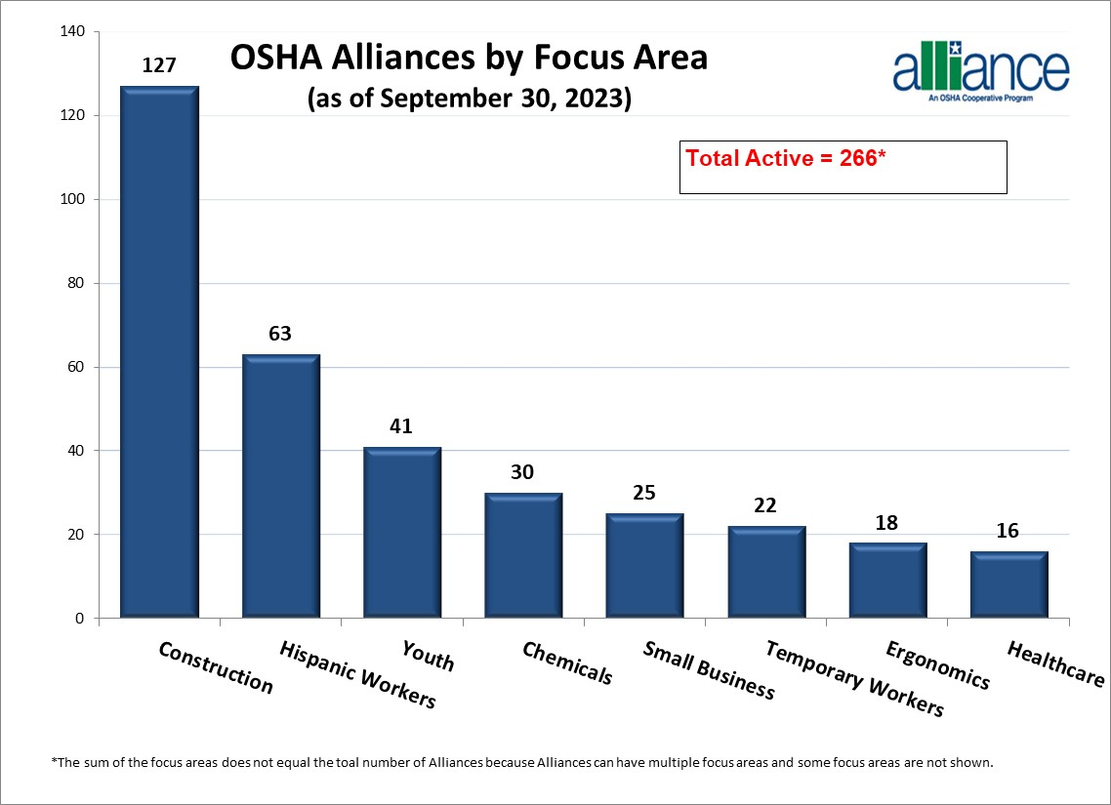
Alliance cover many priority areas for OSHA

Slide 11
In 2022, National Alliances helped OSHA reach millions of employers and workers
Conducted >1,000 dissemination activities, reaching >5 million people
Provided billboard space to support OSHA’s outreach initiatives
Conducted >200 events or training activities reaching >90,000 people
Provided 3 technical training sessions for 250 representatives from federal OSHA, state OSHA agencies, and On-Site Consultation Programs.

Slide 12
In 2022, Regional and Area Office Alliances helped train employers and workers
Examples:
The Sioux Falls Area office worked with alliance partner, South Dakota One-Call (811), to deliver multiple outreach events across the state focusing using on trench and excavation safety.
The Boston, MA and Providence, RI Area Offices conducted workplace safety training for seafood processing workers through their alliance with Centro Comunitario de Trabajadores (CCT), in New Bedford, Connecticut.
Regional and Area Offices conducted >1000 outreach and training activities
Attended by ~200,000 people, likely impacting many more

Slide 13

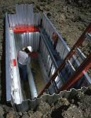


Alliances promote member engagement in OSHA’s national initiatives
Safe + Sound
Heat Illness Prevention
Fall Prevention
Trenching and Excavation
Temporary Workers

Slide 14
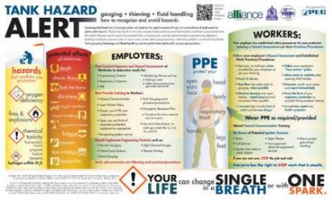
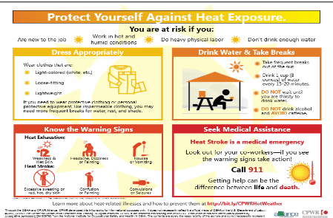
Alliances develop innovative and industry-specific resources
Hazard alert developed through the OSHA/National STEPS Network/NIOSH Alliance
Infographic developed through the OSHA/CPWR Alliance

Slide 15
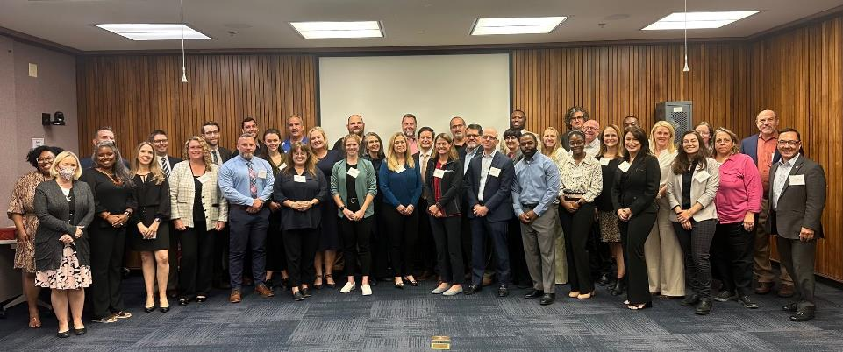
Alliances network with one another and cross-collaborate
The Alliance Program Forum: National Alliances hear OSHA updates and network
Alliance Program Construction Roundtable: National construction-related Alliances collaborate

Slide 16
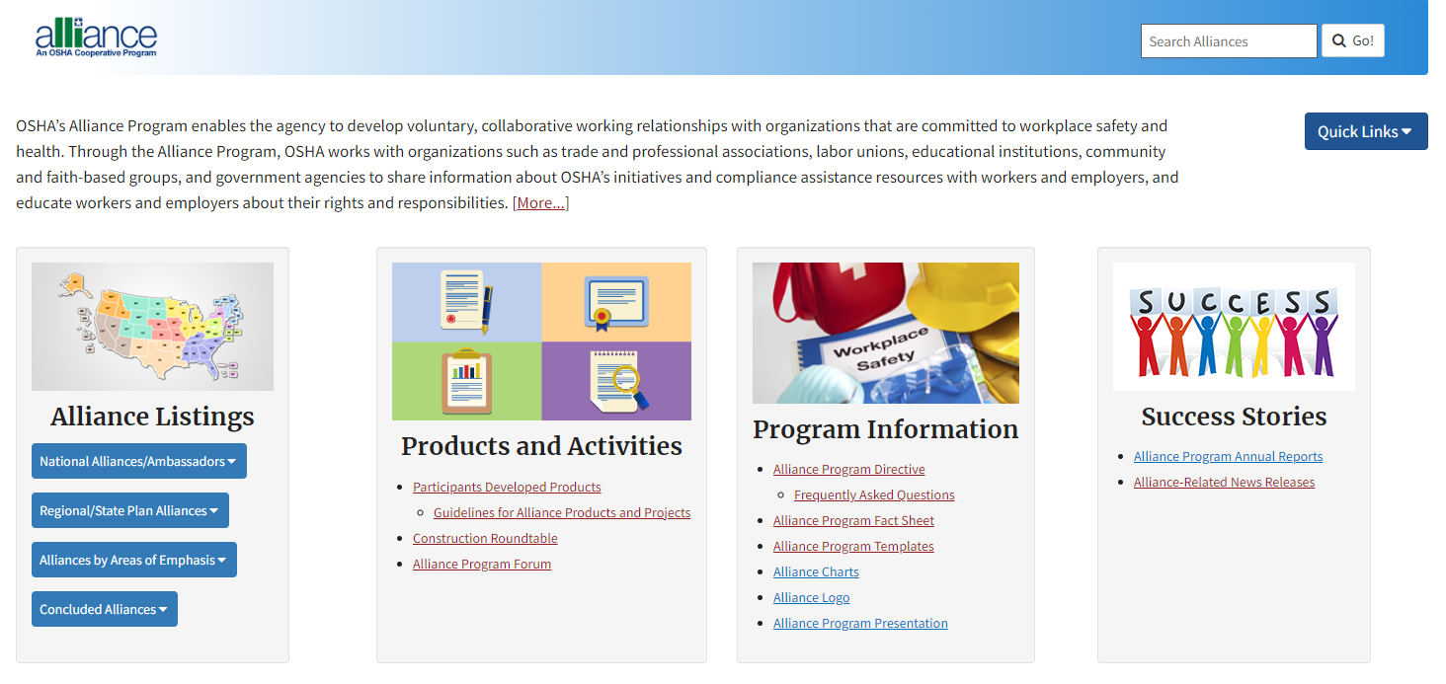
Find out more at osha.gov/alliances

Slide 17
Contact Us
National Alliances
  Contact OSHA’s Office of Outreach Services and Alliances at (202) 693-2340.
Regional and Area Office Alliances
  Contact your local OSHA Regional or Area Office. See osha.gov/contactus/bystate

Slide 18

OSHA
osha.gov
800-321-OSHA (6742)

